Slide 1
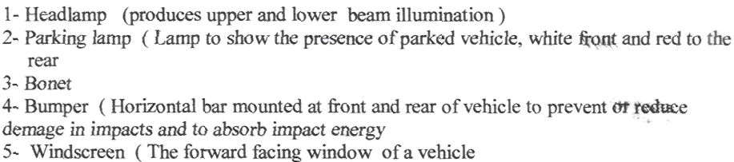
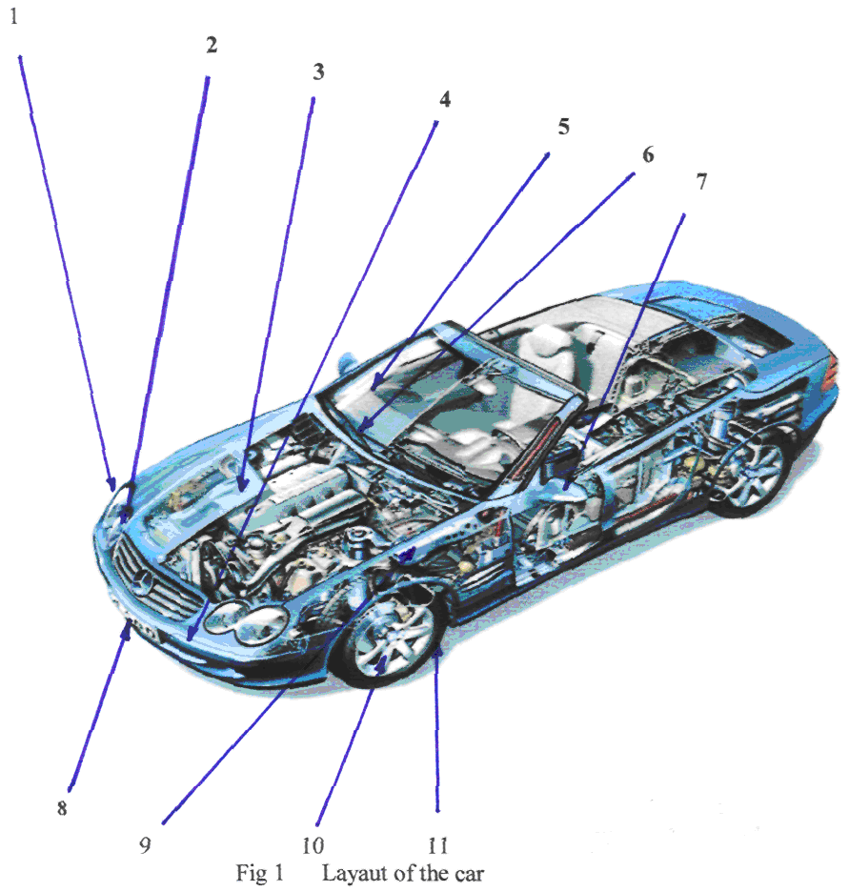
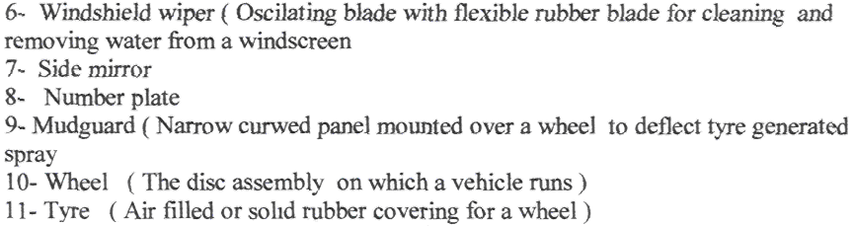

Slide 2
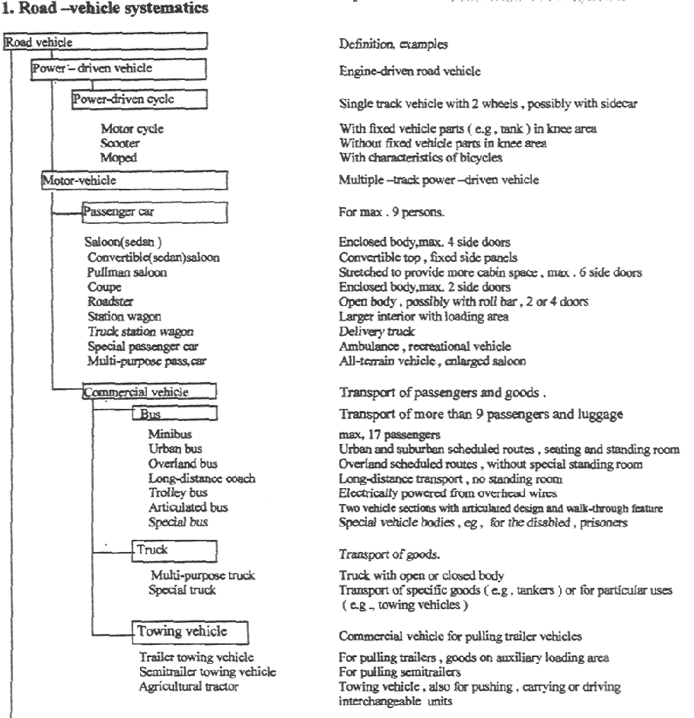

Slide 3
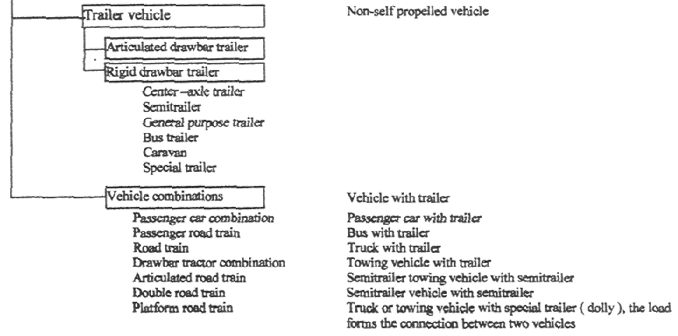

Slide 4
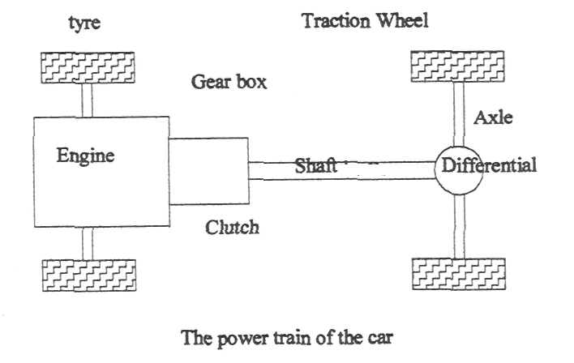

Slide 5
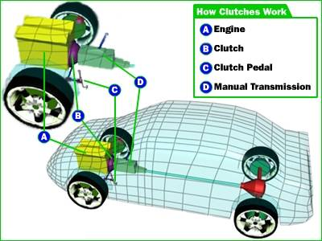

Slide 6
Why Do We Need Clutches? Clutches are useful in devices with two rotating shafts. In these devices, one of the shafts is typically driven by a motor or pulley, and the other shaft is driving another device. In a drill, for instance, one shaft is driven by a motor and the other is driving a drill chuck. The clutch connects the two shafts so that they can either be locked together and spin at the same speed, or be decoupled and spin at different speeds. In a car, you need a clutch because the engineIn a car, you need a clutch because the engine spins all the time and the car wheels don't. In order for a car to stop without killing the engine, the wheels need to be disconnected from the engine somehow. The clutch allows us to smoothly engage a spinning engine to a non-spinning transmission by controlling the slippage between them. To understand how a clutch works, it helps to know a little bit about friction.

Slide 8




Slide 9
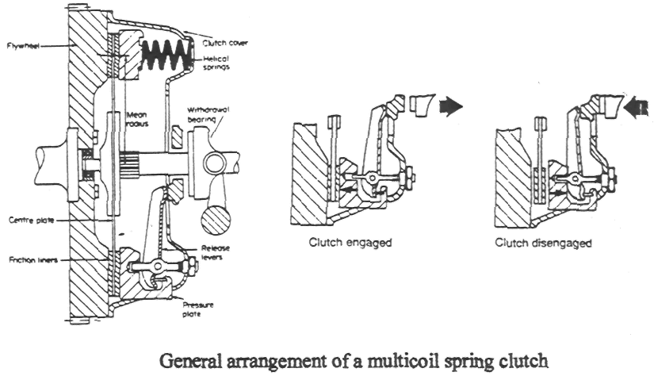

Slide 10
The purpose of clutch is to engage and disengage the transmission system from the engine when a vehicle is being driven away from a standstill and when the gearbox gear change is necessary. The gradual increase in the transfer of engine torque to the transmissions roust be smooth.
When the clutch is in the coupling (normal running) position, power flows through it from the engine to the transmission. If the transmission is in gear, then power flows on through to the propelling wheels of the vehicle.
Essentially, the clutch has the job of permitting the driver to uncouple the engine temporarily so that the gears can be shifted from one to another forward, into reverse or into neutral gear position. It is necessary to interrupt the flow of power before gears are shifted. Other wise, gear shifting would be extremely difficult if not impossible.
The clutch contains a friction disc, spring arrangement and pressure plate for pressing this disc tightly against the smooth rear face of the flywheel. The friction disc is splinted to the clutch shaft (transmissions input shaft). The splines consist of two sets of teeth, an internal set on the hub of the friction disk and the matching external set on the chitch shaft. They permit the friction disk to slide back and forth along the shaft but force the disk and shaft to rotate together.

Slide 11
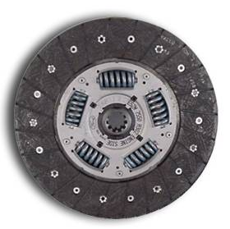
Clutch plate

Slide 12
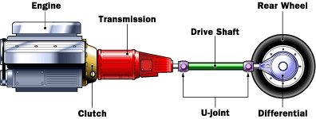
How Transmissions Work
The transmission is connected to the engine through the clutch. The input shaft of the transmission therefore turns at the same rpm as the engine.

Slide 13
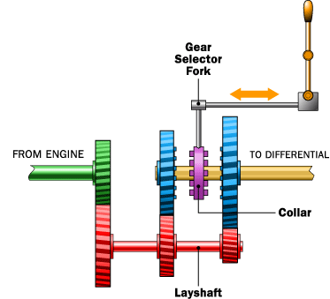
A Very Simple Transmission
To understand the basic idea behind a standard transmission, the diagram below shows a very simple two-speed transmission in neutral:

Slide 14
Let's look at each of the parts in this diagram to understand how they fit together:
The green shaft comes from the engine through the clutch. The green shaft and green gear are connected as a single unit. (The clutch is a device that lets you connect and disconnect the engine and the transmission. When you push in the clutch pedal, the engine and the transmission are disconnected so the engine can run even if the car is standing still. When you release the clutch pedal, the engine and the green shaft are directly connected to one another. The green shaft and gear turn at the same rpm as the engine.)
The red shaft and gears are called the layshaft. These are also connected as a single piece, so all of the gearsThe red shaft and gears are called the layshaft. These are also connected as a single piece, so all of the gears on the layshaft and the layshaft itself spin as one unit. The green shaft and the red shaft are directly connected through their meshed gears so that if the green shaft is spinning, so is the red shaft. In this way, the layshaft receives its power directly from the engine whenever the clutch is engaged.
The yellow shaft is a splined shaft that connects directly to the drive shaft through the differential to the drive wheels of the car. If the wheels are spinning, the yellow shaft is spinning.
The blue gears ride on bearings, so they spin on the yellow shaft. If the engine is off but the car is coasting, the yellow shaft can turn inside the blue gears while the blue gears and the layshaft are motionless.
The purpose of the collar is to connect one of the two blue gears to the yellow drive shaft. The collar is connected, through the splines, directly to the yellow shaft and spins with the yellow shaft. However, the collar can slide left or right along the yellow shaft to engage either of the blue gears. Teeth on the collar, called dog teeth, fit into holes on the sides of the blue gears to engage them.

Slide 15
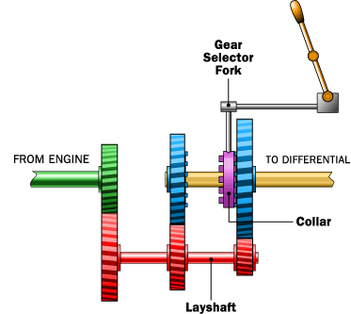
First Gear
The picture below shows how, when shifted into first gear, the collar engages the blue gear on the right:
The green shaft from the engine turns the layshaft, which turns the blue gear on the right. This gear transmits its energy through the collar to drive the yellow drive shaft. Meanwhile, the blue gear on the left is turning, but it is freewheeling on its bearing so it has no effect on the yellow shaft.
When the collar is between the two gears (as shown in the first figure), the transmission is in neutral. Both of the blue gears freewheel on the yellow shaft at the different rates controlled by their ratios to the layshaft.

Slide 16
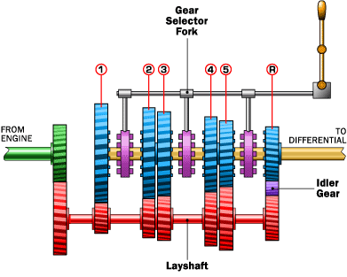
The five-speed manual transmission is fairly standard on cars today. Internally, it looks something like this:

Slide 17
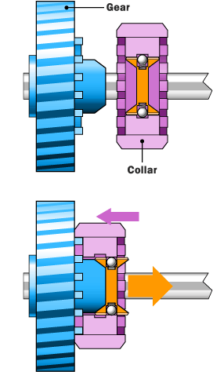
Synchronizers
Manual transmissions in modern passenger cars use synchronizers to eliminate the need for double-clutching. A synchro's purpose is to allow the collar and the gear to make frictional contact before the dog teeth make contact. This lets the collar and the gear synchronize their speeds before the teeth need to engage, like this:
The cone on the blue gear fits into the cone-shaped area in the collar, and friction between the cone and the collar synchronize the collar and the gear. The outer portion of the collar then slides so that the dog teeth can engage the gear.
Every manufacturer implements transmissions and synchros in different ways, but this is the general idea.

Slide 18
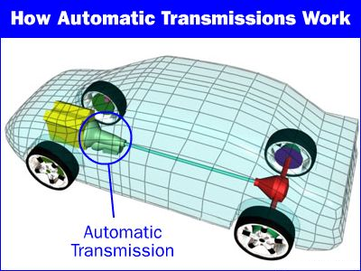
How Automatic Transmissions Work
If you have ever driven a car with an automatic transmission, then you know that there are two big differences between an automatic transmission and a manual transmission:
There is no clutch pedal in an automatic transmission car.
There is no gear shift in an automatic transmission car. Once you put the transmission into drive, everything else is automatic.
Both the automatic transmission (plus its torque converterBoth the automatic transmission (plus its torque converter) and a manual transmissionBoth the automatic transmission (plus its torque converter) and a manual transmission (with its clutch) accomplish exactly the same thing, but they do it in totally different ways. It turns out that the way an automatic transmission does it is absolutely amazing!

Slide 19



Slide 20
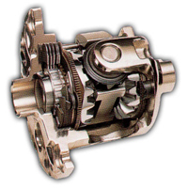

How Differentials Work
The differential has three jobs:
-To aim the engine power at the wheels
-To act as the final gear reduction in the vehicle, slowing the rotational speed of the transmission one final time before it hits the wheels
-To transmit the power to the wheels while allowing them to rotate at different speeds (This is the one that earned the differential its name.)
What is a Differential?
The differential is a device that splits the engine torque two ways, allowing each output to spin at a different speed.

Slide 21
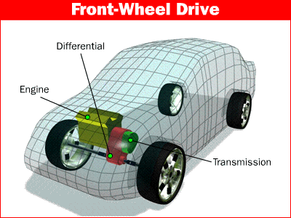
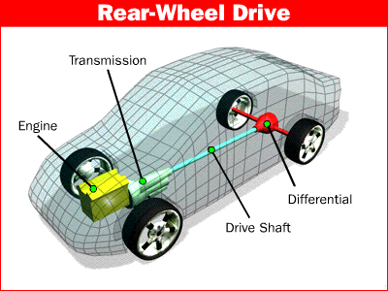
The differential is found on all modern cars and trucks, and also in many all-wheel-drive (full-time four-wheel-drive) vehicles. These all-wheel-drive vehicles need a differential between each set of drive wheels, and they need one between the front and the back wheels as well, because the front wheels travel a different distance through a turn than the rear wheels.

Slide 22
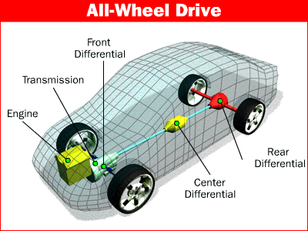
Part-time four-wheel-drive systems don't have a differential between the front and rear wheels; instead, they are locked together so that the front and rear wheels have to turn at the same average speed. This is why these vehicles are hard to turn on concrete when the four-wheel-drive system is engaged.

Slide 23

Brake Basics
When you depress your brake pedal, your car transmits the force from your foot to its brakes through a fluid. Since the actual brakes require a much greater force than you could apply with your leg, your car must also multiply the force of your foot. It does this in two ways:
Mechanical advantage (leverage)
Hydraulic force multiplication
The brakes transmit the force to the tires using friction, and the tires transmit that force to the road using friction also. Before we begin our discussion on the components of the brake system, let's cover these three principles:
Leverage
Hydraulics
Friction

Slide 24

Hydraulic Systems
The basic idea behind any hydraulic system is very simple: Force applied at one point is transmitted to another point using an incompressible fluid, almost always an oil of some sort. Most brake systems also multiply the force in the process. Here you can see the simplest possible hydraulic system:
In the figure above, two pistons (shown in red) are fit into two glass cylinders filled with oil (shown in light blue) and connected to one another with an oil-filled pipe. If you apply a downward force to one piston (the left one, in this drawing), then the force is transmitted to the second piston through the oil in the pipe. Since oil is incompressible, the efficiency is very good -- almost all of the applied force appears at the second piston. The great thing about hydraulic systems is that the pipe connecting the two cylinders can be any length and shape, allowing it to snake through all sorts of things separating the two pistons.

Slide 25
Force and Friction
The amount of force the clutch can hold depends on the friction between the clutch plate and the flywheel, and how much force the spring puts on the pressure plate. The friction force in the clutch works just like the blocks in the friction the clutch can hold depends on the friction between the clutch plate and the flywheel, and how much force the spring puts on the pressure plate. The friction force in the clutch works just like the blocks in the friction section of How Brakes Work, except that the spring presses on the clutch plate instead of weight pressing the block into the ground.
How a clutch engages and releases
When the clutch pedal is pressed, a cable or hydraulic piston pushes on the release fork, which presses the throw-out bearing against the middle of the diaphragm spring. As the middle of the diaphragm spring is pushed in, a series of pins near the outside of the spring causes the spring to pull the pressure plate away from the clutch disc (see below). This releases the clutch from the spinning engine.

Slide 26

A Simple Brake System
Before we get into all the parts of an actual car brake system, let's look at a simplified system:
You can see that the distance from the pedal to the pivot is four times the distance from the cylinder to the pivot, so the force at the pedal will be increased by a factor of four before it is transmitted to the cylinder.
You can also see that the diameter of the brake cylinder is three times the diameter of the pedal cylinder. This further multiplies the force by nine. All together, this system increases the force of your foot by a factor of 36. If you put 10 pounds of force on the pedal, 360 pounds (162 kg) will be generated at the wheel squeezing the brake pads.

Slide 27



