Slide 1
Lecture on
Temperature Measurement

Slide 2
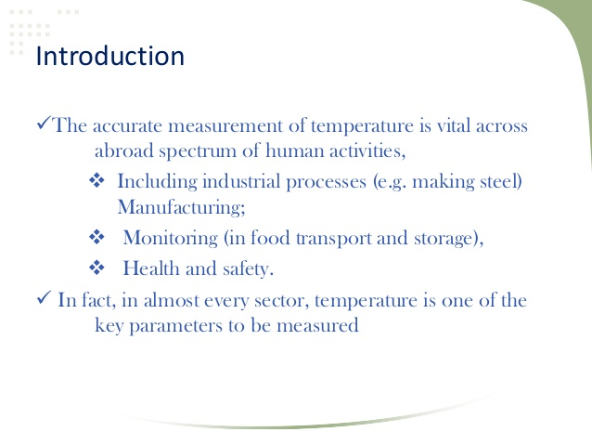

Slide 3
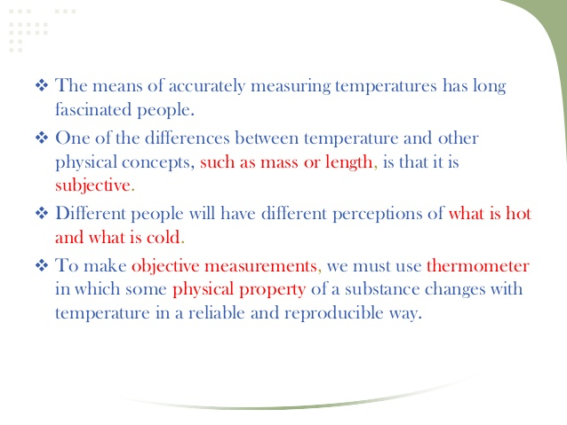

Slide 4
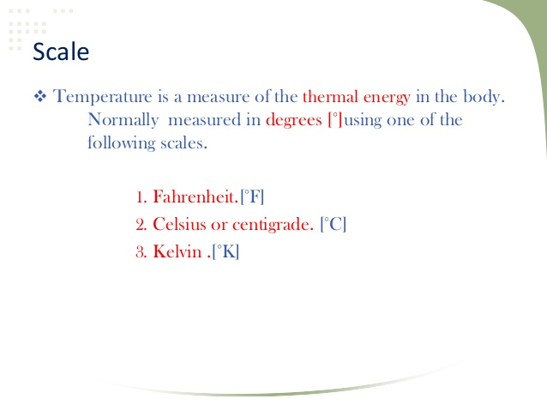

Slide 5
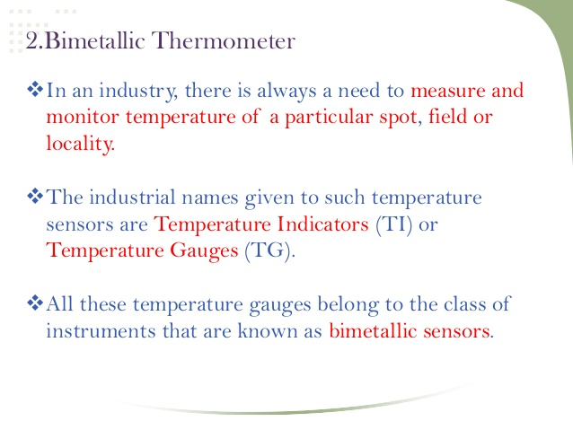

Slide 6
Bimetallic Thermometer
Two basic principles of operation is to be followed in the case of a bimetallic sensor.
1) A metal tends to undergo a volumetric dimensional change (expansion/contraction), according to the change in temperature.
2) Different metals have different co-efficient of temperatures. The rate of volumetric change depends on this co-efficient of temperature.

Slide 7
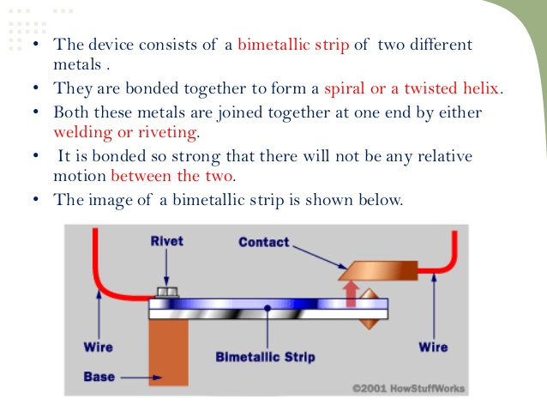

Slide 8
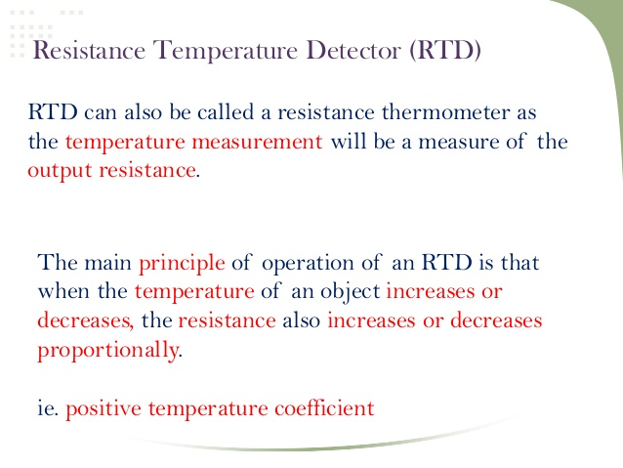

Slide 9
Resistance Thermometers
It is well known that resistance of metallic conductors increases with temperature, while that of semiconductors generally decreases with temperature. Resistance thermometers employing metallic conductors for temperature measurement are called Resistance Temperature Detector (RTD), and those employing semiconductors are termed as Thermistors. RTDs are more rugged and have more or less linear characteristics over a wide temperature range. On the other hand Thermistors have high temperature sensitivity, but nonlinear characteristics.

Slide 10
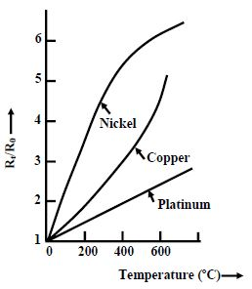

Slide 11
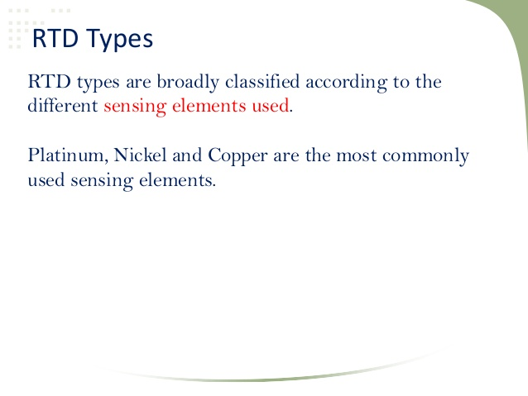

Slide 12
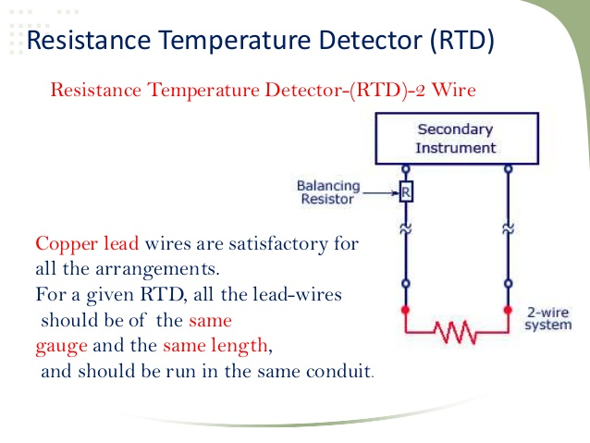

Slide 13
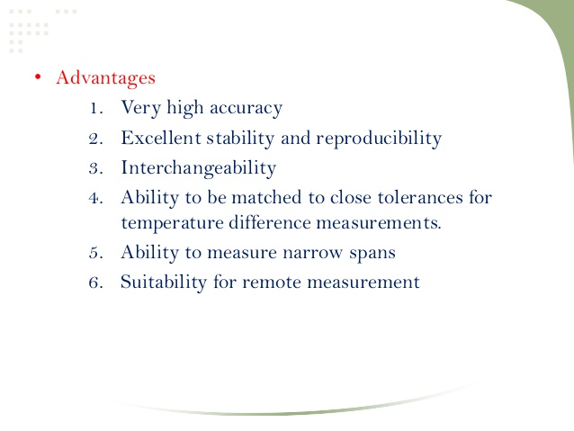

Slide 14
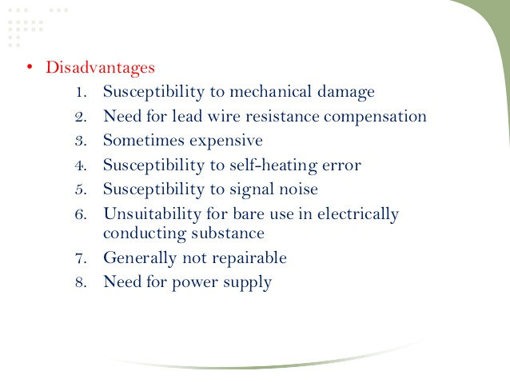

Slide 15
Thermistor
Thermistors are semiconductor type resistance thermometers. They have very high sensitivity but highly nonlinear characteristics. This can be understood from the fact that for a typical 2000 Ω the resistance change at 25 degree Celsius is 80 Ω per degree Celsius, whereas for a 2000 Ω platinum RTD the change in resistance at 25 degree Celsius is 7Ω per degree Celsius. Thermistors can be of two types: (a) Negative temperature coefficient (NTC) thermistors and (b) Positive temperature co-efficient (PTC) thermistors. Their resistance-temperature characteristics are shown in fig. . The NTC thermistors, whose characteristics are shown in fig. is more common.

Slide 16
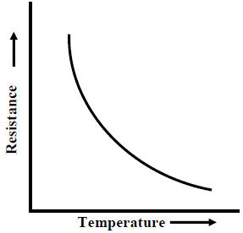
NTC characteristics of thermistor

Slide 17
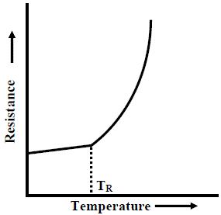
PTC characteristics of thermistor

Slide 18
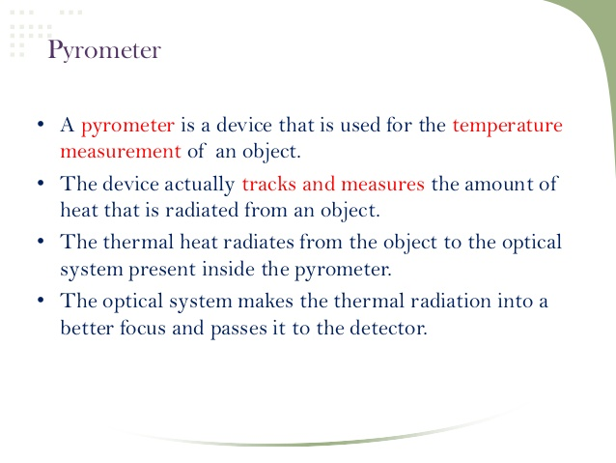

Slide 19
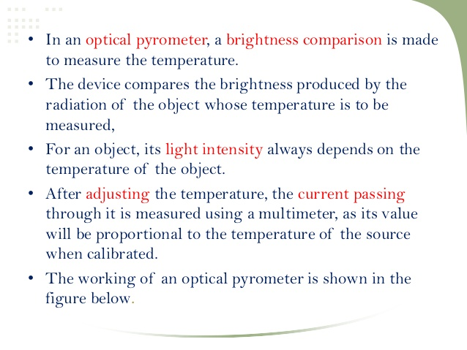

Slide 20
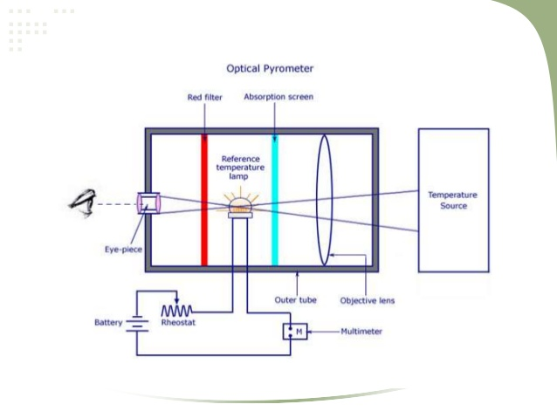

Slide 21
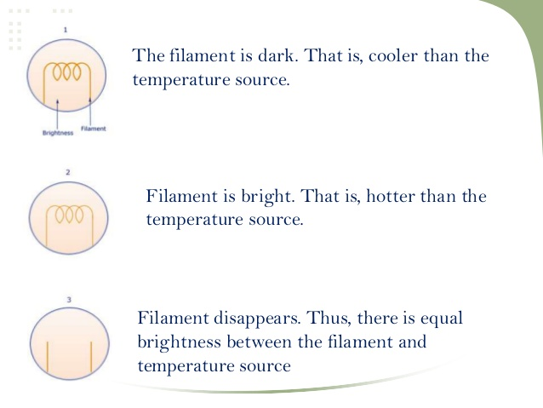

Slide 22
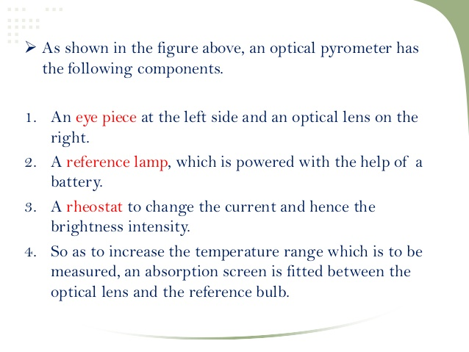

Slide 23
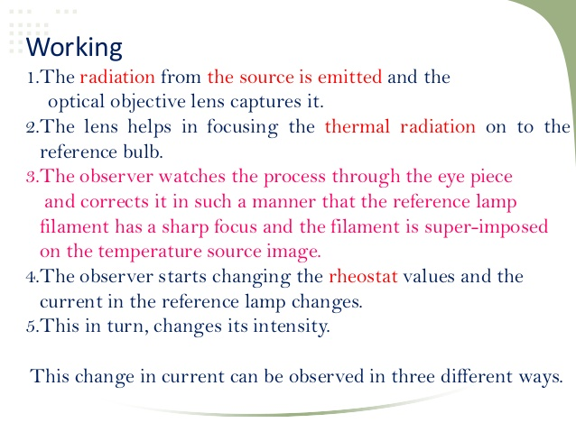

Slide 24
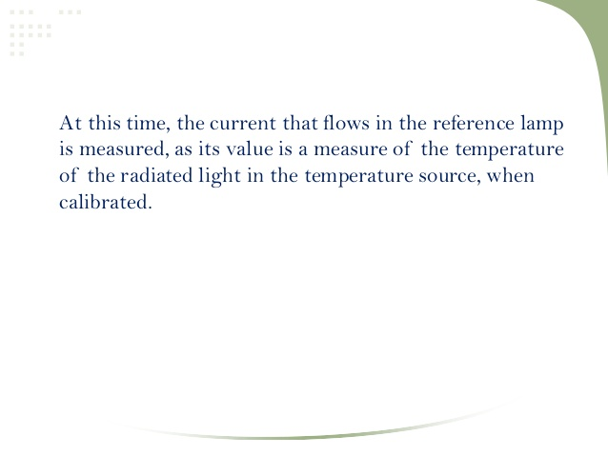

Slide 25
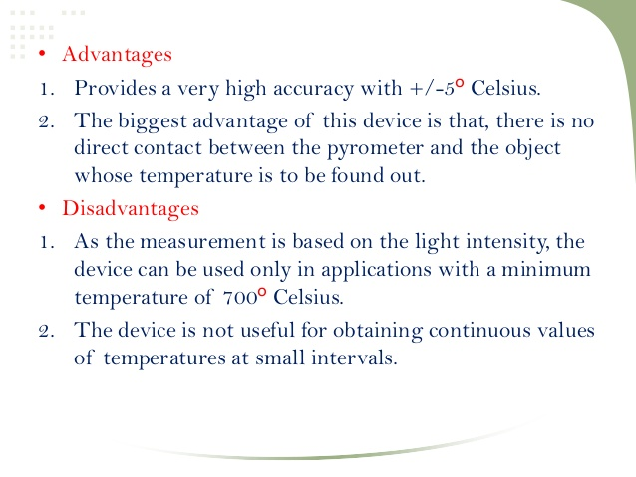

Slide 26
Thanks
Notes:
Thanks

