Slide 1
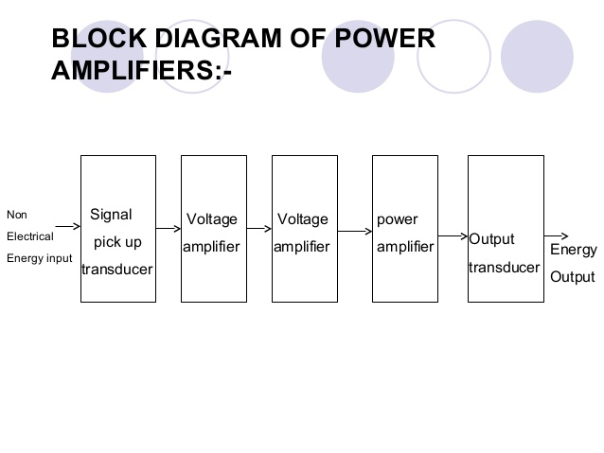

Slide 2
Difference Between Voltage Amplifier and Power Amplifier
A voltage amplifier is designed to achieve maximum voltage amplification. However, it is not important to raise the power level.
On the other hand, a power amplifier is designed to obtain maximum output power.
Voltage Amplifiers
The voltage gain of an amplifier is given by :
In order to achieve high voltage amplification, the following points should be noted :
The transistor with high β, more than 100 is used in the circuit. In other words transistors with thin base are used in this case.
The input resistance of the transistor should be low as compared to the collector load resistance.
A relatively high load resistance is used in the collector. To permit this condition, voltage amplifiers are always operated with at low collector currents nearly 1 mA.
Power Amplifiers
A power amplifier is needed to deliver a large amount of power and hence it has to handle a large amount of current. In order to achieve high power amplification, the following points should be noted :
The size of the power transistor is made considerably larger in order to dissipate the heat generated in the transistor during operation.
The base is made thicker to handle large current. In other words transistors with smaller β (normally between 5 to 20) are used in this case.
Transformer coupling is used for impedance matching.

Slide 3
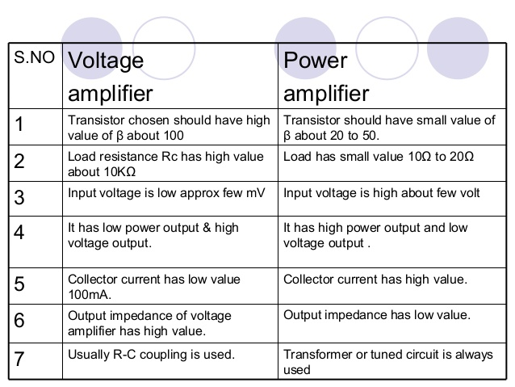

Slide 4
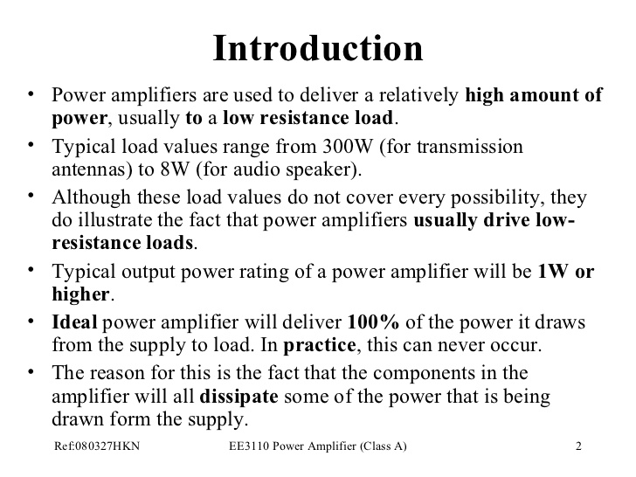

Slide 5
Important terms about power amplifier
1. Collector Efficiency - The ration of A.C. output at zero signal power to average D.C. power input to transistor .
collector efficiency = average a.c. power output
average d.c. power input
2. Distortion - When the output of an amplifier is not similar to the input signal we say distortion is there. This is due to non-linear characteristic of transistor .
Types of distortion - a. Harmonic Distortion
b. Phase distortion
c. Frequency distortion
3. Power dissipation capacity Is defined as the ability of a transistor to dissipate the heat developed in it.

Slide 6
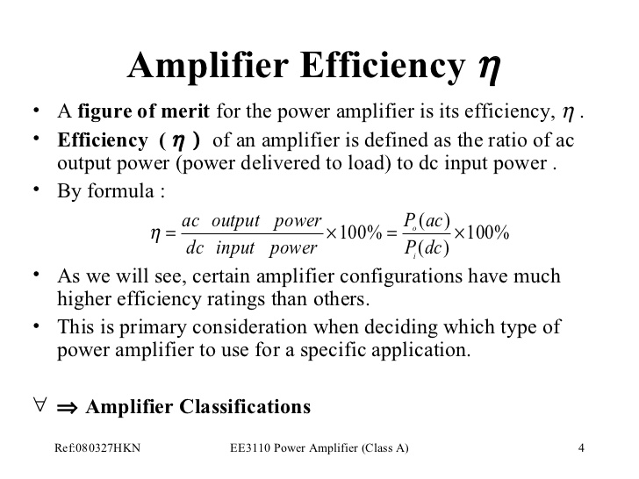

Slide 7
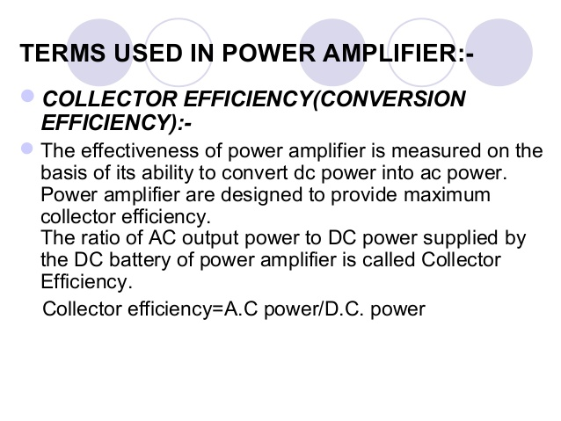

Slide 8
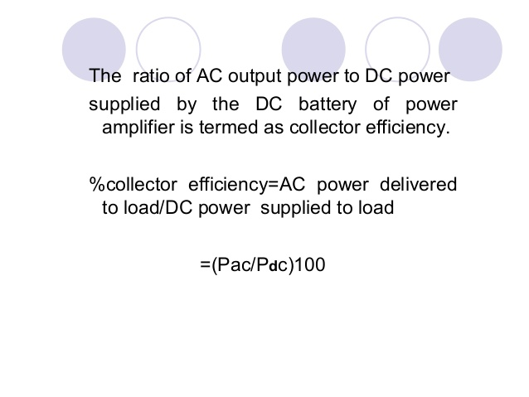

Slide 9
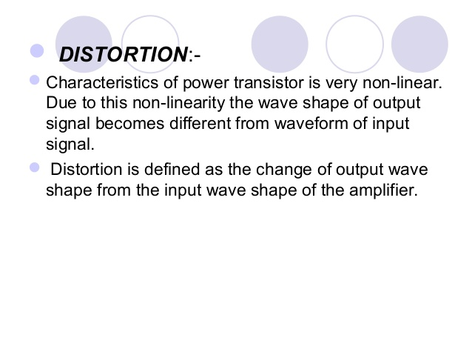

Slide 10
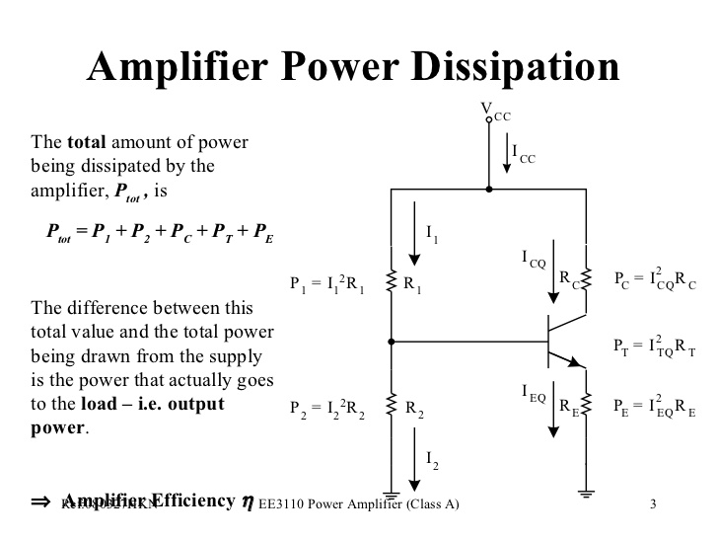

Slide 11
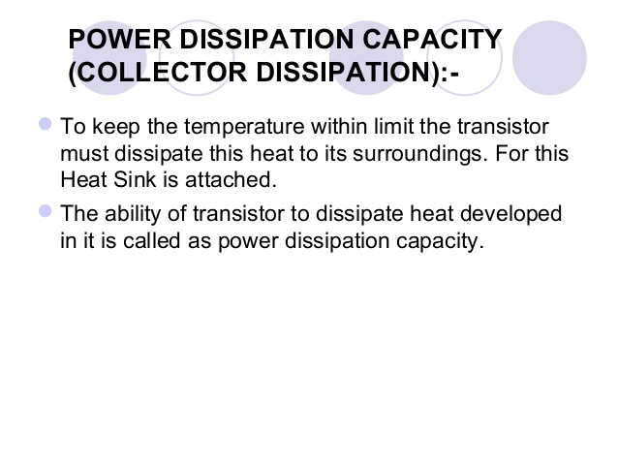

Slide 12
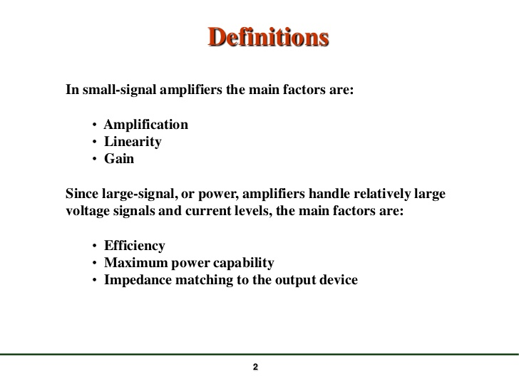

Slide 13
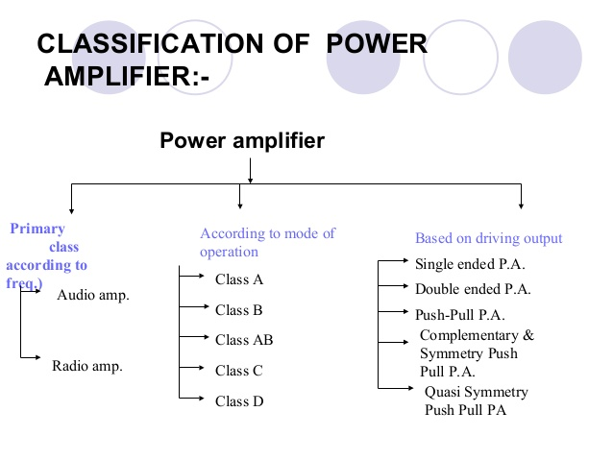

Slide 14
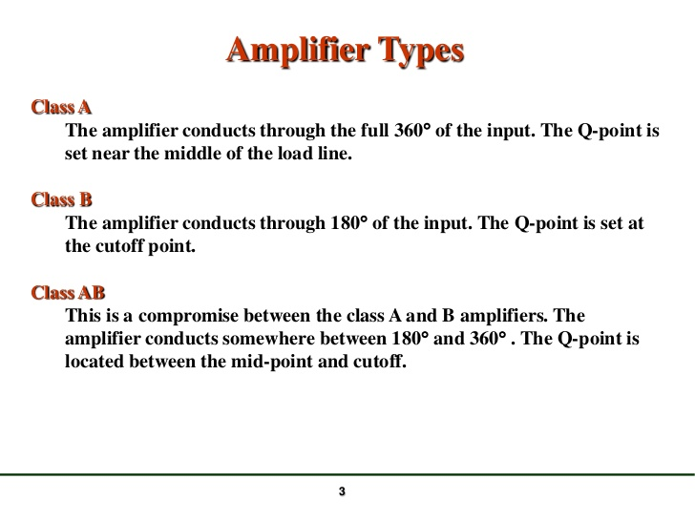

Slide 15
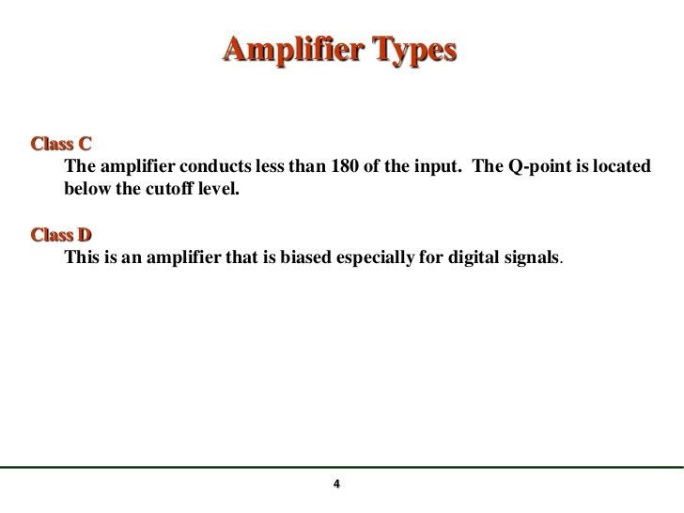

Slide 16
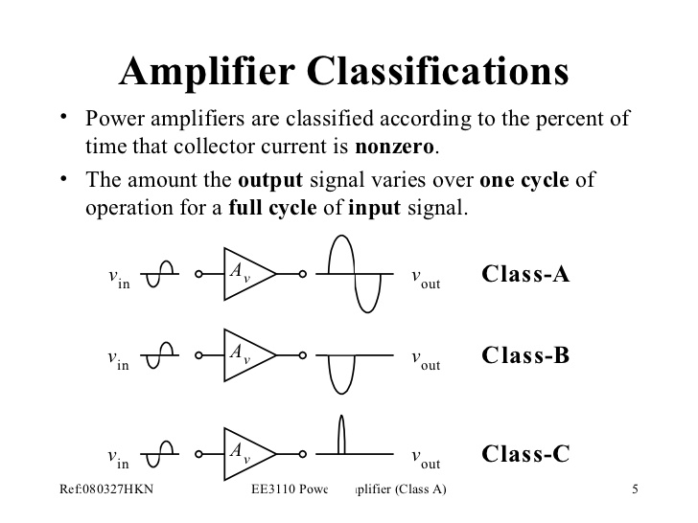

Slide 17
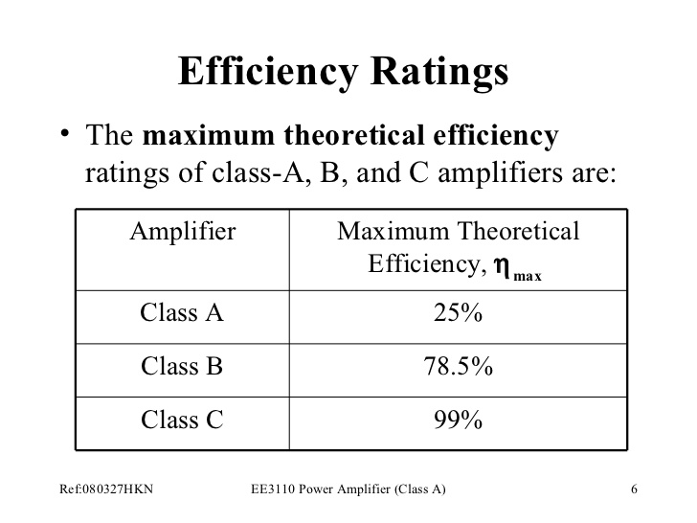

Slide 18
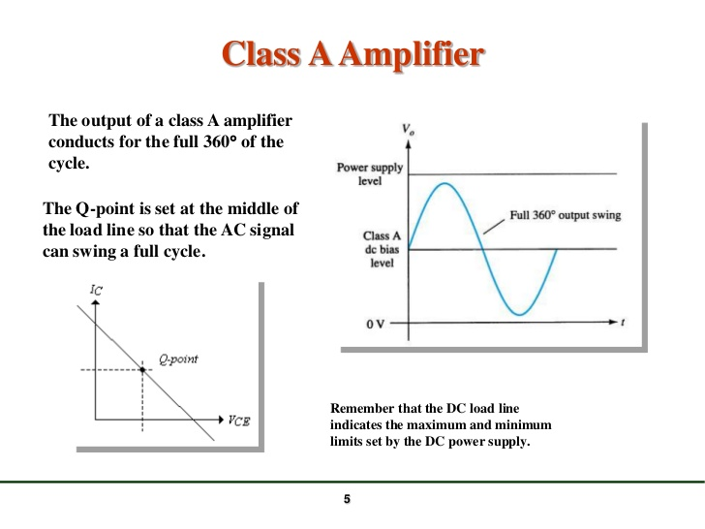

Slide 19
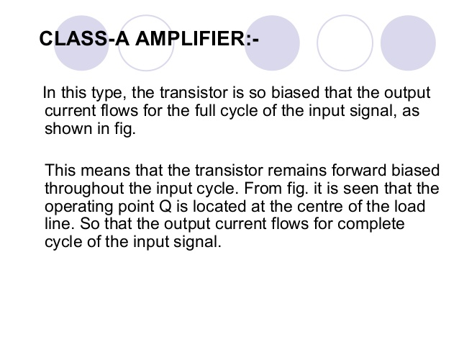

Slide 20
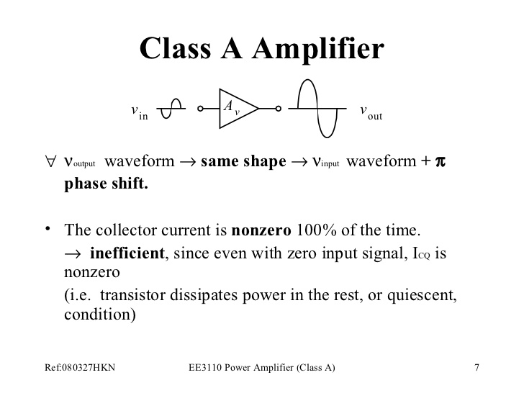

Slide 21
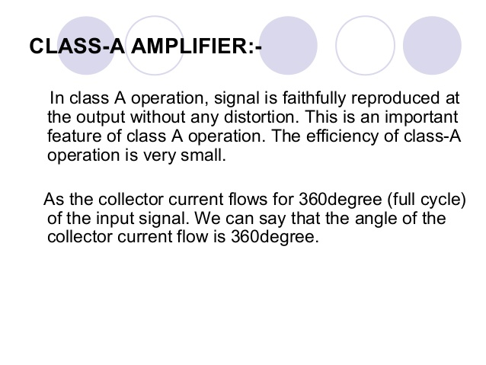

Slide 22
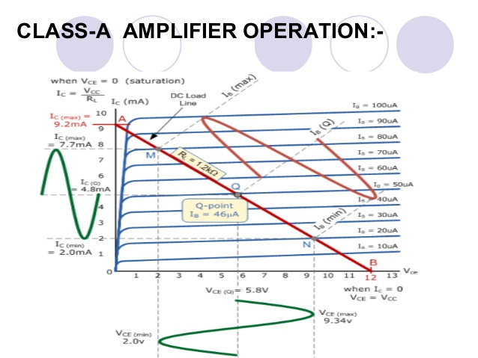

Slide 23
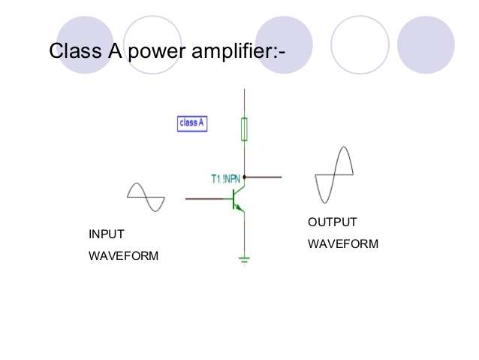

Slide 24
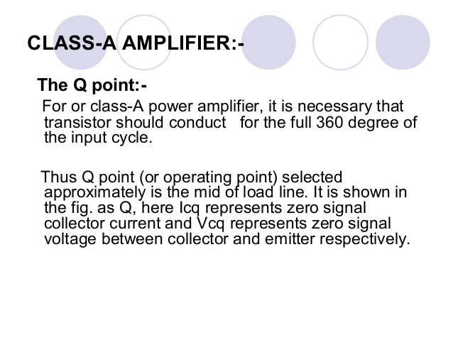

Slide 25
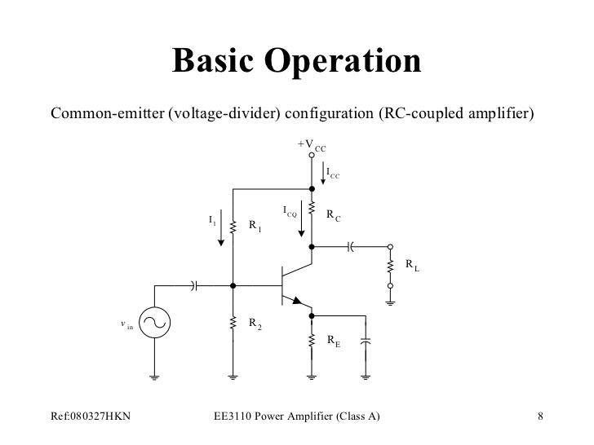

Slide 26
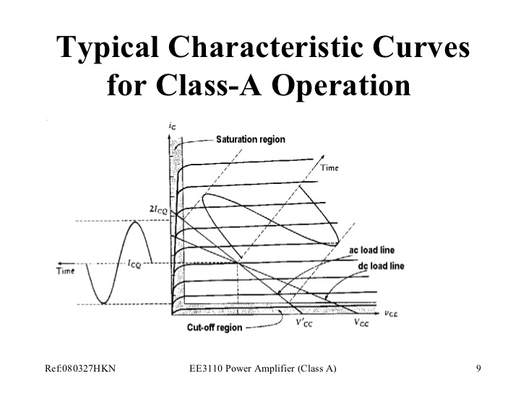

Slide 27
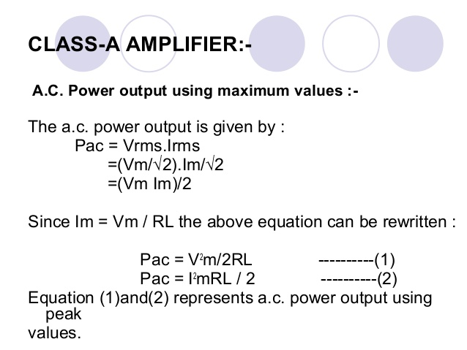

Slide 28
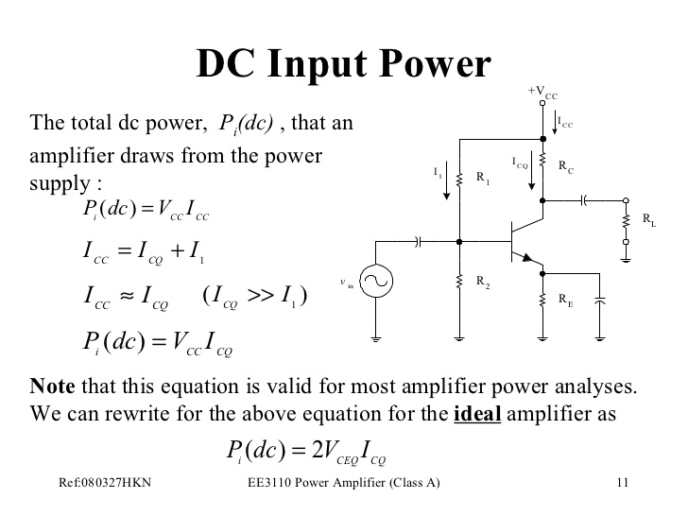

Slide 29
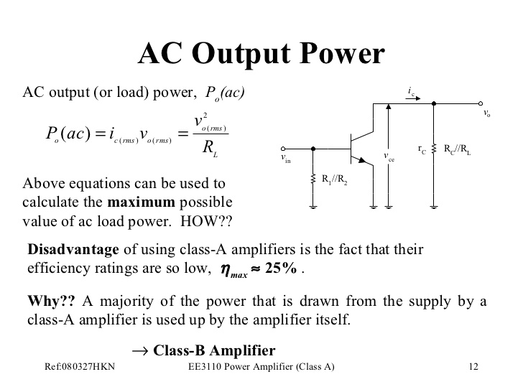

Slide 30
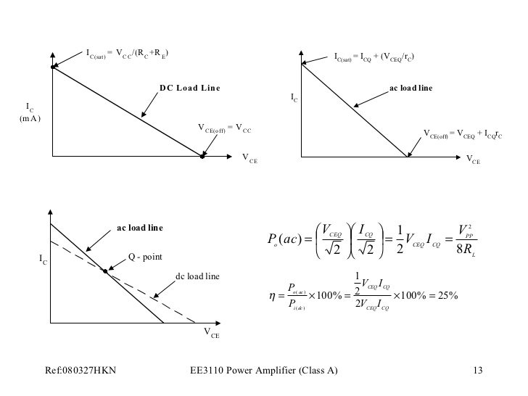

Slide 31
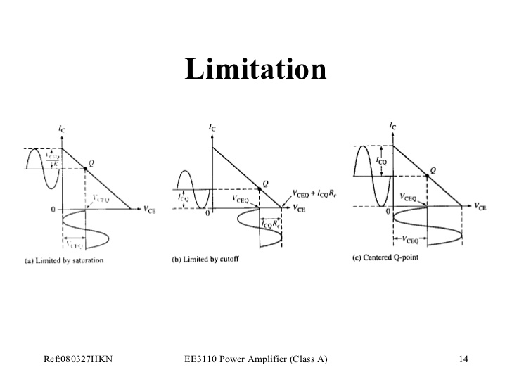

Slide 32
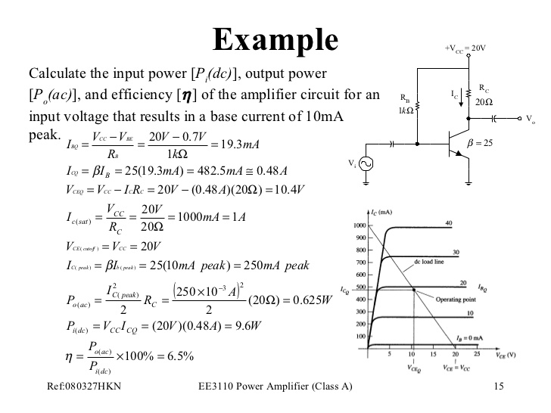

Slide 33
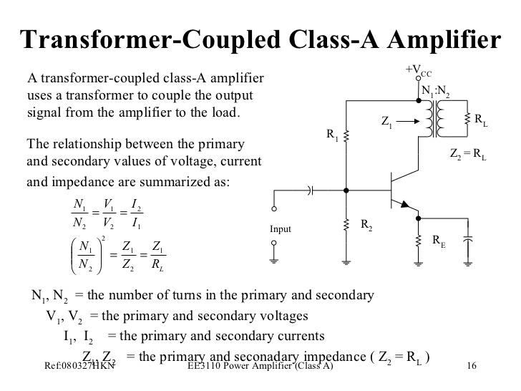

Slide 34
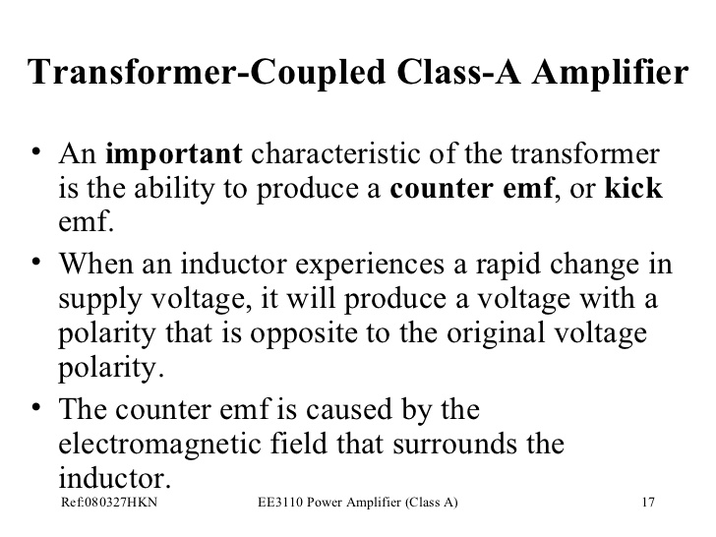

Slide 35
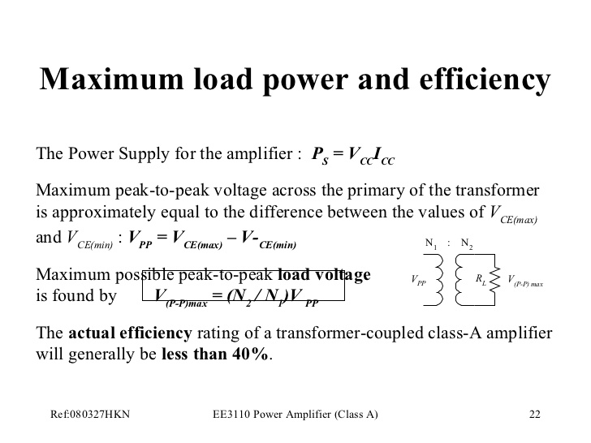

Slide 36
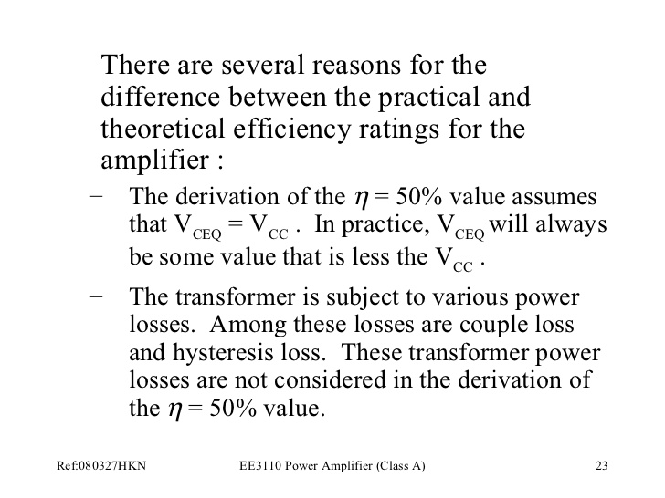

Slide 37
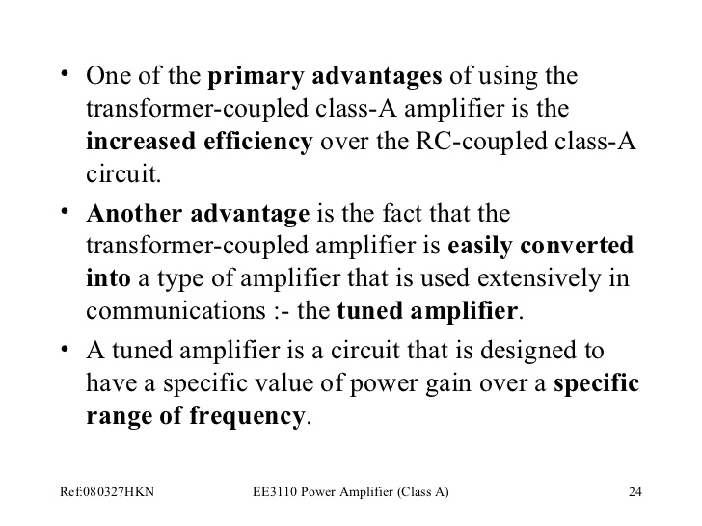

Slide 38
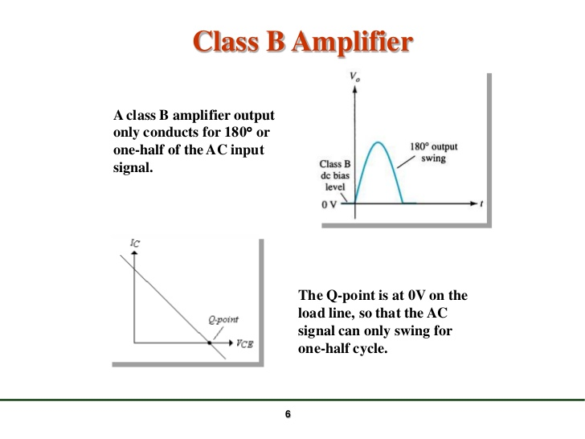

Slide 39
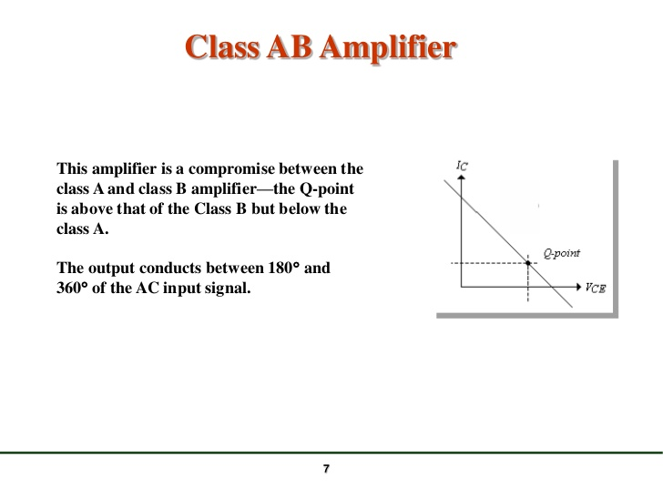

Slide 40
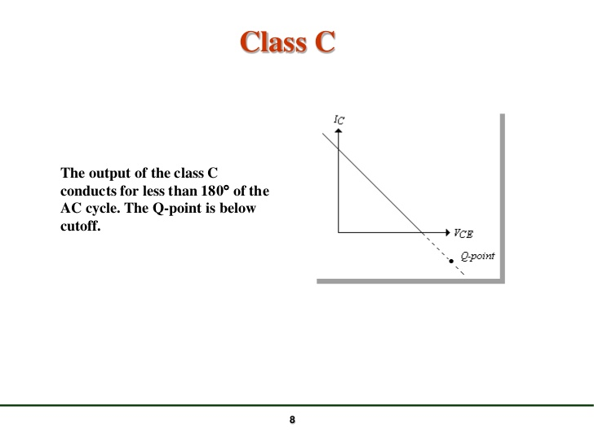

Slide 41
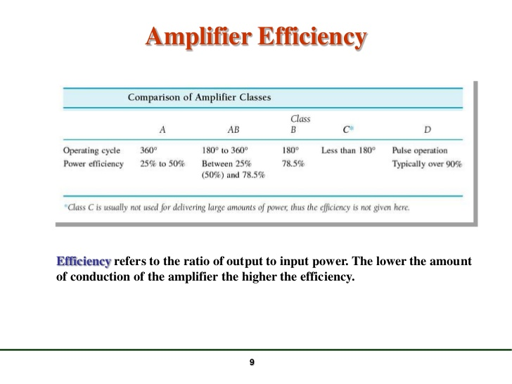

Slide 42
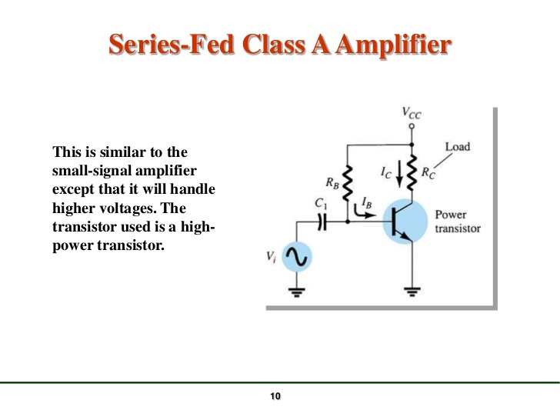

Slide 43
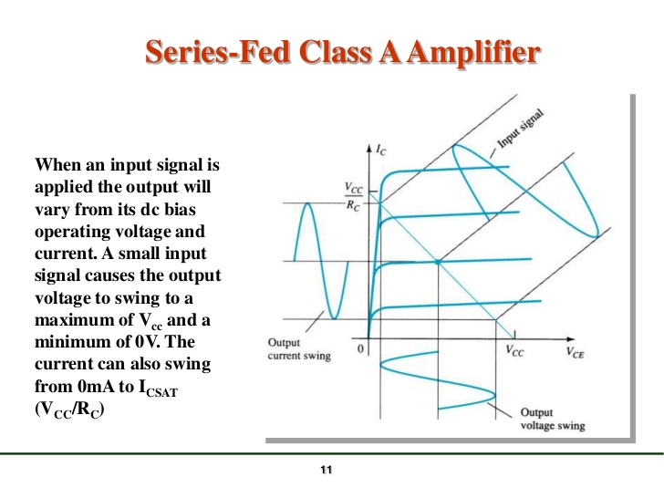

Slide 44
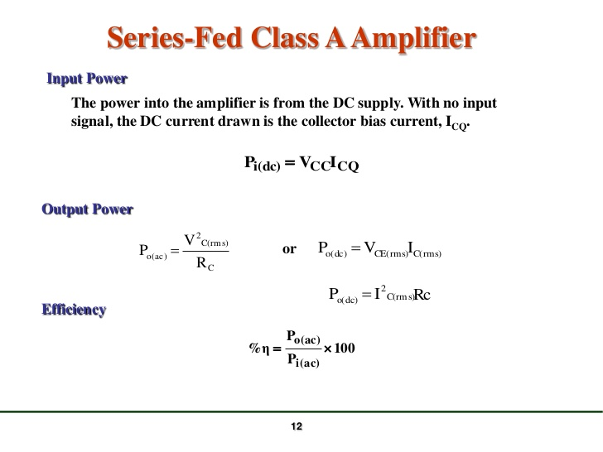

Slide 45
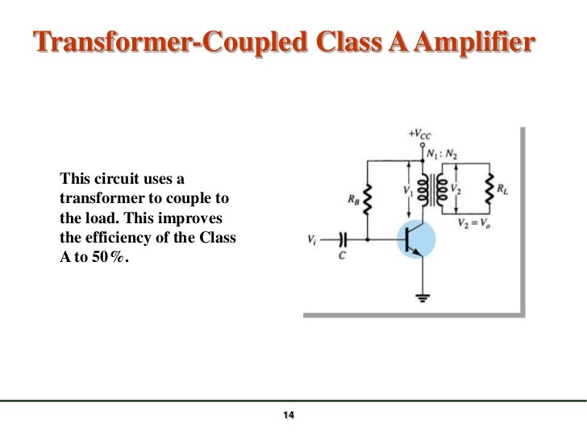

Slide 46
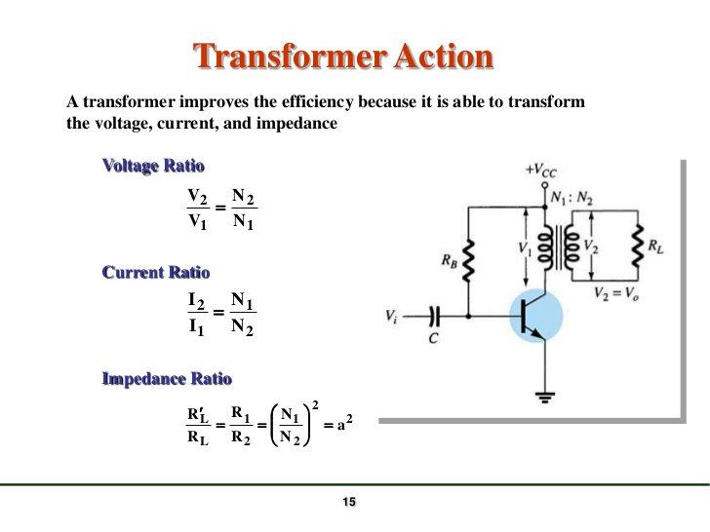

Slide 47
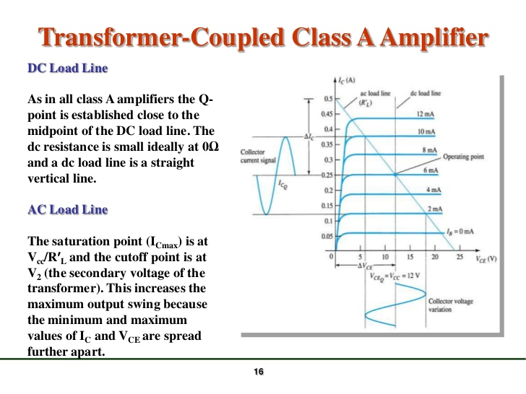

Slide 48
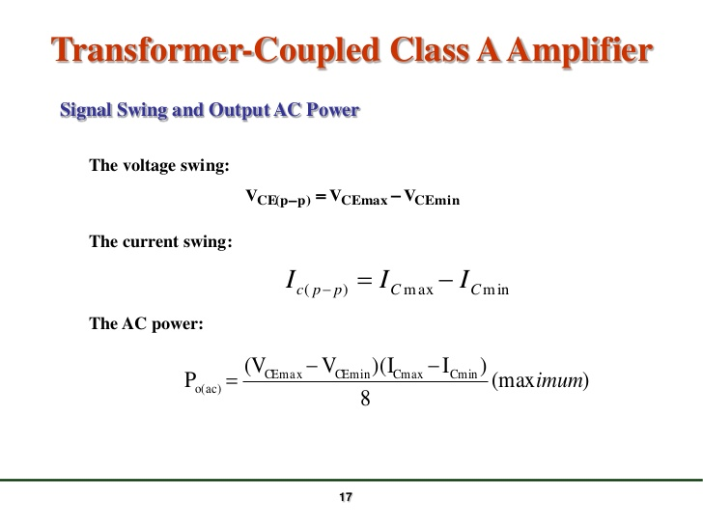

Slide 49
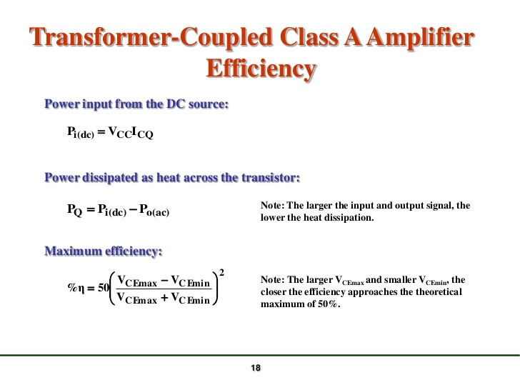

Slide 50
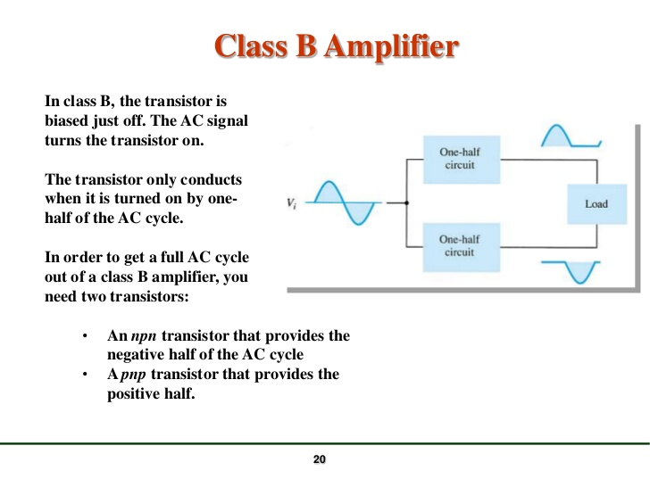

Slide 51
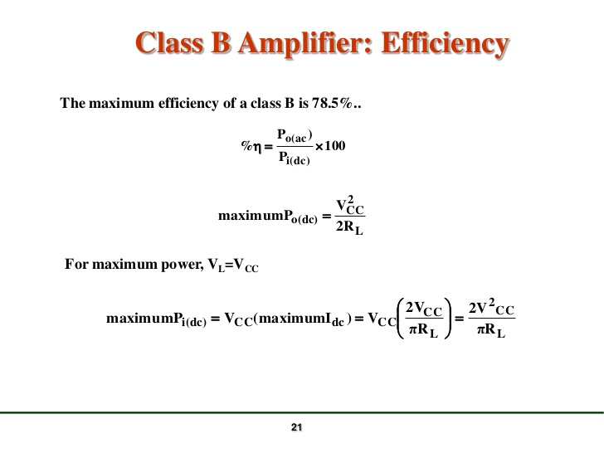

Slide 52
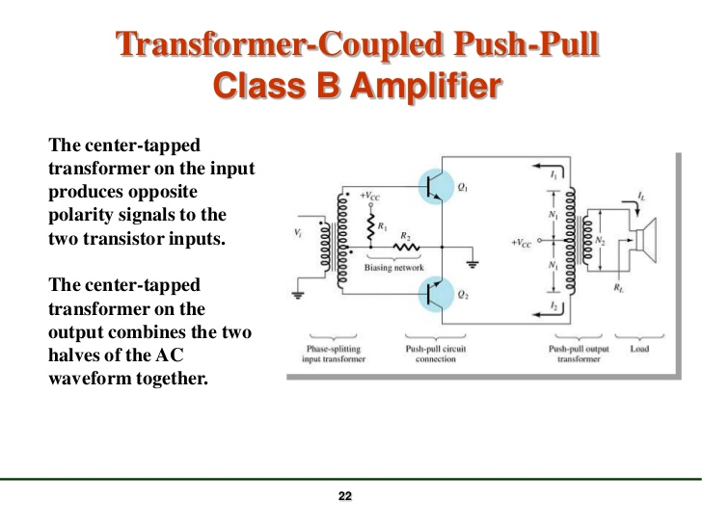

Slide 53


Slide 54


Slide 55


Slide 56


Slide 57


Slide 58


Slide 59


Slide 60


Slide 61


Slide 62


Slide 63


Slide 64


Slide 65


Slide 66


Slide 67


Slide 68


Slide 69


Slide 70


Slide 71


Slide 72


Slide 73


Slide 74


Slide 75


