Slide 1
GOVT.POLYTECHNIC EDUCATION SOCIETY MANESAR
PRESENTATION OF POWER POINT
OF
DATA STRUCTURE USING IN C on Unit 5 - Trees
REPRESENTED BY COMPUTER ENGG.

Slide 2
INTRODUCTION
TO
TREES

Slide 3
TREES
Tree is define as finite set of one or more nodes such that
There is a special desiginated , nodes called the root.
the remaining nodes are portioned into n>=0 different sets T1,T2,T3,……..,Tn are called the subtree of the root.

Slide 4
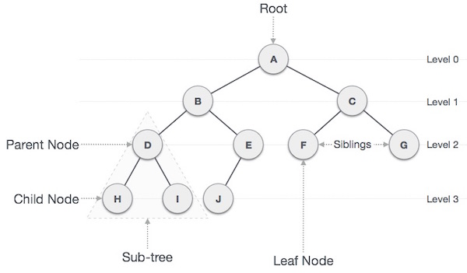
Binary tree
A tree is which each node can have at most two branches or one can say ,there is no nodes with degree greater than two is called a binary tree.

Slide 5
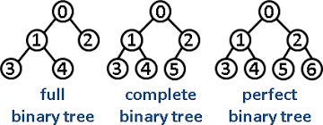
TYPES OF BINARY TREE
FULL BINARY TREE
COMPLETE BINARY TREE
PERFECT BINARY TREE

Slide 6
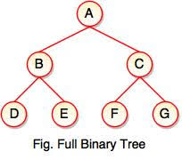
Full Binary Tree A Binary Tree is full if every node has 0 or 2 children. Following are examples of full binary tree. We can also say a full binary tree is a binary tree in which all nodes except leaves have two children.

Slide 7
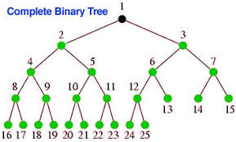
Complete Binary Tree: A Binary Tree is complete Binary Tree if all levels are completely filled except possibly the last level and the last level has all keys as left as possible

Slide 8
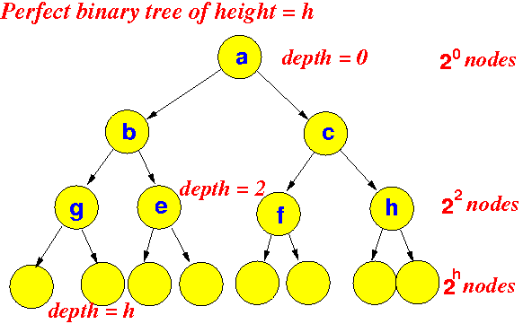
Perfect Binary Tree A Binary tree is Perfect Binary Tree in which all internal nodes have two children and all leaves are at same level.

Slide 9
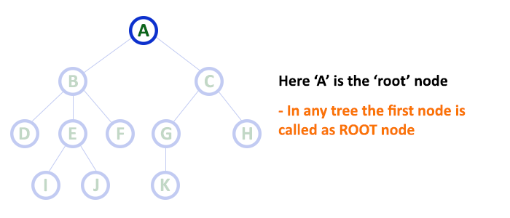
BINARY TREE TERMINOLOGY
1. Root
In a tree data structure, the first node is called as Root Node. Every tree must have root node. We can say that root node is the origin of tree data structure. In any tree, there must be only one root node. We never have multiple root nodes in a tree.

Slide 10
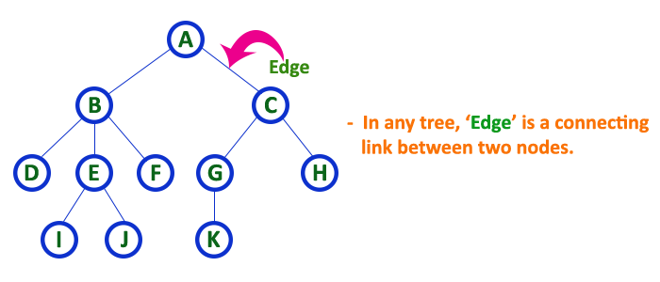
2. Edge
In a tree data structure, the connecting link between any two nodes is called as EDGE. In a tree with 'N' number of nodes there will be a maximum of 'N-1' number of edges.

Slide 11
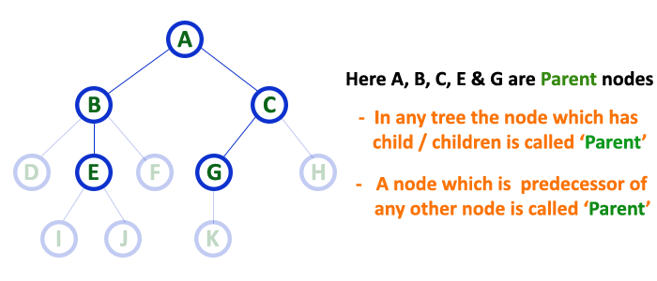
3. Parent
In a tree data structure, the node which is predecessor of any node is called as PARENT NODE. In simple words, the node which has branch from it to any other node is called as parent node. Parent node can also be defined as "The node which has child / children".

Slide 12
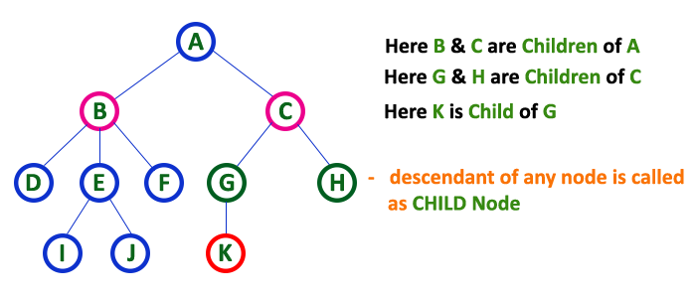
4. Child
In a tree data structure, the node which is descendant of any node is called as CHILD Node. In simple words, the node which has a link from its parent node is called as child node. In a tree, any parent node can have any number of child nodes. In a tree, all the nodes except root are child nodes.

Slide 13
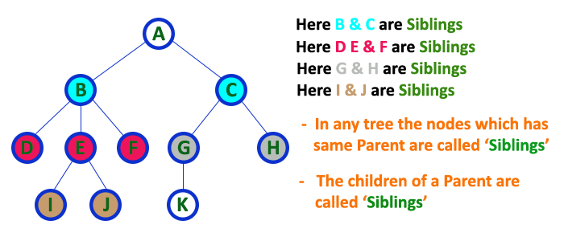
5. Siblings
In a tree data structure, nodes which belong to same Parent are called as SIBLINGS. In simple words, the nodes with same parent are called as Sibling nodes.

Slide 14
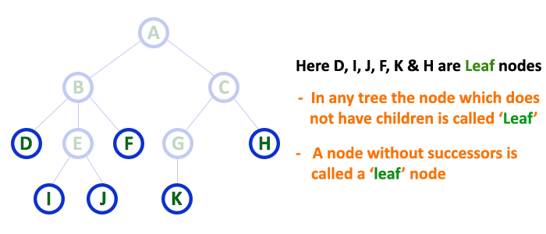
6. Leaf
In a tree data structure, the node which does not have a child is called as LEAF Node. In simple words, a leaf is a node with no child. In a tree data structure, the leaf nodes are also called as External Nodes. External node is also a node with no child. In a tree, leaf node is also called as 'Terminal' node.

Slide 15
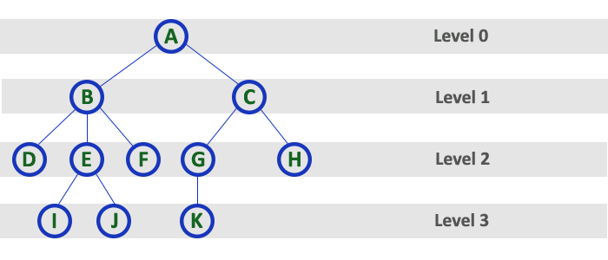
7. Level
In a tree data structure, the root node is said to be at Level 0 and the children of root node are at Level 1 and the children of the nodes which are at Level 1 will be at Level 2 and so on... In simple words, in a tree each step from top to bottom is called as a Level and the Level count starts with '0' and incremented by one at each level (Step).

Slide 16
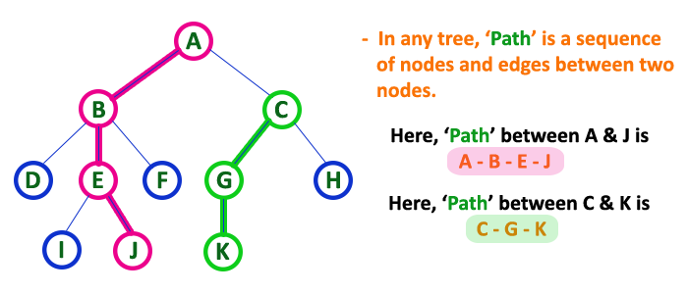
8. Path
In a tree data structure, the sequence of Nodes and Edges from one node to another node is called as PATH between that two Nodes. Length of a Path is total number of nodes in that path. In below example the path A - B - E - J has length 4.

Slide 17
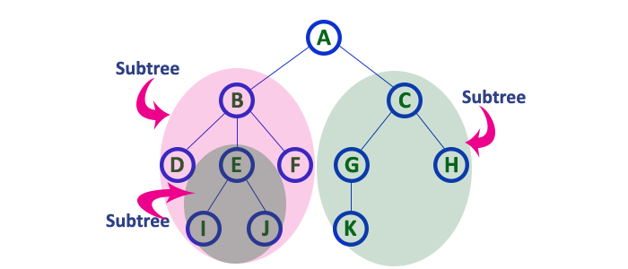
9. Sub Tree
In a tree data structure, each child from a node forms a subtree recursively. Every child node will form a subtree on its parent node.

Slide 18
TRAVERSING A BINARY TREE
Traversal is a process to visit all the nodes of a tree and may print their values too. Because, all nodes are connected via edges (links) we always start from the root (head) node. That is, we cannot randomly access a node in a tree. There are three ways which we use to traverse a tree −
In-order Traversal
Pre-order Traversal
Post-order Traversal

Slide 19
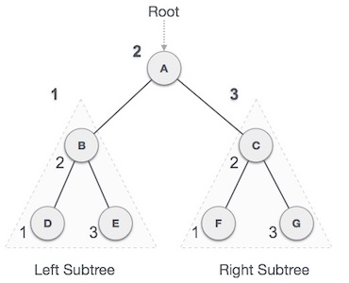
In-order Traversal
In this traversal method, the left subtree is visited first, then the root and later the right sub-tree. We should always remember that every node may represent a subtree itself.
If a binary tree is traversed in-order, the output will produce sorted key values in an ascending order.

Slide 20
We start from A, and following in-order traversal, we move to its left subtree B. B is also traversed in-order. The process goes on until all the nodes are visited. The output of inorder traversal of this tree will be −
D → B → E → A → F → C → G
Algorithm
Until all nodes are traversed −
Step 1 − Recursively traverse left subtree.
Step 2 − Visit root node.
Step 3 − Recursively traverse right subtree.

Slide 21
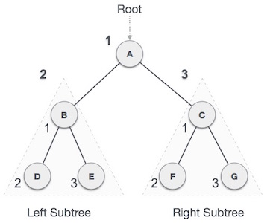
Pre-order Traversal
In this traversal method, the root node is visited first, then the left subtree and finally the right subtree.

Slide 22
We start from A, and following pre-order traversal, we first visit A itself and then move to its left subtree B. B is also traversed pre-order. The process goes on until all the nodes are visited. The output of pre-order traversal of this tree will be −
A → B → D → E → C → F → G
Algorithm
Until all nodes are traversed −
Step 1 − Visit root node.
Step 2 − Recursively traverse left subtree.
Step 3 − Recursively traverse right subtree.

Slide 23
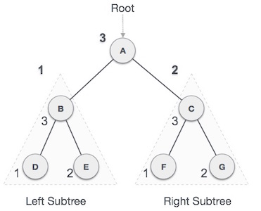
Post-order Traversal
In this traversal method, the root node is visited last, hence the name. First we traverse the left subtree, then the right subtree and finally the root node.

Slide 24
We start from A, and following Post-order traversal, we first visit the left subtree B. B is also traversed post-order. The process goes on until all the nodes are visited. The output of post-order traversal of this tree will be −
D → E → B → F → G → C → A
Algorithm
Until all nodes are traversed −
Step 1 − Recursively traverse left subtree.
Step 2 − Recursively traverse right subtree.
Step 3 − Visit root node.

Slide 25
BINARY SEARCH TREE
Binary Search Tree, is a node-based binary tree data structure which has the following properties:
The left subtree of a node contains only nodes with keys lesser than the node’s key.
The right subtree of a node contains only nodes with keys greater than the node’s key.
The left and right subtree each must also be a binary search tree. There must be no duplicate nodes.

Slide 26
DIAGRAM OF BINARY SEARCH TREE

Slide 27
OPERATION ON BINARY SEARCH TREE
In a binary tree, every node can have maximum of two children but there is no order of nodes based on their values. In binary tree, the elements are arranged as they arrive to the tree, from top to bottom and left to right. A binary tree has the following time complexities...
Search Operation - O(n)
Insertion Operation - O(1)
Deletion Operation - O(n)

Slide 28
Search Operation
In a binary search tree, the search operation is performed with O(log n) time complexity. The search operation is performed as follows...
Step 1: Read the search element from the user
Step 2: Compare, the search element with the value of root node in the tree.
Step 3: If both are matching, then display "Given node found!!!" and terminate the function
Step 4: If both are not matching, then check whether search element is smaller or larger than that node value.
Step 5: If search element is smaller, then continue the search process in left subtree.
Step 6: If search element is larger, then continue the search process in right subtree.

Slide 29
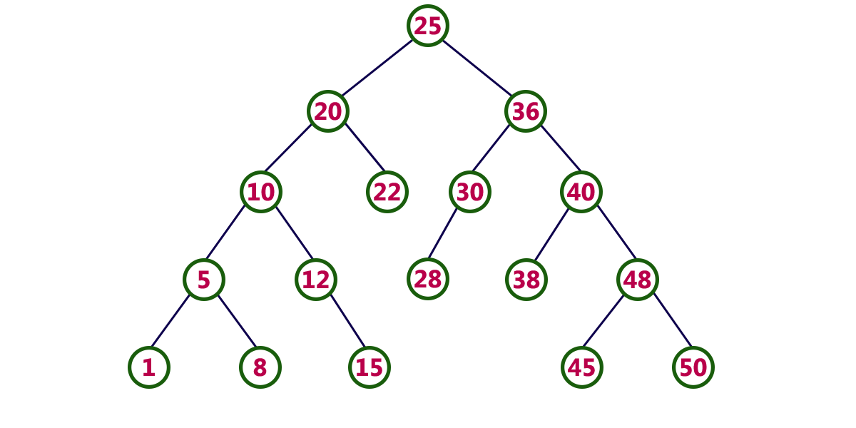
Step 7: Repeat the same until we found exact element or we completed with a leaf node
Step 8: If we reach to the node with search value, then display "Element is found" and terminate the function.
Step 9: If we reach to a leaf node and it is also not matching, then display "Element not found" and terminate the function.

Slide 30
Insertion Operation
In a binary search tree, the insertion operation is performed with O(log n) time complexity. In binary search tree, new node is always inserted as a leaf node. The insertion operation is performed as follows...
Step 1: Create a newNode with given value and set its left and right to NULL.
Step 2: Check whether tree is Empty.
Step 3: If the tree is Empty, then set set root to newNode.
Step 4: If the tree is Not Empty, then check whether value of newNode is smaller or larger than the node (here it is root node).
Step 5: If newNode is smaller than or equal to the node, then move to its left child. If newNode is larger than the node, then move to its right child.

Slide 31
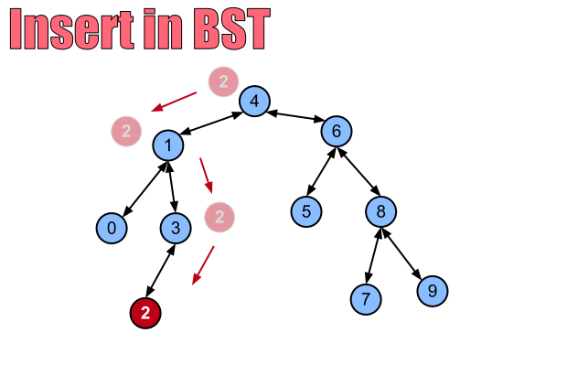
Step 6: Repeat the above step until we reach to a leaf node (e.i., reach to NULL).
Step 7: After reaching a leaf node, then isert the newNode as left child if newNode is smaller or equal to that leaf else insert it as right child.

Slide 32
Deletion Operation
In a binary search tree, the deletion operation is performed with O(log n) time complexity. Deleting a node from Binary search tree has follwing three cases...
Case 1: Deleting a Leaf node (A node with no children)
Case 2: Deleting a node with one child
Case 3: Deleting a node with two children

Slide 34
Case 1: Deleting a leaf node
We use the following steps to delete a leaf node from BST...
Step 1: Find the node to be deleted using search operation
Step 2: Delete the node using free function (If it is a leaf) and terminate the function.

Slide 35
Case 2:Deleting a node with one child
We use the following steps to delete a node with one child from BST...
Step 1: Find the node to be deleted using search operation
Step 2: If it has only one child, then create a link between its parent and child nodes.
Step 3: Delete the node using free function and terminate the function.

Slide 36
Case 3: Deleting a node with two children
We use the following steps to delete a node with two children from BST...
Step 1: Find the node to be deleted using search operation
Step 2: If it has two children, then find the largest node in its left subtree (OR) the smallest node in its right subtree.
Step 3: Swap both deleting node and node which found in above step.
Step 4: Then, check whether deleting node came to case 1 or case 2 else goto steps 2
Step 5: If it comes to case 1, then delete using case 1 logic.
Step 6: If it comes to case 2, then delete using case 2 logic.
Step 7: Repeat the same process until node is deleted from the tree.

Slide 37
THANK YOU

