Slide 1
WORKSHOP
TECHNOLOGY-II
SUBMITTED BY
SHAUKET ME

Slide 2
UNIT – I
CUTTING TOOLS AND CUTTING MATERIALS
A cutting tool is subjected to static and dynamic forces, high temperature, wear and abrasion. To get reasonable tool life, the tool material should meet following requirements:
1. Hot hardness 2. Wear and abrasion resistance. 3.Impact toughness.

Slide 3
CUTTING TOOL AND ITS TYPE
The tools which are used for the purpose of cutting the metals in the desired shape and size are called cutting tool.
1. Single Point Cutting Tool
2. Multi Point Cutting Tool
The cutting tools may also be classified according to the motion as follow:
1. Linear motion tools
2. Rotary motion tools
3. Linear and Rotary motion tools

Slide 4
VARIOUS TYPES OF SINGLE POINT CUTTING TOOLS AND THEIR USES
Tools for Lathe machines:
1. Turning tool
2. Facing tool
3. Chamfering tool
4. External threading tool
5. Internal threading tool
6. Boring tool
Tools for Planers:
1. Straight and Bent Roughing Tools
2. Straight Beck, Round Nose and Goose Neck Tools

Slide 5
Tools for shapers
1. Round nose roughing tool
2.Down cutting tool
3. Square nose finishing tool
4. Side recessing tool
5. Parting off tool
6. Goose neck tool

Slide 6
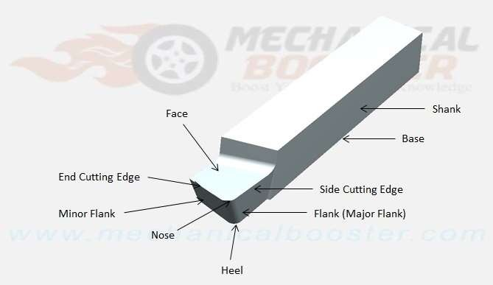
IMPORTANT TERM RELATING TO SINGLE POINT CUTTING TOOL
Single point cutting tool

Slide 7
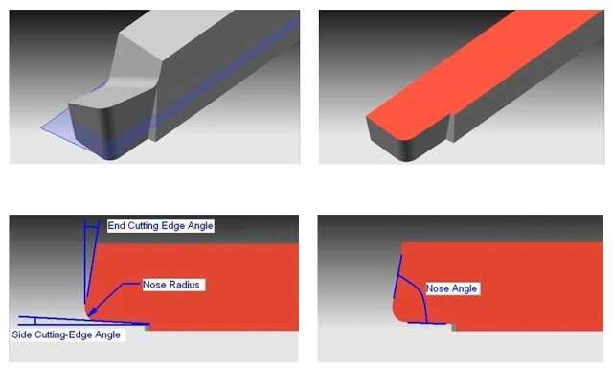

Slide 8
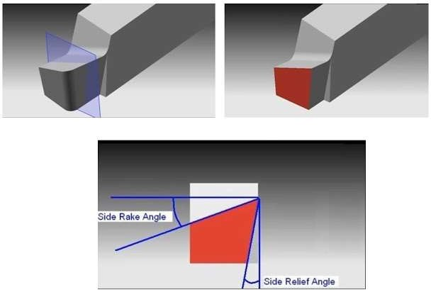

Slide 9
1. Shank
2. Flank
3. Face
4. Heel
5. Nose
6. Neck
7. Cutting edge
Angles
The various angles of the single point cutting tool have great importance. Each angle has its own function and speciality.

Slide 10
TOOL SIGNATURE
The shape of a tool is specified in a special sequence and this special sequence is called tool signature. The tool signature is given below
1. Back rake angle
2. Side rake angle
3. End relief / Clearance angle
4. Side relief / Clearance angle
5. End cutting edge angle
6. Side cutting edge angle
7. Nose radius

Slide 11
EFFECT OF HEAT PRODUCED DURING METAL CUTTING
It reduced the tool life
It reduced the surface finish
It causes the welding of chips with the face of tool
Repeated replacement of tools occurs which increases the cost
CUTTING SPEED
Cutting speed of a cutting tool may be defined as the speed at which the cutting edge passes over the material.

Slide 12
FEED
Feed of a cutting tool may be defined as the distance through which the tool advances in to or along work piece each time the tool passes a certain position in its travel over the surface.
DEPTH OF CUT
Depth of cut may be defined as the perpendicular distances measured from the machined surface to the un cut surface of the work piece.

Slide 13
PROPERTIES OF THE CUTTING TOOL MATERIALS
It should be harder then the cutting material of work piece
It should be tough
It should be cheap
It should be high resistant to wear to ensure longer tool life
It should be able to be fabricated and shaped easily.

Slide 14
CUTTING TOOL MATERIAL
HIGH SPEED STEEL
HIGH CARBON STEEL
TUNGSTEN CARBIDE
CEMENTEDCARBIDS
STELLITE
CERAMIC CUTTING MATERIALS
DIAMOND

Slide 15
UNIT-II
LATHE
Lathe is a machine, which removes the metal from a piece of work to the required shape and size.
Lathe is one of the most important machine tools in the metal working industry. A lathe operates on the principle of a rotating workpiece and a fixed cutting tool.

Slide 16
FUNCTION OF LATHE
Lathe is to remove excess material in the form of chips by rotating the work piece against a stationary cutting tool

Slide 17
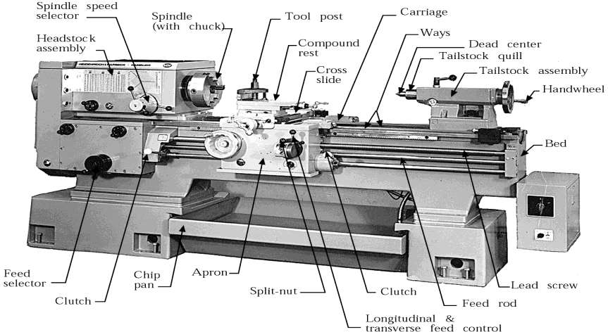

Slide 18
MAIN PART OF LATHE
Lathe Machine is also known as “Centre Lathe”, because it has two centres between which the job can be held and rotated.
The main parts of centre lathe are:
Bed
2. Head stock
3. Tailstock
4. Carriage
5. Feed mechanisms

Slide 19
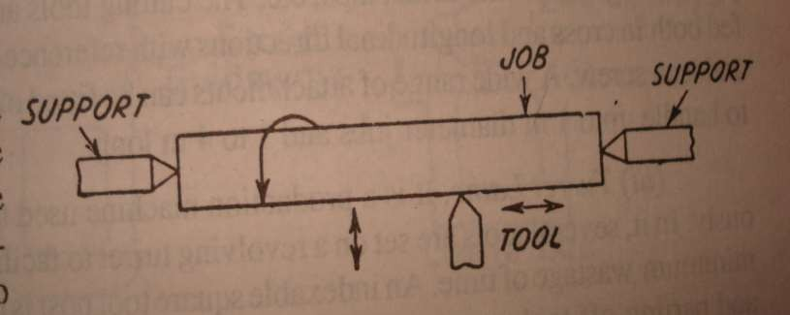
Working Principle of Lathe
1.

Slide 20
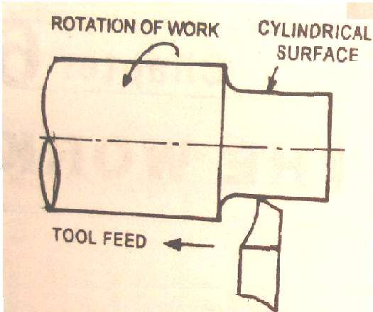
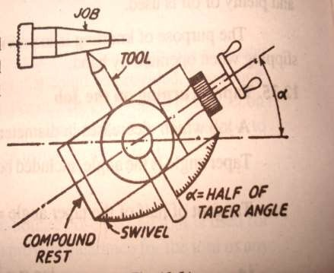

Slide 21
WORKING PRINCIPLES OF LATHE
It holds the work between two supports called centres.
Chuck or Face plate is also used for holding the work.
Chuck or face plate is mounted on machine spindle
Cutting tool is held and supported on a tool post.
Movement of the job is rotation about spindle axis
Tool is fed against the revolving work
Movement of the tool is either parallel to or at any inclination to the work axis

Slide 22
TYPES OF LATHE MACHINE
Speed lathe
Engine or centre lathe
Bench lathe
Tool room lathe
Capstan and turret lathe
Automatic lathe
Special purpose lathe

Slide 23
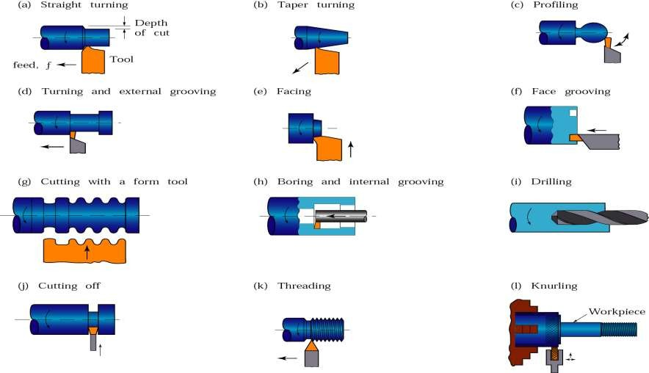
LATHE OPERATIONS

Slide 24
LATHE ACCESSORIES
Centres 2. Lathe dog or carrier
Chucks 4. Collets
Face plates 6. Driving plate
Angle plate 8. Mandrels
Rests 10. Milling attachment
11. Taper turning attachment.

Slide 25
ADVANTAGES OF LATHE MACHINE
Greater production over a given period.
More economy in floor space.
Improvement in accuracy.
Floor space maintenance and inventory requirements are reduced.
More consistently accurate work than turrets.
More constant flow of production.
Scrap loss is reduced by reducing operator error.
During machine operation operator is free to operate another machine/ can inspect completed parts.

Slide 26
UNIT – III
DRILLING
The drilling machine or drill press is one of the most common and useful machine employed in industry for producing forming and finishing holes in a work piece.
WORKING PRINCIPLE OF DRILLING
The rotating edge of the drill exerts a large force on the work piece and the hole is generated. The removal of metal in a drilling operation is by shearing and extrusion.

Slide 27
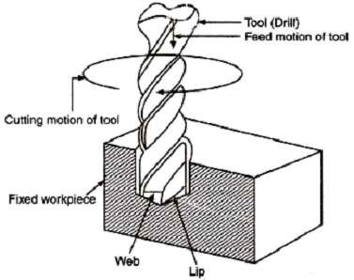

Slide 28
MAIN PARTS OF DRILLING MACHINE
The machine has only a hand feed mechanism for feeding the tool into the work piece. This enables the operator to feel how the drill is cutting and accordingly he can control the down feed pressure. Sensitive drill presses are manufactured in bench or floor models.
Base 2. Column
Adjustable table 4. Spindle
5. Head 6. Drill chuck

Slide 29
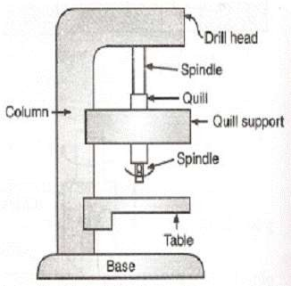

Slide 30
TYPES OF DRILLING MACHINE
Portable Drilling Machine
Sensitive or Bench Drill
Upright Drilling Machine(Single Spindle)
Upright Drilling Machine(Turret Type)
Radial Drilling Machine
Multiple Spindle Drilling Machine
Deep Hole Drilling Machine
Gang Drilling Machine
Horizontal Drilling Machine
Automatic Drilling Machine

Slide 31
OPERATION OF DRILLING MACHINE
Drilling
Reaming
Boring
Counter Boring
Counter Sinking
Spot Facing
Tapping
Core drilling
Buffing
Step drilling
Grinding
Counter sinking

Slide 32
UNIT – IV
BORING
Boring is a process of producing circular internal profiles on a hole made by drilling or another process. It uses single point cutting tool called a boring bar. In boring, the boring bar can be rotated, or the work part can be rotated. Machine tools which rotate the boring bar against a stationary work piece are called boring machines (also boring mills).
Boring can be accomplished on a turning machine with a stationary boring bar positioned in the tool post and rotating work piece held in the lathe chuck as illustrated in the figure. In this section, we will consider only boring on boring machine.

Slide 33
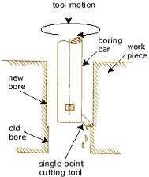
PRINCIPLE OF BORING
In horizontal boring machine, the work piece is held on the machine table and kept stationary, while boring tool revolves. At the same time, the tool may be moved forward or backward in a direction parallel to its axis of rotation and can also be offset in a direction perpendicular to its axis of rotation.

Slide 34
CLASSIFICATION OF BORING MACHINES
Horizontal boring machine
Vertical boring machine
Jigs boring machine
Special purpose boring machine

Slide 35
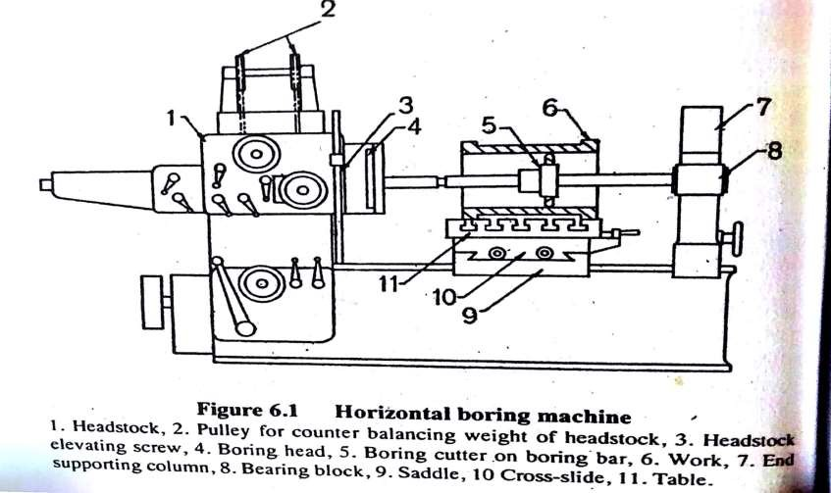
HORIZONTAL BORING MACHINE
.

Slide 36
1. Bed
2. Saddle
3. Table
4. Base
5. Column
6. Headstock
7. End support column
VERTICAL BORING MACHINE
A vertical boring mill is used for large, heavy work parts with diameters up to 12 m. The typical boring mill can position and feed several cutting tools simultaneously. The work part may be mounted on a rotating worktable.

Slide 37
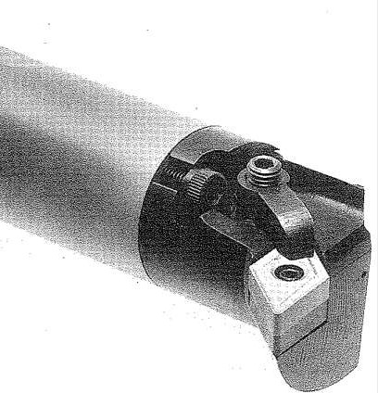
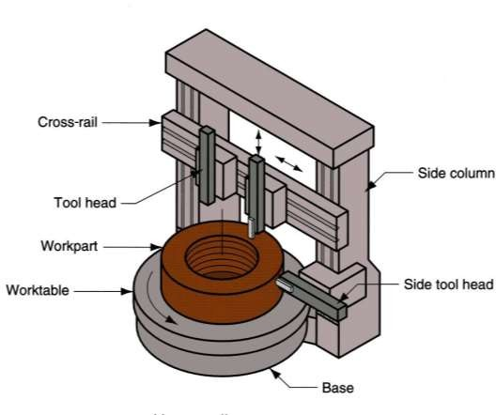
VERTICAL BORING MACHINE
Boring bar made by cemented carbide

Slide 38
CUTTING TOOLS FOR BORING
The typical boring bar is shown in the figure. When boring with a rotating tool, size is controlled by changing the radial position of the tool slide, which hold the boring bar, with respect to the spindle axis of rotation. For finishing machining, the boring bar is additionally mounted in an adjustable boring head for more precise control of the bar radial position.
Forged tool
Inserted teeth boring tool
Boring tool bit in boring bar

Slide 39
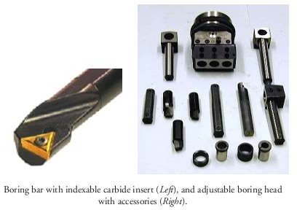

Slide 40
BORING OPERATIONS
Internal taper boring
External taper boring
Necking or cutting off
Boring a large diameter
Boring a small diameter
Spot facing
Reaming
Counter boring
Threading
Facing
Trepanning
Milling

Slide 41
UNIT – V
SHAPING, PLANNING AND SLOTTING
SHAPING
Shaping or shaper machine is a reciprocating type of machine tool used for producing small flat surfaces with the help of a point cutting tool which reciprocates over the stationary work piece.
A shaping machine is used to machine surfaces. It can cut curves, angles and many other shapes. It is a popular machine in a factory workshop because its movement is very simple although it can produce a variety of work. They are less common in school workshops, perhaps because of their moving parts which present a high risk.

Slide 42
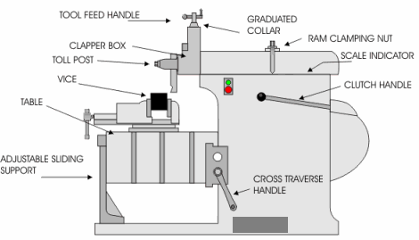
DESCRIPTION OF SHAPER MACHINE
.

Slide 43
MAIN PARTS OF SHAPER MACHINE
Base
Column
Cross rail
Saddle
Table
Ram
Tool head
Shaper head

Slide 44
CLASSIFICATION OF SHAPER MACHINE
Crank shaper
Geared shaper
Hydraulic
Horizontal shaper
Vertical shaper
Travelling head shaper
Plain shaper
Universal shaper
Push cut type shaper
Draw type shaper

Slide 45
WORKS ON SHAPER MACHINE
Shaping a vertical grooves
Shaping horizontal flat surfaces
Shaping a dovetail slide
Shaping flat inclined surfaces
Shaping v-block
Shaping a jib and guide jib
Shaping a curved surface

Slide 46
PLANER
The machine tool for planning is a planer. Cutting speed is achieved by a reciprocating worktable that moves the part past the single-point cutting tool. Construction and motion capability of a planer permit much larger parts to be machined than on a shaper.
CLASSIFICATION OF PLANING MACHINE
1. Standard or double housing planer
2. Open side planer
3. Pit type planer
4. Edge or plate planer
5. Divided table planer
6. Universal planer

Slide 47
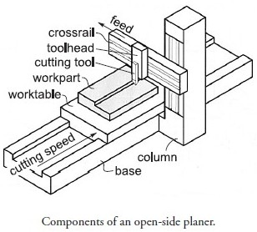
DESCRIPTION OF PLANER MACHINE
.

Slide 48
MAIN PARTS OF PLANER MACHINE
Bed
Table
Housing
Cross rail
Saddle
Tool head

Slide 49
WORKS ON PLANER MACHINE
Bed and slides of all kind of machine
Large structures and frames of different engine
Locomotive frames
Forging hammer die block
Dies , jigs and fixtures
Helical grooves on large valves
Deep slot on large motors
Roll mill bearing
Lathe carriage and way
Pressure plate
Parts of large hydraulic presses

Slide 50
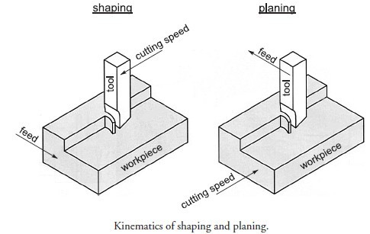
DIFFERENCE SHAPER AND PLANER
Planning and shaping are similar operations, which differ in the kinematics of the process. Planning is a machining operation in which the primary cutting motion is performed by the work piece and feed motion is imparted to the cutting tool. In shaping, the primary motion is performed by the tool, and feed by the work piece.

Slide 51
SALTTING MACHINE
Slotting machines can simply be considered as vertical shaping machine. Unlike shaping and planning machines, slotting machines are generally used to machine internal surfaces (flat, formed grooves and cylindrical.
CLASSIFICATION OF SLOTTING MACHINE
Punch type slotter machine
Precision slotter machine

Slide 52
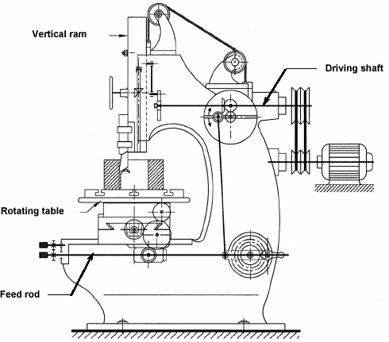
DESCRIPTION OF SLOTTING MACHINE
.

Slide 53
MAIN PARTS OF SLOTTING MACHINE
Base
Column
Saddle
Cross slide
Rotary table
Ram and tool head assembly

Slide 54
WORKS ON SLOTTING MACHINE
  Cutting keyway or spline
  Cutting serrations
  Finishing die opening
  Finishing a punch profile
  Matching tall or bulky pieces
  Finishing regular or irregular section
  Cutting cam profile

Slide 55
DIFFERENCE BETWEEN SLOTTER AND PLANER
SALOTTING MACHINE
PLANING MACHINE
Tool reciprocates
Only one tool operates at a time
Work is stationary with table feed motion
Light duty machine
Material removal rate is less as compared to planer
Slotter ram of tool can be tilted with respect to table surface
Tool is stationary with intermittent feed motion.
Multiple tools can operate at a time
Work reciprocates on the table
Heavy duty machine
Material removal rate is more
No tilting of tool heads

Slide 56
UNIT – VI
BROACHING
Broaching is a machining operation in which a tool used is called as broach having series of cutting teeth.
In this operation broach is either Pulled or Pushed with the help of broaching machine on the work piece surface.
Parts that is produced by the broaching have good surface finish and dimensional accuracy.

Slide 57
PRINCIPLE OF BROACHING MACHINE
Broaching is a machining process for removal of a layer of material of
desired width and depth usually in one stroke by a slender rod or bar type cutter having a series of cutting edges with gradually increased protrusion as indicated in Fig.a. In shaping, attaining full depth requires a number of strokes to remove the material in thin layers step – by – step by gradually in-feeding the single point tool (Fig.b).. Whereas, broaching enables remove the whole material in one stroke only by the gradually rising teeth of the cutter called broach. The amount of tooth rise between the successive teeth of the broach is equivalent to the in feed given in shaping.

Slide 58
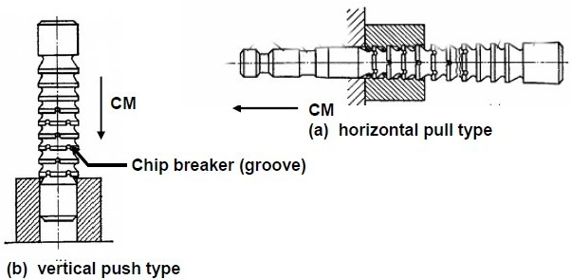

Slide 59
NOMENCLATURE OF BROCHING TOOL
Both pull and push type broaches are made in the form of slender rods or bars of varying section having along its length one or more rows of cutting teeth with increasing height (and width occasionally). Push type broaches are subjected to compressive load and hence are made shorter in length to avoid buckling.
The general configuration of pull type broaches, which are widely used for enlarging and finishing preformed holes, is schematically shown in Fig.

Slide 60
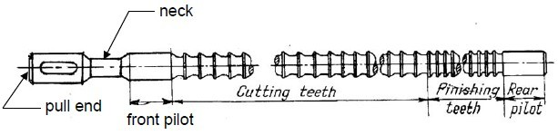

Slide 61
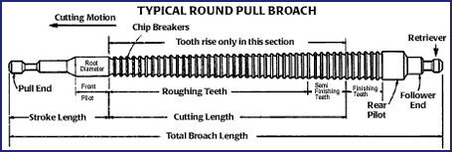

Slide 62
NOMENCLATURE OF BROCHING TOOL
Pull end for engaging the broach in the machine.
Neck of shorter diameter and length, where the broach is allowed to fail, if at all, under overloading.
Front pilot for initial locating the broach in the hole.
Roughing and finishing teeth for metal removal
Finishing and burnishing teeth for fine finishing
Rear pilot and follower rest or retriever

Slide 63
TYPES OF BROACHES MACHINE
According to method of operation
Push , pull or stationary broaches.
According to type of operation
Internal or external broaches.
According to shape
Solid , inserted tooth, built up or replaceable.
According to function
Roughing , finishing , keyways , burnishing, sizing and serrating.
Internal and external broaches

Slide 64
CLASSIFICATION OF BROACHING MACHINE
Horizontal broaching machine.
Vertical broaching machine.
Duplex head broaching machine.
Surface broaching machine.
Continuous broaching machine.
BROACHING TECHNIQUES
1. Internal broaching 2. External broching

Slide 65
UNIT – VII
JIGS AND FIXTURES
Jigs and fixtures are special devices used for large scale production. The production of components with the help of jigs and fixtures is based on the concept of interchangeability where components are produced with in established tolerances. Jigs and fixture provide the means of clamping the components rapidly without any additional set up.
JIG : A device that holds the work and locates the path of the tool.
FIXTURE: A device fixed to the worktable of a machine and locates the work in an exact position relative to the cutting tool.

Slide 66
ELEMENT OF JIG AND FIXTURE
Locating elements
Clamping elements
A rigid body in to which work piece are loaded
Tool guiding element or tool setting element.
Element for positioning or fastening the jig or fixture on the machine on which it is used.

Slide 67
USES OF JIGS AND FIXTURES
To reduce production cost
To increase production rate
To ensure high accuracy in part manufacture
To enable heavy and complicated complex shaped parts to be machined by being held rigidly to a machine
To provide interchange ability
Reduce quality control expenses
Less skilled labour & save labour costs
Improve work safety

Slide 68
MATERIALS FOR JIGS AND FIXTURES
Timber
Cast iron
Light metals
Brasses and bronzes
Steels

Slide 69
PRINCIPLES OF JIG AND FITURE DESIGN
Reduction of ideal time
Study of component
Study of machine
Production requirement
Rigidity
Location
Loading
Ejection of component
Design for safety
Coolant passage
Swarf clearance
Clamping
Bushes
Burr grooves
Trunnions
Jig base
Spring location
Wear

Slide 70
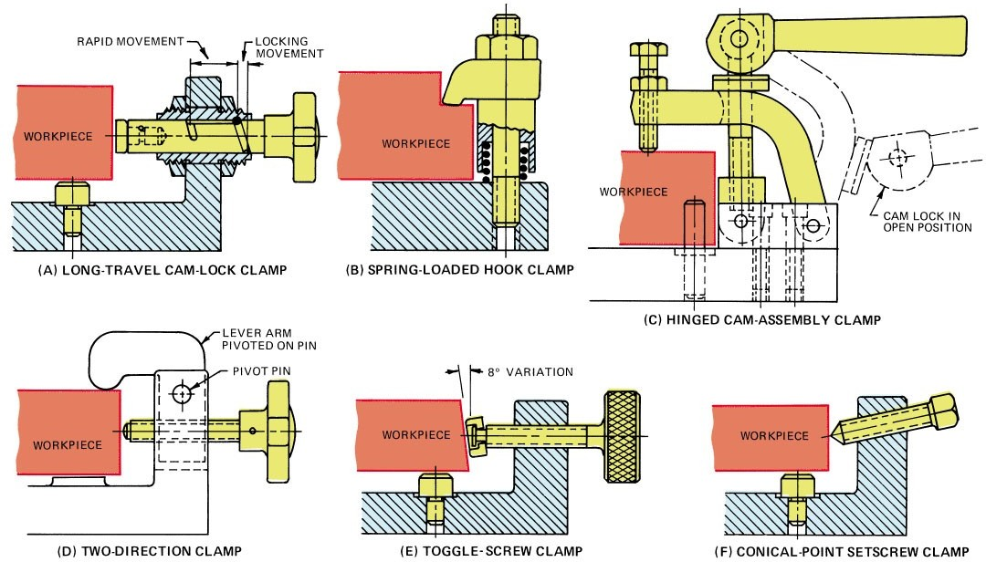
CLAMPING DEVICES
.

Slide 71
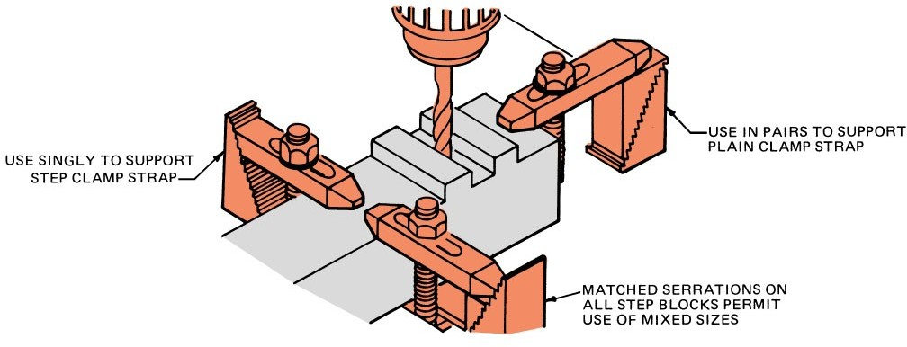

Slide 72
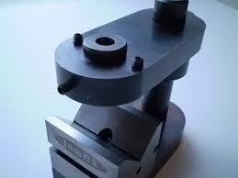
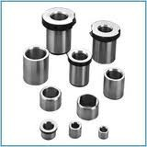
JIG BUSHES
.

Slide 73
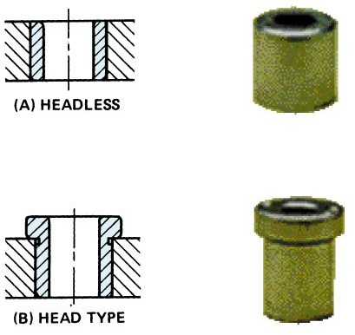

Slide 74
PRINCIPLE OF LOCATION
The principle of minimum locating points
The principle of mutually perpendicular planes
The principle of extreme position of pins
Relief should be provided where burr or swarf will get collected
Locating surface should be raised above the surrounding surfaces of J/F so that chips can be swept off readily.
Sharp corners in the locating surfaces must be avoided
Adjustable type locators to be used for rough surfaces

Slide 75
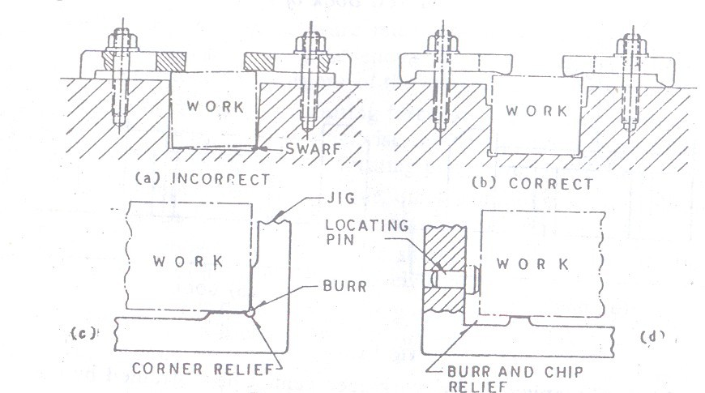

Slide 76
LOCATING DEVICES
Flat locators
Cylindrical locators
Conical locators
Jack pin locators
Vee locators
Adjustable locators
Flattened locators

Slide 77
PRINCIPLES OF CLAMPING
The clamping pressure applied against the work piece must counteract the tool forces
The clamping pressure should not be directed towards the cutting operation. Wherever possible it should be directed parallel to it.
The clamping pressure must not damage/deform the work surface.
Clamps should be arranged directly above the points supporting the work, otherwise distortion of work may occur.
Clamping pressure should be directed towards the points of support, else the work will tend to rise from support
Clamping should be simple, effective and fool proof.
Fibre pads should be riveted to clamp faces to avoid damage to fragile work pieces

Slide 78
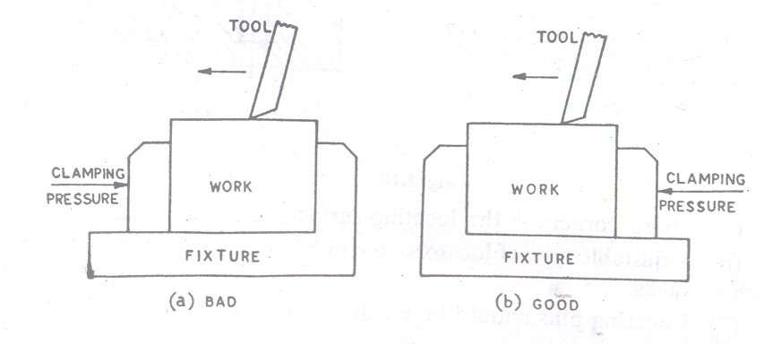
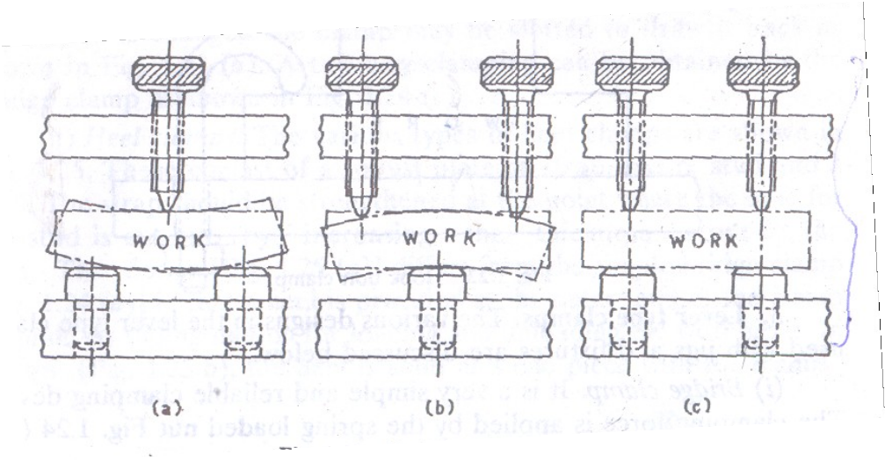

Slide 79
TYPES OF CLAMPING
Screw clamp
Pivoted clamp
Equalizing clamp
Retractable clamp
Two way clamp
Edge clamp
Special strap clamp
Button clamp
Plate strap clamp
Hook bolt clamp
Eccentric or cam clamp
Swing leaf or latch type clamp
Toggle clamp
C- clamp

Slide 80
TYPES OF DRILLING JIGS
Template jig
plate type jig
Open type jig
Channel jig
Leaf Jig
Box type jig
Post jig
Pot jig
Indexing jig
Vice type jig

Slide 82
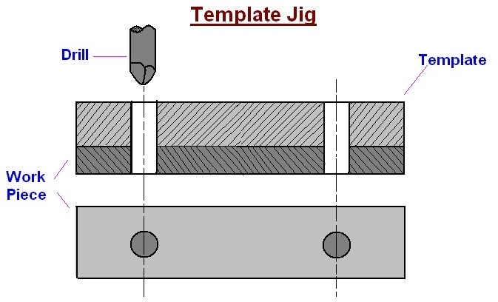
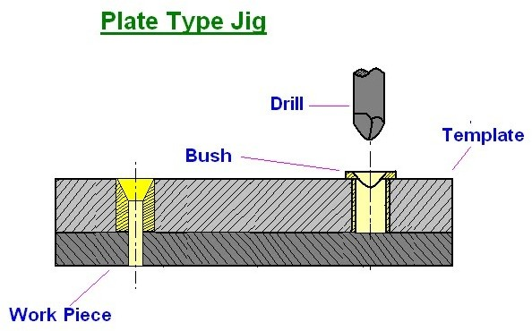
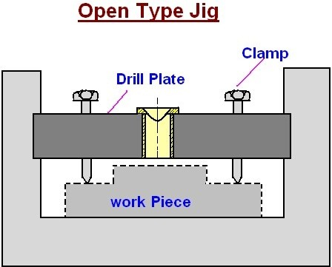
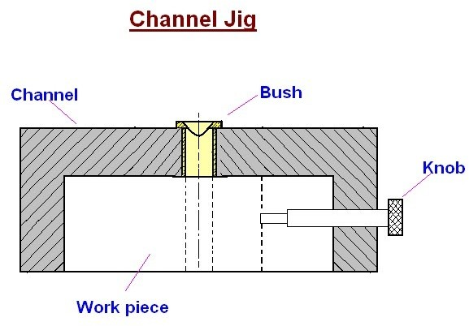

Slide 83
JIG BUSHES
Fixed bushes
Linear bushes
Slip bushes
Renewable bushes
Special bushes
Extended drill bush
Screwed drill bush

Slide 84
DIFFERENCE BETWEEN JIGS AND FIXTURE
JIG
FIXTURE
Locates and Holds the work and guides the cutting tool in true position of the work
Work Locating elements, Tool Guiding elements & Work Clamping elements
Light
Drilling, reaming , Tapping, Counterboring, Countersinking
Drill bushes used for tool guiding
Only Holds & Positions the work, but doesn’t guide the work
Work Locating elements, Tool setting elements & Work Clamping elements
Heavy
Milling, Turning, Grinding, Broaching etc
Feeler gauges, setting blocks to adjust position of tool in relation to work

Slide 85
UNIT – VIII
CUTTING FLUIDS AND LUBRICANTS
CUTTING FLUID
Essential in metal-cutting operations to reduce heat and friction Centuries ago, water used on grindstones
100 years ago, tallow used (did not cool) Lard oils came later but turned rancid Early 20th century saw soap added to water Soluble oils came in 1936
Chemical cutting fluids introduced in 1944

Slide 86
FUNCTIONS OF CUTTING FLUID
To reduce cutting forces.
To decrease wear and tear of the tool and increase tool life.
To provide lubrication effect to the tool , work piece and chip.
To improve surface finish and machinability.
To protect the finished surface from oxidation and corrosion.
To wash away the chip, scale and dust from and in between the working surfaces.
To minimize friction at the matting surfaces thus prevent rapid rate increase of temperature.

Slide 87
PROPERTIES OF CUTTING FLUID
It should be chemically stable.
It should be non corrosive.
It should be high flash point.
It should cause no skin irritation.
It should prevent the electrochemical effect of corrosion.
It should not deteriorate on storage.
It should be low cost.
It should be readily available in qualities required for use.

Slide 88
TYPES OF CUTTING FLUIDS
Neat cutting oils.
Soluble oils.
Synthetic fluids.
Semi synthetic fluids.
Mineral cutting oils.
Chemical additive oils.
Sulphurised mineral oils.
Chemical compounds.

Slide 89
APPLICATION OF CUTTING FLUIDS
By hand or brush
Flood method
Jet method
Mist method

Slide 90
LUBRICANT
The function of a lubricant is simple. It The function of a lubricant is simple. It reduces friction between moving metal surfaces. A lubricant coats surfaces and resists being displaced by the pressure, keeping the metal parts separated. Lubricants also prevent corrosion, block contaminants and can serve as a coolant. A good lubricant flows easily under pressure and remains in contact with moving surfaces. It does not leak out from gravitational or centrifugal forces nor does it stiffen in cold temperatures.
reduces friction between moving metal surfaces. A lubricant coats surfaces and resists being displaced by the pressure, keeping the metal parts separated. Lubricants also prevent corrosion, block contaminants and can serve as a coolant. A good lubricant flows easily under pressure and remains in contact with moving surfaces. It does not leak out from gravitational or centrifugal forces nor does it stiffen in cold temperatures.

Slide 91
TYPES OF LUBRICATION
Solid lubrication
Graphite , Zinc oxide , Molybdenum
Semi – solid lubrication
Greases
Liquid lubrication
Oils

Slide 92
COMMON METHODS OF LUBRICATION OF MACHINE TOOLS
Grease cup
Gravity feed
Oil can
Force feed
Splash lubrication
Hand oiling

