Slide 1
Maintenance
Apart from safety, maintenance is needed to keep plant in an acceptable condition. Maintenance of this kind must be reviewed on an economic and energy efficiency basis.

Slide 2
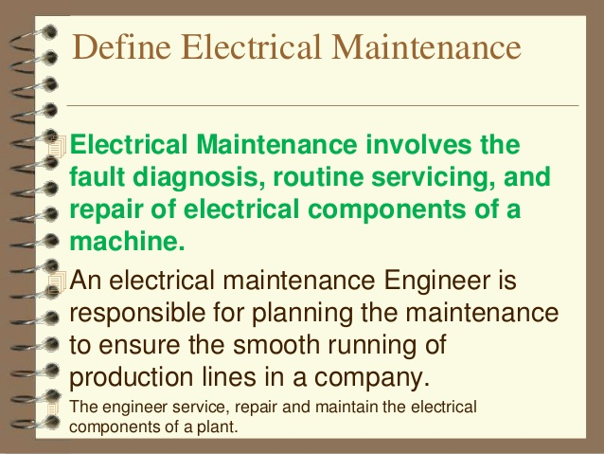

Slide 3
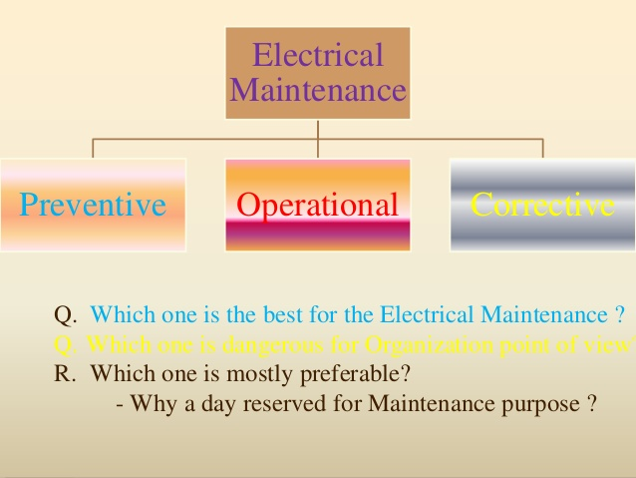

Slide 4
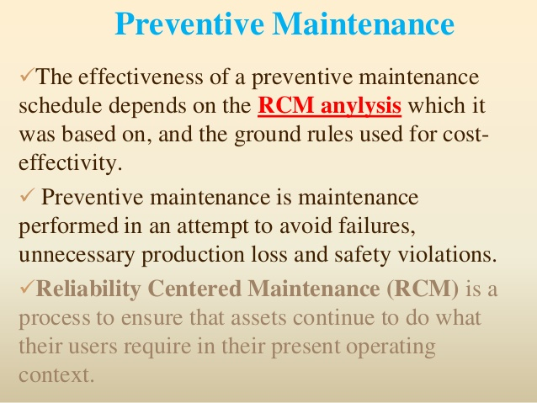

Slide 5
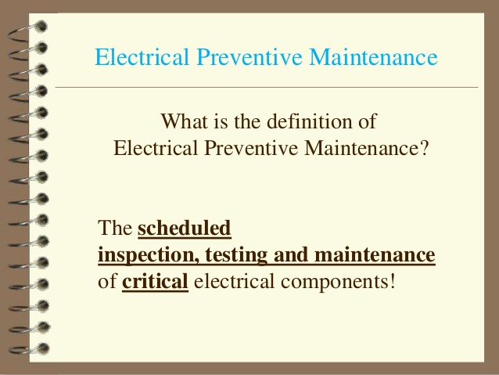

Slide 6
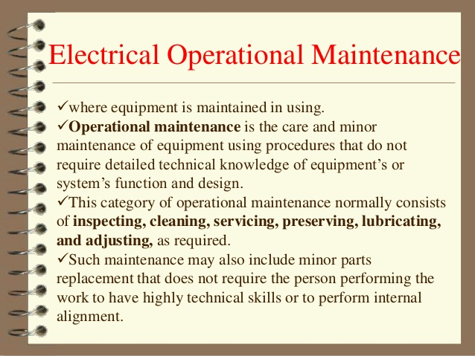

Slide 7
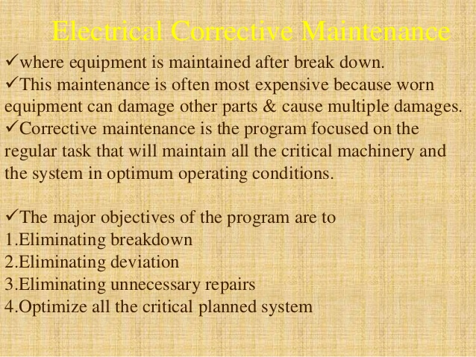

Slide 8
When designing the Maintenance Plan should be taken into account two important considerations affecting some equipment in particular. Firstly, some equipment are subjected to legal rules that regulate their maintenance, forcing them to perform certain activities with an established frequency.
Secondly, some of the maintenance activities can not be performed with the regular maintenance equipment (either their own or hired) because it requires knowledge and / or specific resources that are only up to the manufacturer, distributor or a specialist team.
These two aspects should be assessed when trying to determine the maintenance model that we should apply to an equipment.

Slide 9
Some equipment are subjected to rules or regulations by the Administration. Above all, there are equipment that are hazardous to people or the environment. The Administration requires the completion of a series of tasks, tests and inspections, and some of them must be performed by companies duly authorized to carry them out. These tasks must necessarily be incorporated into the Maintenance Plan of the equipment, whatever model you decide to apply.
Some of the equipment subjected to this type of maintenance are:
Equipment and devices under pressure
Installation of High and Medium Voltage
Cooling Towers
Certain lifts: service or people
Vehicles
Fire Prevention Facilities
Storage tanks of certain chemicals

Slide 10
Thankyou
Notes:
thankyou

