Slide 1
Multimedia Systems
Pooja
GPES, Manesar

Slide 2
WHAT IS MULTIMEDIA?
A Multimedia System is a system capable of processing multimedia data and applications.
A Multimedia System is characterized by the processing, storage, generation, manipulation and rendition of Multimedia information.

Slide 3
Definition :
  A computer platform, communications network or software tool that supports the interactive use of at least one of the following types of information - audio, still image, motion video, text and graphics.

Slide 4
History of Multimedia Systems :
  1945 – Bush wrote about Memex
  1967 – Negroponte formed the Architecture Machine Group at MIT
  1969 – Nelson & Van Dam hypertext editor at Brown
  Birth of The Internet
  1971 – Email
  1976 – Architecture Machine Group proposal to DARPA: Multiple Media
  1980 – Lippman & Mohl: Aspen Movie Map

Slide 5
  1983 – Backer: Electronic Book
  1985 – Negroponte, Wiesner: opened MIT Media Lab
  1989 – Tim Berners-Lee proposed the World Wide Web to CERN (European Council for Nuclear Research)
  1990 – K. Hooper Woosey, Apple Multimedia Lab, 100 people, educ.
  1991 – Apple Multimedia Lab: Visual Almanac, Classroom MM Kiosk
  1992 – the first M-bone audio multicast on the Net

Slide 6
History of Multimedia Systems :
  1993 – U. Illinois National Center for Supercomputing Applications: NCSA Mosaic
  1994 – Jim Clark and Marc Andreesen: Netscape
  1995 – JAVA for platform-independent application development. Duke is the first applet
  1996 – Microsoft, Internet Explorer

Slide 7
Characteristics of a Multimedia System
A Multimedia system has four basic characteristics:
Multimedia systems must be computer controlled.
Multimedia systems are integrated.
The information they handle must be represented digitally.
The interface to the final presentation of media is usually interactive.

Slide 8
Challenges for Multimedia Systems
Distributed Networks
Temporal relationship between data
– Render different data at same time — continuously.
– Sequencing within the media
playing frames in correct order/time frame in video.
Synchronization — inter-media scheduling E.g. Video and Audio conversation.

Slide 9
Key Issues for Multimedia Systems
The key issues multimedia systems need to deal with here are:
-How to represent and store temporal information.
-How to strictly maintain the temporal relationships on play

Slide 10
Key Issues for Multimedia Systems
back/retrieval
What process are involved in the above.
Data has to be represented digitally.
Conversion, Sampling etc.
Large Data Requirements — bandwidth, storage, Data compression is usually mandatory.

Slide 11
Desirable Features for a Multimedia System
Given the above challenges the following feature a desirable (if not a prerequisite) for a Multimedia System:
-Very High Processing Power — needed to deal with large data
-processing and real time delivery of media.

Slide 12
Desirable Features for a Multimedia System
Special Hardware/Software needed.
Data Representations — File Formats that support multimedia should be easy to handle yet allow for compression/decompression in real-time.
Efficient and High I/O —input and output to the file subsystem needs to be efficient and fast. Needs to allow for real-time recording as well as playback of data

Slide 13
Desirable Features for a Multimedia System
Special Operating System —to allow access to file system and process data efficiently and quickly.
Storage and Memory — large storage units.
Network Support — Client-server systems -Software Tools — user friendly tools needed to handle media, design and develop applications to deliver media.

Slide 14
Components of a Multimedia System
Now let us consider the Components (Hardware and Software) required for a multimedia system:
Capture devices — Video Camera, Video Recorder, Audio Microphone, Keyboards, mice, graphics tablets.
Storage Devices — Hard disks, CD-ROMs, DVD-ROM, etc..
Communication Networks — Local Networks, Intranets, Internet, Multimedia or other special high speed networks

Slide 15

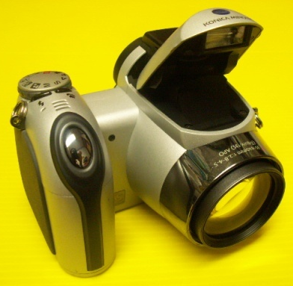
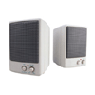

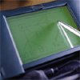
Components of a Multimedia System
Computer Systems — Multimedia Desktop machines, Workstations.
Display Devices, quality speakers, HDTV. monitors, Colour printers etc

Slide 16
A Brief Look at Multimedia Data:
Input and Format
Text and Static Data
Source: keyboard, speech input, optical character recognition,
data stored on disk.
Stored and input character by character:

Slide 17
A Brief Look at Multimedia Data:
Input and Format
Text and Static Data
Storage of text is 1 byte per char / more bytes for Unicode.
– For other forms of data (e.g. Spreadsheet files). May store format as text (with formatting) others may use binary encoding.
Format: Raw text or formatted text e.g HTML, Rich Text Format (RTF), Word or a program language source (C, Pascal, etc..

Slide 18
A Brief Look at Multimedia Data:
Input and Format
Graphics
Format: constructed by the composition of primitive objects such as lines, polygons, circles, curves and arcs.
Input: Graphics are usually generated by a graphics editor program (e.g. Illustrator).
Graphics are usually editable.

Slide 19
A Brief Look at Multimedia Data:
Input and Format
Graphics
Graphics input devices: keyboard (for text and cursor control), mouse, trackball or graphics tablet.
graphics standards : OpenGL, PHIGS, GKS
Graphics files usually store the primitive assembly
Do not take up a very high storage overhead.

Slide 20
A Brief Look at Multimedia Data:
Input and Format
Images
Still pictures which (uncompressed) are represented as a bitmap (a grid of pixels).
Input: digitally scanned photographs/pictures or direct from a digital camera.
Input: May also be generated by programs “similar” to graphics, or animation programs.

Slide 21
A Brief Look at Multimedia Data:
Input and Format
Images
Stored at 1 bit per pixel (Black and White), 8 Bits per pixel (Grey Scale, Colour Map) or 24 Bits per pixel (True Colour)
Size: a 512x512 Grey scale image takes up 1/4 MB, a 512x512
24 bit image takes 3/4 MB with no compression.

Slide 22
A Brief Look at Multimedia Data:
Input and Format
Images
This overhead soon increases with image size — modern
high digital camera 10+ Megapixels 29MB uncompressed!
Compression is commonly applied.

Slide 23
A Brief Look at Multimedia Data:
Input and Format
Audio
Audio signals are continuous analog signals.
Input: microphones and then digitised and stored
CD Quality Audio requires 16-bit sampling at 44.1 KHz
Even higher audiophile rates (e.g. 24-bit, 96 KHz)

Slide 24
A Brief Look at Multimedia Data:
Input and Format
Audio
1 Minute of Mono CD quality (uncompressed) audio requires 5 MB.
1 Minute of Stereo CD quality (uncompressed) audio requires 10 MB.
Usually compressed (E.g. MP3, AAC, Flac, Ogg Vorbis).

Slide 25
A Brief Look at Multimedia Data:
Input and Format
Video
Input: Analog Video is usually captured by a video camera and then digitized.
There are a variety of video (analog and digital) formats
Raw video can be regarded as being a series of single images.
There are typically 25, 30 or 50 frames per second.

Slide 26
A Brief Look at Multimedia Data:
Input and Format
Video
E.g. A 512 512 size monochrome video images take 6.25MB for a second to store uncompressed.
Typical PAL digital video (720 576 pixels per colour frame).
High Definition video on Blu-ray (up to 19201080 = 2 Megapixels per frame) Digital video clearly needs to be compressed for most times.

Slide 27
Multimedia Data Compression
How can we compress data?
Lossy v Lossless :
Lossless : Ideal (e.g. zip, unix compress) not good enough for MM data!
Lossy :Throw away nonessential (perceptually less relevant) parts of the data stream FILTER the data somehow. Examples: MP3, JPEG, MPEG Video

Slide 28
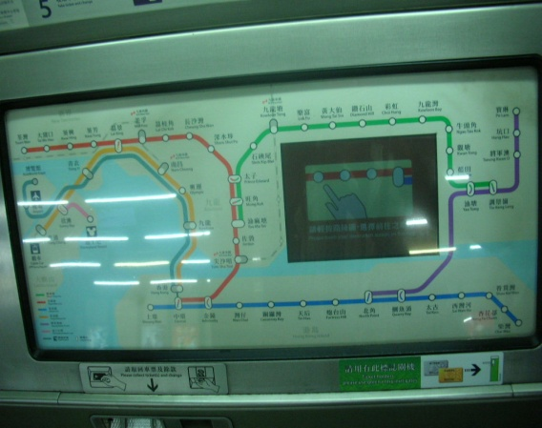
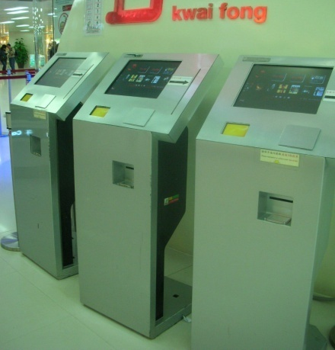
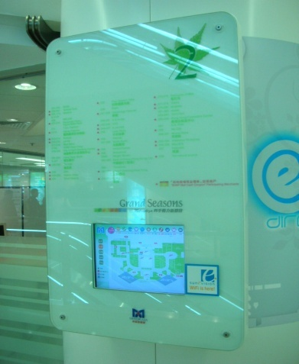
Multimedia uses and application examples:
  Video conferencing
  Multimedia kiosk in shopping mall
  LED display panel in bus stops
  Web-based learning systems

