Slide 1
MICROPROCESSOR

Slide 2
TOPICS COVERED
INTRODUCTION
HISTORY AND ITS EVOLUTION
FEATURES OF 8085 MP
8085 MP BLOCK ARCHITECTURE
8085 PIN DIAGRAM
INTERRUPT SIGNALS
DATA TRANSFER TECHNIQUES

Slide 3
INTRODUCTION
A microprocessor is the most important unit within a computer system and is responsible for processing the unique set of instructions and processes. A microprocessor is designed to execute logical and computational tasks with typical operations such as addition/subtraction, inter processing and device communication, input/output management, etc. A microprocessor is composed of integrated circuits that hold thousands of transistors; exactly how many depends on its relative computing power.

Slide 4
HISTORY AND ITS EVOLUTION
Before the development of the microprocessor, there were a variety of early technologies for simulating logic functions in computing devices. Many of these early inventions were spurred by wartime necessity during World War II. These early technologies were extremely expensive, slow, and prone to failure ;€“ and by today â€™s standards their capabilities were amazingly primitive. Computing technologies based on vacuum tubes and transistors helped make IBM a giant in the large-scale computing industry, but were not realistic for business or home use due to their prohibitive costs and intensive maintenance schedules. Early integrated circuits appeared in calculators, of all things, in the early 1960s; years before Intel began work on the first recognizable microprocessor.

Slide 5
Continued…
4 bit chips
it was Intel, founded in 1968, that provided much of the pioneering work associated with first-generation microprocessor technology. The power of a given microprocessor was, and still is, measured in bits. Put simply, this refers to the most basic unit of coded instructions, expressed in a string of binary 1s and 0s, which the computer interprets to carry out tasks. The more powerful the processor, the more instructions it can carry out at one time, leading to faster processing and more effectiveness at complex tasks. Though 4-bit chips were fairly simple, they gave weight to the prophetic prediction known as Moore’s Law, predicting that the capacity of integrated circuits would double every two years. for ex -intel 4004.

Slide 6
Continued..
8 bit chips Intel remained a forerunner in early microprocessor technology, releasing its first 8-bit microprocessor, the 8008, in 1972. Many of the same engineers involved with the original 4-bit models contributed ideas and design specifications to this new generation of chips, which had taken only about four years to develop.
32 bit chips
By the late 1970s, development of 32-bit microprocessors was in full swing and they began to appear on the mass market in the 1980s, courtesy of National Semiconductor and Hewlett-Packard. Then 64 bit chips RISC and CISC chips are found.

Slide 7
MICROPROCESSORS TODAY
Today’s microprocessors are immensely powerful, capable of executing complex instructions at a faster rate than ever before. As computers grow ever more sophisticated, engineering science begins to run up against puzzling challenges.

Slide 8
8085 MICROPROCESSOR

Slide 9
FEATURES OF
MICROPROCESSOR
It is a 8-bit processor.
8085 microprocessor +5v DC power supply.
It provides on chip clock generator, so there is no need of external clock generator, but it requires external tuned circuit like LC, RC or crystal.
The maximum clock frequency of 8085 microprocessor is 3MHz where as minimum clock frequency is 500 KHz.

Slide 10
Continued…..
8085 provides 74 instructions with the following addressing modes:
register
direct
immediate
indirect
implied.
The data bus is multiplexed with the address bus, hence it requires external hardware to separate data lines from address lines.

Slide 11
Continued….
8085 microprocessor provides 16 address lines, therefore it can access 2^16 = 64K bytes of memory
It generates 8 bit I/O address, hence it can access 2^8 = 256 input ports and 256 output ports
8085 microprocessor has five hardware interrupts: TRAP, RST 5.5, RST 6.5, RST 7.5, INTR
The hardware interrupt capability of 8085 microprocessor can be increased by providing external hardware
8085 microprocessor has capability to share its bus with external bus controller (direct memory access controller); for transferring large amount of data from memory to I/O and vice versa.

Slide 12
8085 MICROPROCESSOR ARCHITECTURE

Slide 13
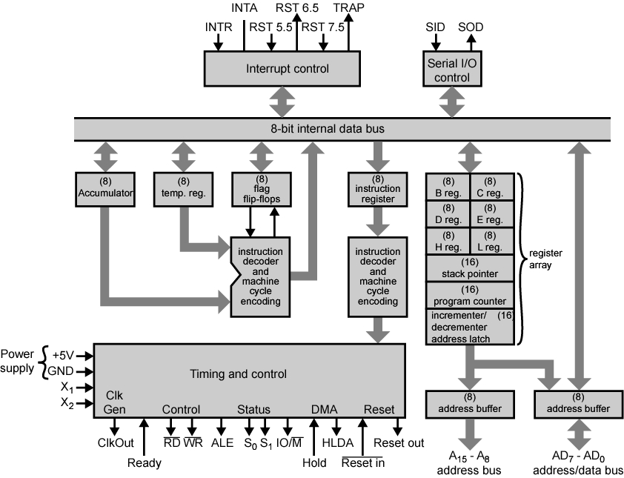
INTEL 8085 CPU BLOCK DIAGRAM

Slide 14
ACCUMULATOR :- It is an 8-bit register used to perform arithmetic, logical, I/O & LOAD/STORE operations. It is connected to internal data bus & ALU.
ALU( ARITHMETIC AND LOGIC UNIT):-As the name suggests, it performs arithmetic and logical operations like Addition, Subtraction, AND, OR, etc. on 8-bit data.
GENERAL PURPOSE REGISTER (GPR):- Apart from accumulator 8085 consists of six special types of registers called General Purpose Registers . These general purpose registers are used to hold data like any other register. These are B, C, D, E, H and L. Each register can hold 8-bit data.

Slide 15
  INTERRUPT CONTROL SECTION:- Consider that a microprocessor is executing the main program. Now whenever the interrupt signal is enabled or requested the microprocessor shifts the control from main program to process the incoming request and after the completion of request, the control goes back to the main program
  8085 microprocessor has following interrupts:-
(i) Trap (ii) RST 7.5 (iii) RST 6.5 (iv)5.5 (v) INTR
SERIAL I/O CONTROL SECTION:- The input and output of serial data can be carried out using 2 instructions in 8085:-
SID:- Serial input data
SOD:- Serial output data

Slide 16
INSTRUCTION REGISTER AND DECODER:- Instruction register is 8-bit register just like every other register of microprocessor. When such an instruction is fetched from memory, it is directed to Instruction register. So the instruction registers are specifically to store the instructions that are fetched from memory.
  Temporary register- holds information from the memory or register array. An input of the ALU.
  Increment/Decrement address latch – It adds or subtracts one from any of other registers in register array.

Slide 17
SPECIAL PURPOSE REGISTER:- These are used for special purpose. These are following types:-
PROGRAM COUNTER:- It is a 16 bit register which is used to store the address of the next instruction to be executed.
STACK POINTER :- Stack pointer is also a 16-bit register which is used as a memory pointer. A stack is nothing but the portion of RAM. Stack pointer maintains the address of the last byte that is entered into stack.

Slide 18
INCREMENT/DECREMENT REGISTER:- The 8-bit contents of a register or a memory location can be incremented or decremented by 1.
ADDRESS /DATA BUFFER AND ADDRESS BUFFER:- The contents of the stack pointer and program counter are loaded into the address buffer and address-data buffer. These buffers are then used to drive the external address bus and address-data bus. The address data buffer can both send and receive data from internal data bus.

Slide 19
INTERRUPT SIGNALS
An interrupt is a hardware-initiated subroutine CALL.
When interrupt pin is activated, an ISR will be called, interrupting the program that is currently executing.
Pin | Subroutine Location
TRAP | 0024
RST 5.5 | 002C
RST 6.5 | 0034
RST 7.5 | 003C
INTR | *
Note: * the address of the ISR is determined by the external hardware.

Slide 20
INTERRUPT SIGNALS
INTR input is enabled when EI instruction is executed.
The status of the RST 7.5, RST 6.5 and RST 5.5 pins are determined by both EI instruction and the condition of the mask bits in the interrupt mask register.

Slide 21
RESET SIGNAL
Following are the two kind of RESET signals:
  RESET IN: an active low input signal, Program Counter (PC) will be set to 0 and thus MPU will reset.
  RESET OUT: an output reset signal to indicate that the μp was reset (i.e. RESET IN=0). It also used to reset external devices.

Slide 22
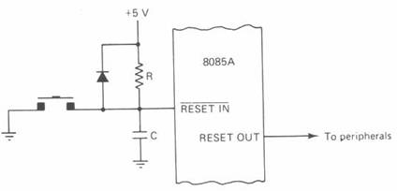
RESET SIGNAL

Slide 23
8085 PINOUT
8085 μp consists of 16 signal pins use as address bus.
Divide into 2 part: A15 – A8 (upper) and
AD7 – AD0 (lower).
  A15 – A8 : Unidirectional, known as ‘high order address’.
  AD7 – AD0 : bidirectional and dual purpose (address and data placed once at a time).
  AD7 – AD0 also known as ‘low order address’.
  To execute an instruction, at early stage AD7 – AD0 uses as address bus and alternately as data bus for the next cycle.
  The method to change from address bus to data bus known as ‘bus multiplexing’.

Slide 24
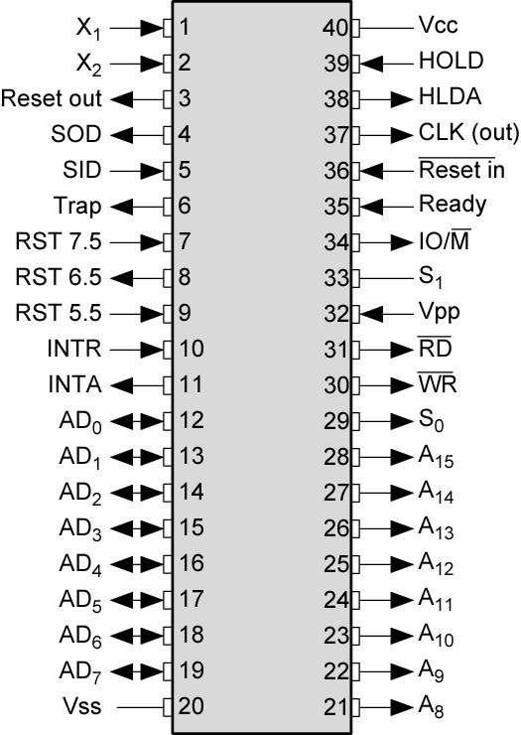
Intel 8085 Pin
Configuration

Slide 25
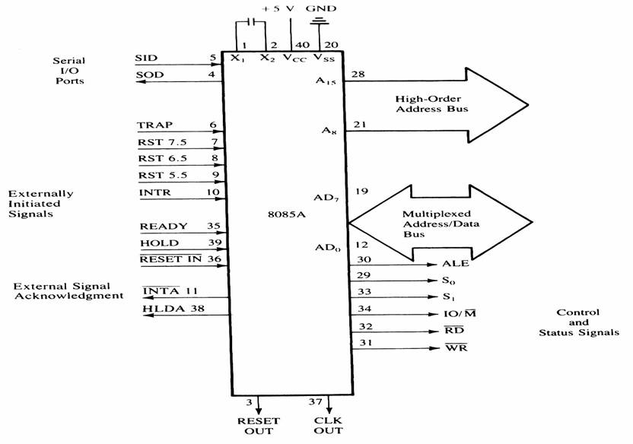
Signals and I/O Pins

Slide 26
CLOCK PINS
8085 MPU has 3 pins that control or present the clock signal.
  X1 and X2 pins determine the clock frequency.
  CLK OUT is a TTL square-wave output clock.
The CLOCK OUT is one-half the crystal frequency.
8085A
X1 CLK OUT
X2
6 MHz

Slide 27
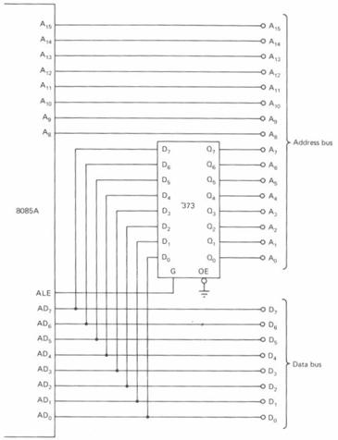
ALE USED TO DEMULTIPLEX ADDRESS/DATA BUS

Slide 28
CONTROL AND STATUS SIGNALS
Signals:
  RD – Read (active low). To indicate that the I/O or memory selected is to be read and data are available on the bus.
  WR – Write: Active low. This is to indicate that the data available on the bus are to be written to memory or I/O ports.
  IO/M – To differentiate I/O operation of memory operations.
    ‘0’ - indicates a memory operation.
    ‘1’-indicates an I/O operation.
  IO/M combined with RD and WR to generate I/O and memory control signals.
  S1 and S0: Status signals, similar to IO/M, can identify various operations as shown on the following table :

Slide 29
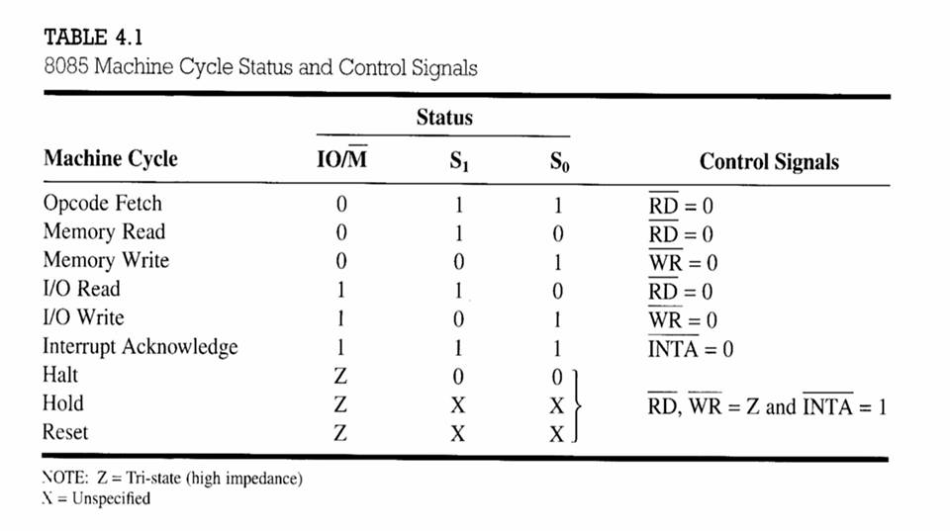
CONTROL AND STATUS SIGNALS.

Slide 30
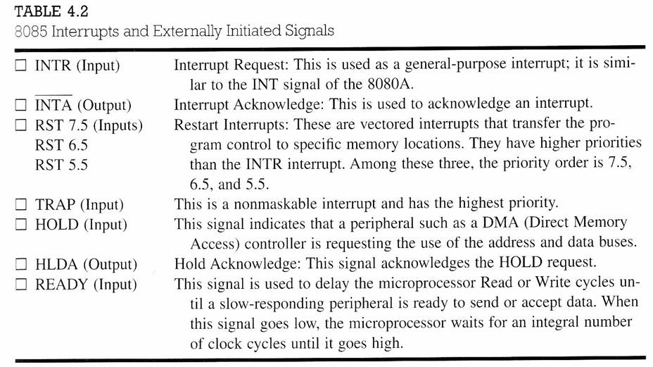
INTERRUPT SIGNALS
8085 μp has several interrupt signals as shown in the following table.

Slide 31
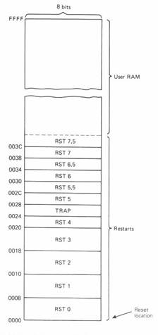
Interrupt Vectors

Slide 32
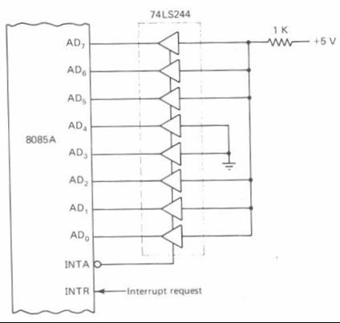
A circuit that causes an RST4 instruction (E7) to be executed in response to INTR.
When INTR is asserted, 8085 response with INTA pulse.
During INTA pulse, 8085 expect to see an instruction applied to its data bus.

Slide 33
DATA TRANSFER TECHNIQUES
In which manner data is transferred from I/O from to microprocessor or m/m. basically here are two techniques of data transfer as:-
Programmed Data Transfer
DMA ( Direct Memory Access)
If microprocessor is executing a sequence of instruction and then input output device send a request to communicate then it called interrupt so it also classified as a interrupt driven data transfer techniques

Slide 34
PROGRAMMED DATA TRANSFER
Programmed data transfer transfers the data under the control of CPU. CPU takes place in every phase of transfer. It is separated in into two classes.
Synchronous data transfer
Asynchronous data transfer
Synchronous data transfer
when sender and receiver is connected to a same clock and both communicates at a time both have same speed is called synchronous data transfer. Both have information about the data transfer and ready at time for task.

Slide 35
ASYCHRONOUS DATA TRANSFER
When sender and receiver have no same clock and receiver is unknown about the status of sender he has no information about the status of sender that is ready or not transfer . In this type transfer receiver has slow speed where sender is fast.
So when sender is ready to transfer a data it sends a signal to receiver that he is ready to transfer it is called a
” HANDSHAKING SIGNAL” and after getting this signal receiver start to receive the data.

Slide 36
Direct Memory Access (DMA)
There is no control of CPU.
DMA is an IO technique where external IO device requests the use of the MPU buses.
Allows external IO devices to gain high speed access to the memory.
  Example of IO devices that use DMA: disk memory system.
HOLD and HLDA are used for DMA.
If HOLD=1, 8085 will place it address, data and control pins at their high-impedance.
A DMA acknowledgement is signaled by HLDA=1.

Slide 37
THANK YOU

