Slide 1
MACHINE DESIGN & DRAWING (MDD)
NITIN DIXIT,
GUEST FACULTY, MDD
GOVERNMENT POLYTECHNIC,
MANESAR

Slide 2
Machine Design
The subject Machine Design is the creation of new and better machines and improving the existing ones.
A new or better machine is one which is more economical in the overall cost of production and operation.
In designing a machine component, it is necessary to have a good knowledge of many subjects such as Mathematics, Engineering Mechanics, Strength of Materials, Theory of Machines, Workshop Processes and Engineering Drawing.

Slide 3
Classifications of Machine Design
Adaptive design: In most cases, the designer’s work is concerned with adaptation of existing designs.
Development design: This type of design needs considerable scientific training and design ability in order to modify the existing designs into a new idea by adopting a new material or different method of manufacture.
New design: This type of design needs lot of research, technical ability and creative thinking. Only those designers who have personal qualities of a sufficiently high order can take up the work of a new design.

Slide 4
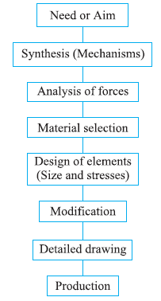
Design Procedure

Slide 5
Engineering Material Properties
Stiffness
Ductility
Brittleness
Hardness
Strength
Elasticity
Plasticity
Malleability
Toughness
Machinability

Slide 6
Load & Types
It is defined as any external force acting upon a machine part.
1. Dead or steady load: A load is said to be a dead or steady load, when it does not change in magnitude or direction.
2. Live or variable load: A load is said to be a live or variable load, when it changes continually.
3. Suddenly applied or shock loads: A load is said to be a suddenly applied or shock load, when it is suddenly applied or removed.
4. Impact load: A load is said to be an impact load, when it is applied with some initial velocity.

Slide 7
Stress
When some external system of forces or loads act on a body, the internal forces (equal and opposite) are set up at various sections of the body, which resist the external forces. This internal force per unit area at any section of the body is known as unit stress or simply a stress. It is denoted by a Greek letter sigma (σ). Mathematically,
Stress, σ = P/A
where P = Force or load acting on a body, and
A = Cross-sectional area of the body.

Slide 8
Strain
When a system of forces or loads act on a body, it undergoes some deformation. This deformation per unit length is known as unit strain or simply a strain. It is denoted by a Greek letter epsilon (ε). Mathematically,
Strain, ε = δl / l or δl = ε.l
where δl = Change in length of the body, and
l = Original length of the body.

Slide 9
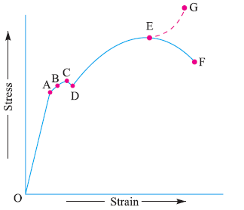
Stress-strain Diagram

Slide 10
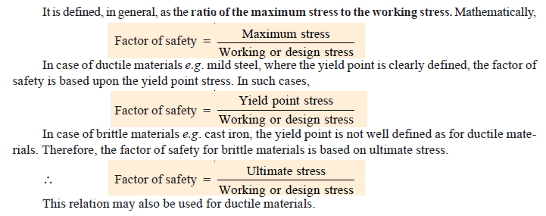
Factor of Safety

Slide 11
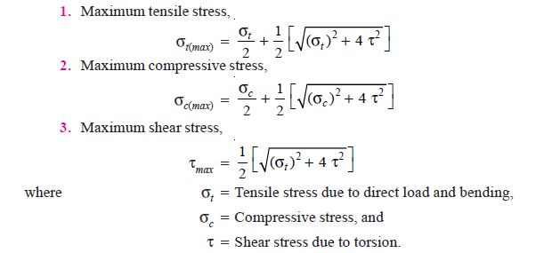
Principal Stresses

Slide 12
Theories of Failure Under Static Load
1. Maximum principal (or normal) stress theory (also known as Rankine’s theory).
2. Maximum shear stress theory (also known as Guest’s or Tresca’s theory).
3. Maximum principal (or normal) strain theory (also known as Saint Venant theory).
4. Maximum strain energy theory (also known as Haigh’s theory).
5. Maximum distortion energy theory (also known as Hencky and Von Mises theory).

Slide 13
Stress Concentration
Irregularity in the stress distribution caused by abrupt changes of form is called stress concentration
It occurs for all kinds of stresses in the presence of fillets, notches, holes, keyways, splines, surface roughness or scratches etc.

Slide 14
Shaft
A shaft is a rotating machine element which is used to transmit power from one place to another.
The power is delivered to the shaft by some tangential force and the resultant torque (or twisting moment) set up within the shaft.
A shaft is used for the transmission of torque and bending moment.

Slide 15
Material Used for Shafts
1. It should have high strength.
2. It should have good machinability.
3. It should have low notch sensitivity factor.
4. It should have good heat treatment properties.
5. It should have high wear resistant properties.

Slide 16
Shaft Materials
The material used for ordinary shafts is carbon steel of grades 40 C 8, 45 C 8, 50 C 4 and 50 C 12.
When a shaft of high strength is required, then an alloy steel such as nickel, nickel-chromium or chrome-vanadium steel is used.

Slide 17
Types of Shafts
1. Transmission shafts: These shafts transmit power between the source and the machines absorbing power. The counter shafts, line shafts, over head shafts and all factory shafts are transmission shafts. Since these shafts carry machine parts such as pulleys, gears etc., therefore they are subjected to bending in addition to twisting.
2. Machine shafts: These shafts form an integral part of the machine itself. The crank shaft is an example of machine shaft.

Slide 18
Design of Shafts
Shafts subjected to twisting moment or torque only,
Shafts subjected to bending moment only,
Shafts subjected to combined twisting and bending moments, and
Shafts subjected to axial loads in addition to combined torsional and bending loads.

Slide 19

Shafts Subjected to Twisting Moment Only
When the shaft is subjected to a twisting moment (or torque) only, then the diameter of the shaft may be obtained by using the torsion equation.
T = Twisting moment (or torque) acting upon the shaft,
J = Polar moment of inertia of the shaft about the axis of rotation,
τ = Torsional shear stress, and
r = Distance from neutral axis to the outer most fibre

Slide 20

Shafts Subjected to Bending Moment Only
When the shaft is subjected to a bending moment only, then the maximum stress (tensile or compressive) is given by the bending equation.
M = Bending moment,
I = Moment of inertia of cross-sectional area of the shaft about the axis of rotation,
σb = Bending stress, and
y = Distance from neutral axis to the outer-most fibre.

Slide 21
Shafts Subjected to Combined Twisting Moment and Bending Moment
Various theories have been suggested to account for the elastic failure of the materials when they are subjected to various types of combined stresses. The following two theories are important from the subject point of view :
1. Maximum shear stress theory or Guest's theory. It is used for ductile materials such as mild steel.
2. Maximum normal stress theory or Rankine’s theory. It is used for brittle materials such as cast iron.

Slide 22
Screwed Joints
A screw thread is formed by cutting a continuous helical groove on a cylindrical surface.
A screw made by cutting a single helical groove on the cylinder is known as single threaded (or single-start) screw and if a second thread is cut in the space between the grooves of the first, a double threaded (or double-start) screw is formed.

Slide 23
Advantages and Disadvantages of Screwed Joints
Advantages
1. Screwed joints are highly reliable in operation.
2. Screwed joints are convenient to assemble and disassemble.
3. A wide range of screwed joints may be adopted to various operating conditions.
4. Screws are relatively cheap to produce due to standardization and highly efficient manufacturing processes.
Disadvantages
The main disadvantage of the screwed joints is the stress concentration in the threaded portions which are vulnerable points under variable load conditions.

Slide 24
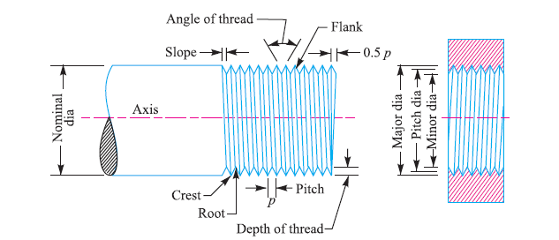
Important Terms Used in Screw Threads

Slide 25
Key
A key is a piece of mild steel inserted between the shaft and hub or boss of the pulley to connect these together in order to prevent relative motion between them.
It is always inserted parallel to the axis of the shaft.
Keys are used as temporary fastenings and are subjected to considerable crushing and shearing stresses.
A keyway is a slot or recess in a shaft and hub of the pulley to accommodate a key.

Slide 26
Types of Keys
Sunk keys
Saddle keys
Tangent keys
Round keys
Splines

Slide 27
Sunk Keys
The sunk keys are provided half in the keyway of the shaft and half in the keyway of the hub or boss of the pulley. The sunk keys are of the following types :
Rectangular sunk key
Square sunk key
Parallel sunk key
Gib-head key
Feather key
Woodruff key

Slide 28
Saddle keys
Keyway is only present in the hub only not in shaft.
It is of following two types:
Flat saddle key,
Hollow saddle key.

Slide 29
Effect of Keyways
The keyway cut into the shaft reduces the load carrying capacity of the shaft
This is due to the stress concentration near the corners of the keyway and reduction in the cross-sectional area of the shaft
The following relation for the weakening effect of the keyway is based on the experimental results by H.F. Moore.
It is usually assumed that the strength of the keyed shaft is 75% of the solid shaft.

Slide 30
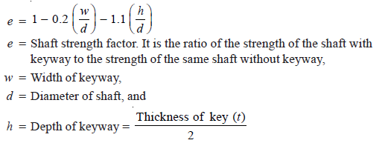
Effect of Keyways

Slide 31
Gears
A friction wheel with the teeth cut on it is known as gear or toothed wheel.
The usual connection to show the toothed wheels is by their pitch circles.

Slide 32
Advantages and Disadvantages of
Gear Drives
Advantages
1. It transmits exact velocity ratio.
2. It may be used to transmit large power.
3. It may be used for small centre distances of shafts.
4. It has high efficiency.
5. It has reliable service.
6. It has compact layout.
Disadvantages
1. Since the manufacture of gears require special tools and equipment, therefore it is costlier than other drives.

Slide 33
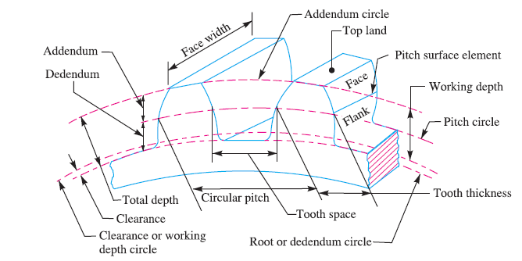
Terms used in Gears

Slide 34
Forms of Teeth
Cycloidal Teeth: A cycloid is the curve traced by a point on the circumference of a circle which rolls without slipping on a fixed straight line.
Involute Teeth: An involute of a circle is a plane curve generated by a point on a tangent, which rolls on the circle without slipping

Slide 35
Cams
Cams are used to convert rotary motion to oscillatory motion or oscillatory motion to rotary motion
For high speed applications – example, internal combustion engines

Slide 36
Followers
Knife-edge
Flat-face
Roller
Sperical-face

Slide 37
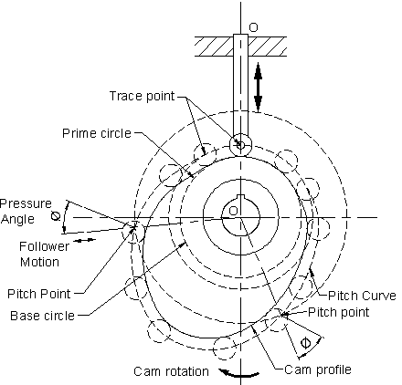
CAM Nomenclature

Slide 38
Displacement diagram types
Uniform motion ( constant velocity)
Simple harmonic motion
Uniform acceleration and retardation motion
Cycloidal motion

Slide 39
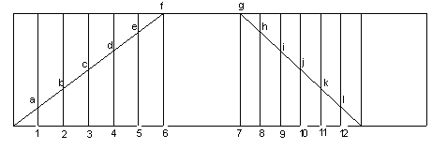
Uniform motion (constant velocity)

Slide 40
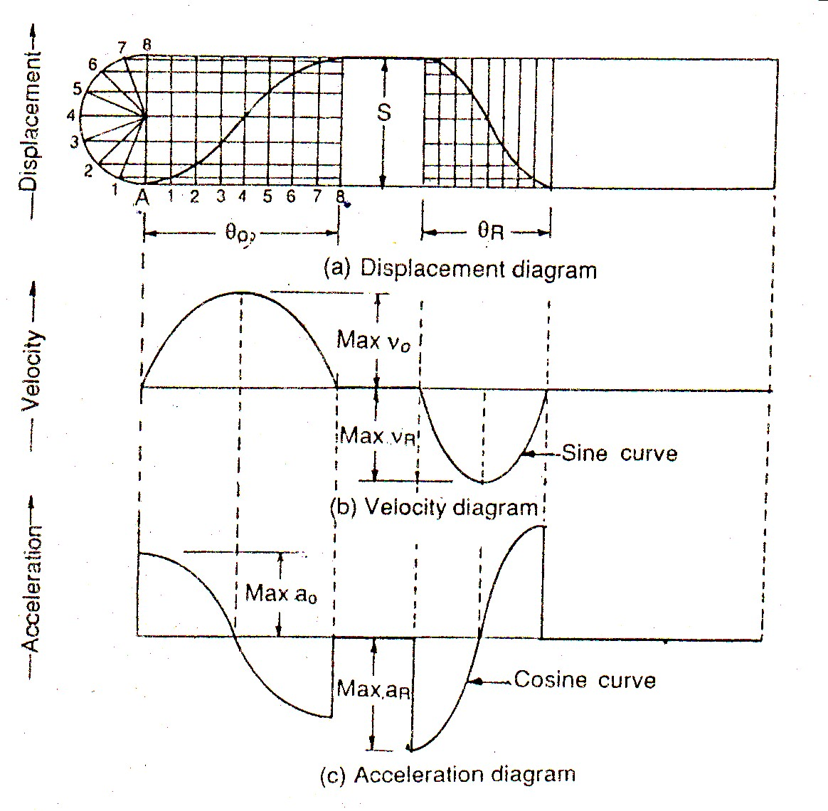
Simple Harmonic Motion

Slide 41
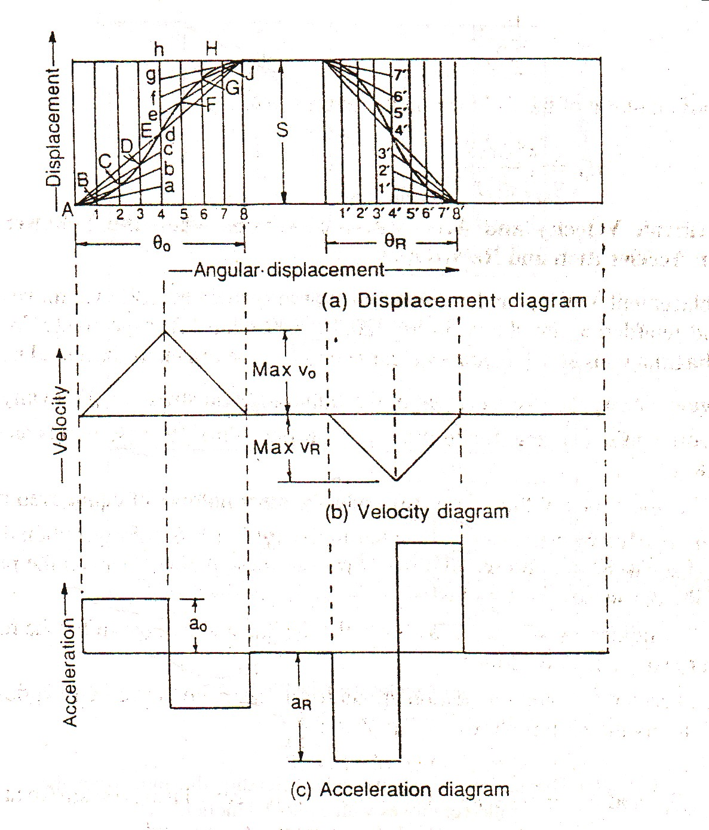
Uniform acceleration and retardation

Slide 42
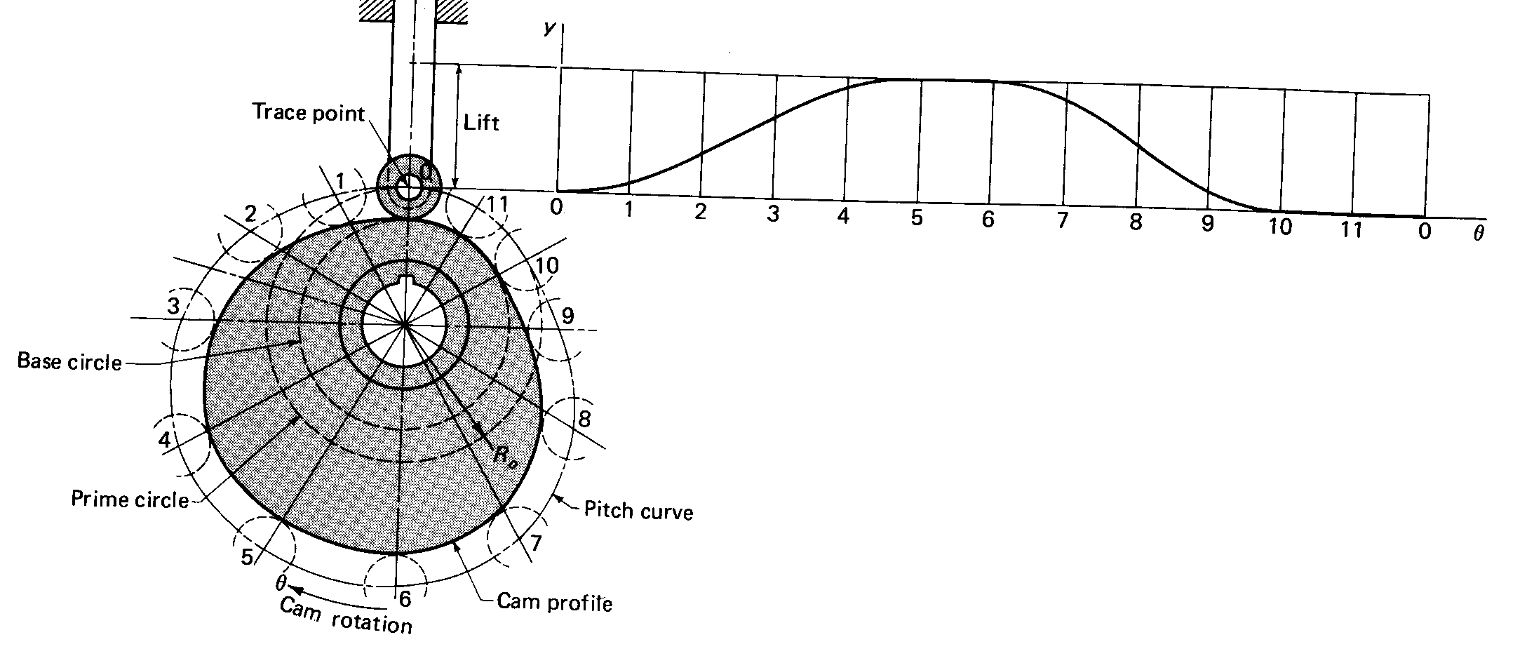
Layout of cam profile: roller follower

Slide 43
CAM Profile

Slide 44
THANK YOU

