Slide 1

ENVIRONMENTAL EDUCATION
FOR
SUSTAINABLE DEVELOPMENT
Pooja
GPES, Manesar

Slide 2
INTRODUCTION
About Ecology
Biodiversity
About Pollution
Role of Environment Education

Slide 3
Overview of Ecology
Ecology: Study of relationships between organisms and the environment.
  Simple definition does not convey the extreme breadth of this discipline.
Ecosystem: Includes all organisms living in an area, and the physical environment with which these organisms interact.

Slide 4
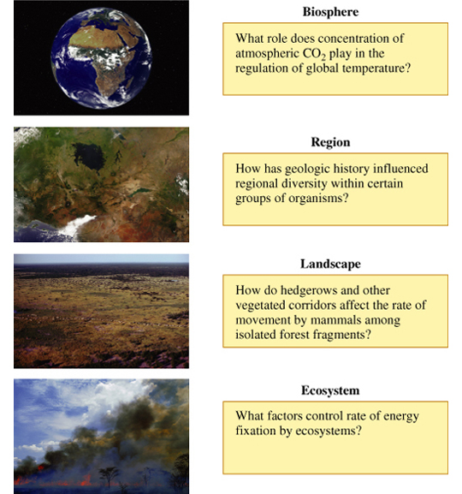

Slide 5
Biodiversity is the variety of life on Earth and the essential interdependence of all living things
(www.thecatalogueoflife.org)
Scientists have identified more than 1.4 million species. Tens of millions -- remain unknown
The tremendous variety of life on Earth is made possible by complex interactions among all living things including micro-oganisms.

Slide 6
There are 3 components of biodiversity
Diversity of genes-
Chihuahuas, beagles, and rottweilers are all the same species —but they're not the same because there is variety in their genes.
Diversity of number of species-
For example, monkeys, dragonflies, and meadow beauties are all different species.
Variety of ecosystems-
Lakes, Ponds, and Rivers are all Freshwater Ecosystems. Rocky coast, Sand Dune, Estuary, Salt Marsh , Coral Reef are all Marine Ecosystems.

Slide 7
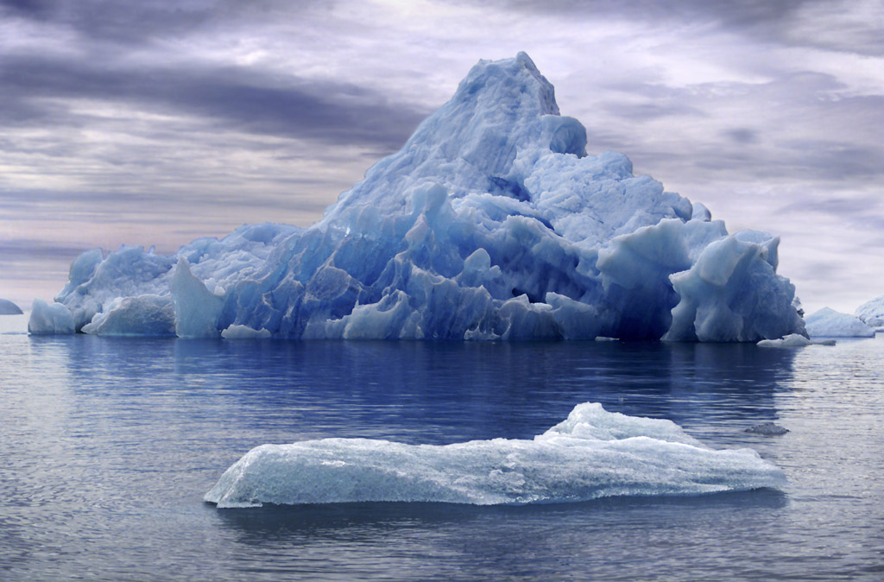
EFFECT OF GLOBAL WARMING
Melting of Ice in North and South Pole.
All the Water Drained to Sea.
Rise in Sea Level.
So, What is Effect?

Slide 8
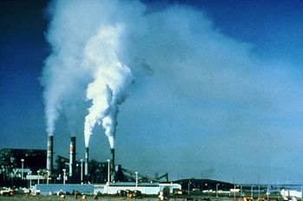
Air Pollution

Slide 9
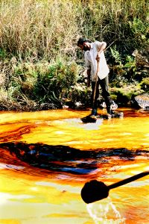
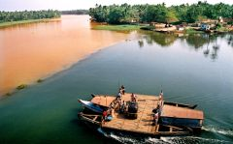
Water Pollution

Slide 10
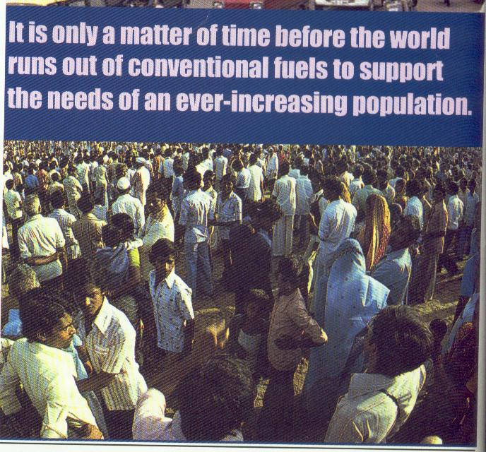

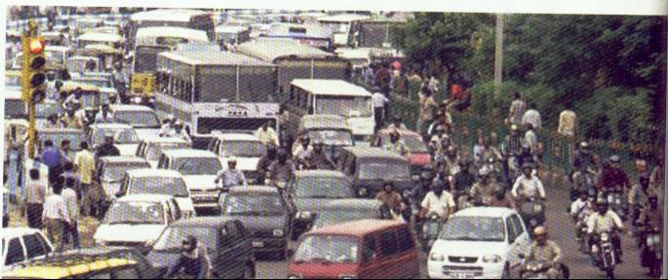
TODAY’S PROBLEMS

Slide 11
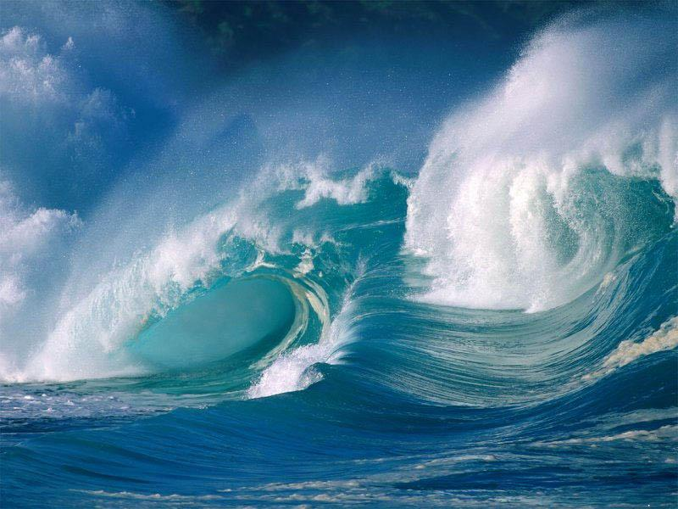
Natural Calamity - TSUNAMI
For Example Effects: 26 December 2004

Slide 12
TYPES OF POLLUTION
Every day, earth becomes more and more polluted.
Air pollution fills our lungs with deadly substances.
Water pollution is rapidly eradicating what little freshwater we have left.
Land pollution is causing once-fertile lands to become little more than deserts

Slide 13
Awareness about the following issues are needed.
Difference between sustainable development and environmental sustainability.
Unique definition for sustainable development
Will depending on Science and Technology alone deliver environmental sustainability?

Slide 14
Sustainable development and environmental sustainability
Definition for sustainable development :
“ Development that meets the needs of the
present without compromising the ability of future
generation to meet their own needs”
The resource base is not inexhaustible
sustainable development is economic development
Without environmental sustainability it is impossible to achieve sustainable development.

Slide 15
Unique definition for sustainable development:
An indicator is needed
for comparing the relative progress made by different countries towards sustainable development at a given time or
for measuring progress made by a given country or region over time.

Slide 16
operational definition must be based on the reduction in consumption of goods and services by the affluent within and between nations.
The production and consumption must be curbed to achieve even a modest degree of sustainable development and determined efforts must be made to reduce consumption through formal education

Slide 17
Science, technology and environmental sustainability
Role of science and technology in delivering environmental sustainability:
sustainable development and global environmental sustainability achieved not only with the application of science and technology alone. Example : USA
progress towards sustainable development is dependent upon a fundamental change in societies’ attitude to nature and the environment
to bring about this change of attitude is education in moral and ethical philosophy. In the young minds it is essential to reinforce the environment-respecting moral values.

Slide 18
Can science and technology deliver sustainable development
impacts of science and technology
turnout to be good or bad is determined by their environmental impacts.
economic development through industrialization
World Bank and International Monetary Fund

Slide 19
Benefits of Science
paying a high ‘price’ for it in terms of environmental degradation
this has serious implications for future generations.
science and technology can help the process of sustainable development in a limited way but they cannot deliver them.

Slide 20
NEED FOR ENVIRONMENTAL EDUCATION
All major natural resources in the country are in grave danger of irreparable damage.
A society cannot survive if its natural resources are rendered unfit for use by its people.
The only hope of salvaging this grave situation is by making the young aware that they need to proactively begin to protect the environment they will inherit.
Science and Technology can help in a limited way but cannot deliver it.

Slide 21
NEED FOR ENVIRONMENTAL EDUCATION (Contd.)
The moral and ethical education for changing people’s attitude
To protect children living in polluted regions, environmental education represents a relevant means of prevention
It is need for the hour to propose the environmental education with the essential elements of moral philosophy.
For conceptual change

Slide 22
Essential components Of
The environmental education
Alerting the public to the need to achieve global sustainale development and the likely consequences of failing to do so.
Focusing the educational curricula for global sustainable development by incorporating the know – how and skills and also the moral imperatives.

Slide 23
Curriculum development
Reasons for including moral education in Engineering Curricula:
As future planners, designers, builders and decision makers , students shoulder special responsibility in protecting the integrity of nature and the natural environment.
Human beings are rational creatures who have an innate need to rationalize all their actions and thoughts .Moral philosophy provjdes this rationale, and by doing so gives us our humanity.
Albert Einsteins statement “Science without philosophy is just mechanics”.

Slide 24
Criteria for curriculum development:
  The focus must be on reducing consumption with a view to achieving sustainability. The content should be holistic, covering all essential aspects.
  The content should comprises two strategic elements:
The ‘end- of- the pipe’ element
based on science and technology to deal
with pollution already produced.
The ‘ before-the-pipe’ element
concerned with pollution prevention and
reduction.

Slide 25
MAJOR AREAS TO BE COVERED
Curriculum units and materials have to be developed in five areas:
1. Air Quality
2. Ecosystems & Biodiversity
3. Energy Resources
4. Land Use
5. Water Quality

Slide 26
CURRICULUM
Air - acid rain, indoor air pollution, ozone, radon
Conservation - energy, environmental stewardship, natural resources, pollution prevention
Ecosystems - ecology, endangered species, global warming, habitats, watersheds
Human Health - drinking water, fish advisories, indoor air, lead, ozone depletion, pesticides, radon, smog
In Your Neighborhood - databases, local issues, maps
Waste & Recycling - garbage, household, hazardous & solid waste, landfills, superfund cleanups, trash
Water- drinking water, ecosystems, lakes, oceans, rivers, water pollution, watersheds

Slide 27
IMPORTANCE OF WATER RESOURCES
According to the latest census of India statistics, only 38 percent of the 192 million households in India enjoy the privilege of grossly under-priced piped water supply.
“Water is a resource which is much too free.
Under-pricing of this vital resource has ironically put it beyond the reach of the poor majority.
A resource conscious society should carefully calculate the cost — and price — of its natural resources.
Since we haven’t done so, there’s a lot of pilferage and waste.
Water should be a costed resource, only then will we use and save it as a precious resource.
Water management should receive top priority as environment education is introduced in schools and colleges

Slide 28
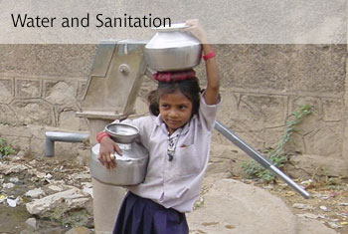
Though children and youth in rural India are physically closer to nature, they seldom have access to natural resources to satisfy their basic needs.
For instance though they may live beside a river, it’s rare for rural youth to have experienced piped water.
Instead river water is transported across hundreds of miles to cities. Continuous mismanagement and waste of water resources and years of large-scale deforestation has transformed India from a once water-rich society into a water-insecure nation.

Slide 29
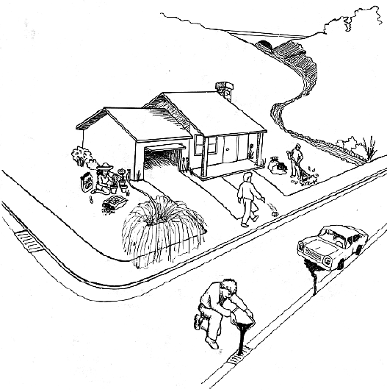
 | The people below are taking care of their home and car, but they are doing many things that can damage the environment, especially our water.

Slide 30
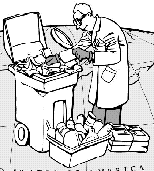
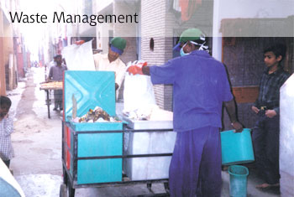
Management of waste

Slide 31
Today’s status of Environmental Education
While environment education is a compulsory subject in schools, Children are just mugging another subject — environment studies.
For example the prescribed curriculum won’t help a student in getting a mound of rubbish outside a house or school cleared.
Students are being taught mere facts and figures.
We have to make our children to realise that they are part of the problem, and therefore they have to be part of the solution

Slide 32
Effective Handling of EE
Mandating environment education as a boring study subject is the best way to kill it.
Instead it should be introduced as a voluntary, extra-curricular activity to arouse the interest and awareness of students in green issues.
Indeed environment education as a hands-on extra-curricular activity rather than an academic classroom subject is arousing growing enthusiasm across the country.
Enhancing research activities by providing incentives

Slide 33
Understanding environmental behavioural change through communication
Developing a ‘responsible environmental behaviour’ became one of the tasks of environmental education
The ‘responsible environmental behaviour’ is defined as “ the whole of actions of an individual within the society, that takes into account, in a conscious way, the perennial and harmonious relationship between these actions and environment”.
Communication is a way of approaching and explaining processes in society and it can be defined as “ the exchange processes among the individual and group members of a given society”.

Slide 34
Creating Environmental Awareness
Global Learning and Observations to Benefit the Environment (GLOBE)
(NASA), USA. Over 50,000 schools all over the world, of which 86 are in India, are enrolled in the GLOBE programme.
A School in Lucknow, they have set up a small weather monitoring station in their school. Children use the station to maintain temperature and cloud charts, measure rainfall, gather weather-related information and feed it into the GLOBE website. The data is then used to forecast worldwide weather trends and to develop environment protocols,”

Slide 35
Conclusion
Effective policy must be implemented to curb consumption by the affluent
We need moral education to instill genuinely environment respecting moral values in the young student society.
Conventional educational methodology is no longer adequate for the real needs of tomorrow
Though there are definitional and implementation flaws, environment NGOs and activists need to be given credit and accolades for creating a nation-wide awareness of the crisis of environment deterioration.

Slide 36
Future student generation must acquire knowledge and skills in technologies and keep pace with rapid advances in practically in all areas.
The communication perspective opens the door to another kind of tools that environmental educators can use in order to improve the educational practice.
Minds on experience is also needed with Hands on experience.

Slide 37
Education For Life
Education Through Life
Education Throughout Life
Mahatma Gandhi

Slide 38
THANK YOU

