Slide 1
MANAGEMENT SCOPE IN DIFFERENT AREAS
Submitted by- Mrs. Reena Rani

Slide 2
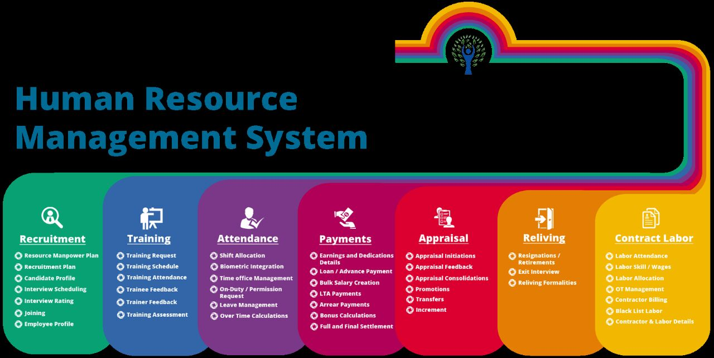

Slide 3
DEFINITION OF H.R.D
Human Resource Development may be defined as follows:
Human Resource Development is the process of increasing knowledge, capabilities and positive attitude of all people working at all levels in a business undertaking.

Slide 4
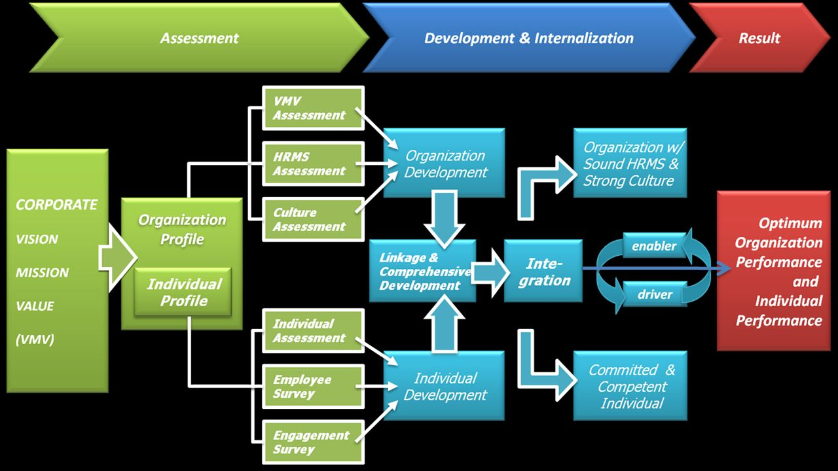
H.R.D.

Slide 5
OBJECTIVES OF HUMAN RESOURCE DEVELOPMENT
To develop the capabilities of each employee in the organization.
To develop team-spirit.
To retain demotivated employees.
To develop good relationship between employees and supervisors
To establish collaboration between different units.

Slide 6
FEATURES OF HUMAN RESOURCE DEVELOPMENT
H.R.D. is a planned process.
H.R.D. is a continuous process.
It makes efforts to develop competences at four levels:
At the individual level.
At interpersonal level.
At group level.
At organization level.

Slide 7
DEFINITION OF MANPOWER PLANNING
Manpower planning is the process of determining manpower requirements and the means of meeting those requirements in order to carry an integrated plan at the organization.

Slide 8
OBJECTIVES OF MANPOWER PLANNING
To forecast the future human resource rhuman resources are available as and when required equipments of an organization.
To determine the status of available human resources.
To determine the suitable recruitment process.
To ensure that necessary.

Slide 9
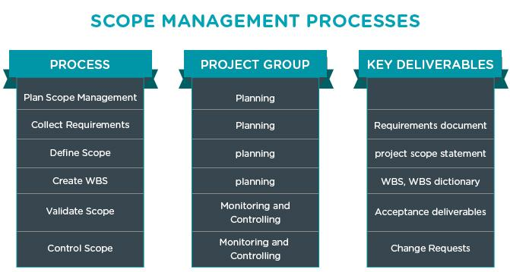
SCOPE MANAGEMENT PROCESS

Slide 10
STEPS IN MANPOWER PLANNING
Goals and plans of organisation.
Current human resource situation.
Human resource forecast.
Audit and adjustment.
Implementation of programs.

Slide 11
RECRUITMENT AND SELECTION
Recruitment is a process to discover the sources of manpower to meet the requirements of the staffing schedule and to employ effective measures for attracting the manpower in adequate number of facilitate effective selection of an efficient working force.

Slide 12

RECRUITMENT AND SELECTION

Slide 13
SOURCES OF RECRUITMENT
Internal Source
Present permanent employees
Casual employees
External Source
Education and training institute.
Private employment agencies.

Slide 14
PERFORMANCE APPRAISAL
The objective of performance appraisal is to determine the present state of efficiency of a worker in order to establish the actual need for training.

Slide 15
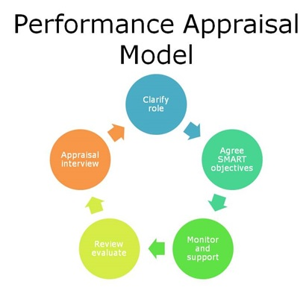

Slide 16

PERFORMANCE APPRAISAL METHODS
Ranking method
Forced distribution method
Unstructured appraisal method
Checklist appraisal method
Critical incident method

Slide 17
MATERIAL MANAGEMENT
Material management is the branch of logistics that deals with the tangible components of a supply chain.

Slide 18
DEFINITION OF MATERIAL MANAGEMENT
Material management is concerned with control of materials in such a manner which ensures maximum return on the working capital of the enterprise.

Slide 19
OBJECTIVE OF MATERIAL MANAGEMENT
Effective and efficient handling of materials.
Make decisions about purchase of materials.
Keeping less inventory in relation to the sales.
To give assistance to the production department.

Slide 20
FUNCTION OF MATERIAL MANAGEMENT
Material planning
Material purchasing
Stores management
Inventory control

Slide 21
METHODS OF INVENTORY MANAGEMENT
Several methods have been developed in the recent past for determining the optimum level of inventory in the enterprise. The following are the important methods of the inventory management:
Selective inventory control
Economic ordering quantity

Slide 22
A.B.C. ANALYSIS
ABC is a form of control over stores. Its full name is “Always Better Control”. The ABC analysis is based on the logic that in any large number, we usually have significant few and significant many.

Slide 23
EOQ MODEL
The firm knows with certainty how much items of particular inventories will be used within a specified period of time.
The use of inventories remains constant or unchanged throughout the period.
The moment inventories reach to the zero level, the order is placed to replenish inventory and stocks are received

Slide 24
MARKETING
Market is a place where the seller and buyers assemble to exchange their products for money and vice-versa. It is also the place where the actual exchange of goods and services takes place.

Slide 25
MARKETING MANAGEMENT
The process of ascertaining consumer needs and wants and converting them into products and services and then moving these products and services to the final consumers to satisfy their needs and wants.

Slide 26
IMPORTANCE OF MARKETING
Marketing helps in raising the living standard of the people
It is a good link between production and consumption
Continuous marketing is must for continuous production
It helps in finding out right type of production for an industry

Slide 27
FUNCTION OF MARKETING
Buying raw materials
Selling
Marketing research
Pricing
Transportation

Slide 28
FINANCIAL MANAGEMENT
Financial management is a branch of general management which looks after the financial functions of a business. Finance is not only needed to start a business but also needed for running it successfully.

Slide 29
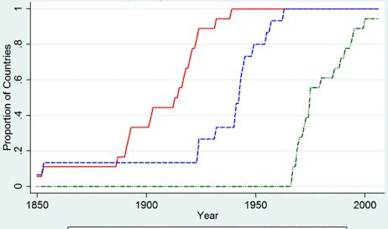
Financial graph

Slide 30
NEED FOR FINANACIAL PLANNING
We know that production is the outcome of these factors i.e. land, labor, capital and organisation. Finance is one of the important prerequisites to start an enterprise. In fact, it is the availability of finance that facilitates an entrepreneur to bring together land, labour, machinery and raw materials to produce goods.

Slide 31
IMPORTANCE OF FINANCIAL MANAGEMENT
Helpful in acquiring sufficient funds
Proper cash management
Ploughing back the profits
Important for share holders

Slide 32
FUNCTION OF FINANCIAL MANAGEMENT
Determining financial needs
Arranging funds
Investment of funds
Financial Analysis
Maintaining liquidity

Slide 33
TAXATION
Taxation is the collection of a share of individual and organizational income and wealth by a govt. under the authority of law

Slide 34


Slide 35
INCOME TAX
Income tax is a very important direct tax. It is an important and most significant source of revenue of the govt. The govt. needs money to maintain law ad order in the country, safeguard the security of the country from foreign powers and promote the welfare of the people.

Slide 36
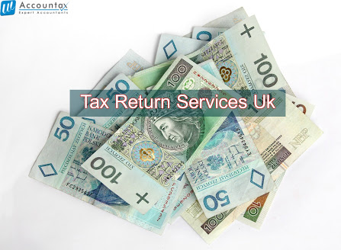
Income Tax

Slide 37
SALES TAX
It is a tax imposed on sales of goods or services. Sales tax may be levied on commodities in more than one state in the process of distribution.

Slide 38

Tax Imposed on Sales

Slide 39
EXCISE DUTY
Acc. To the Supreme Court “Excise duty is the tax levied necessarily on those dutiable goods which are produced or manufactured in India and it has no relationship with the sale of these goods.”

Slide 40
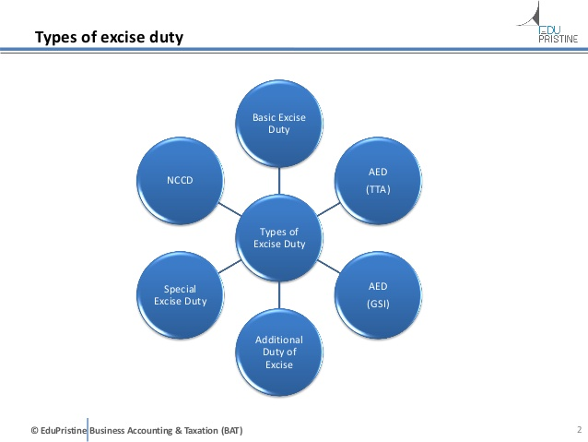
TYPES OF EXCISE DUTY

Slide 41
CUSTOM DUTY
Custom duty is a duty or tax which is levied by govt. on the import of goods into India and export of goods from India.

Slide 42
VALUE ADDED TAX(VAT)
Value added tax (VAT) is a form of sales tax. It is a multipoint tax with provision of granting set off or credit of the tax paid on purchases against the tax payable on sales.

Slide 43
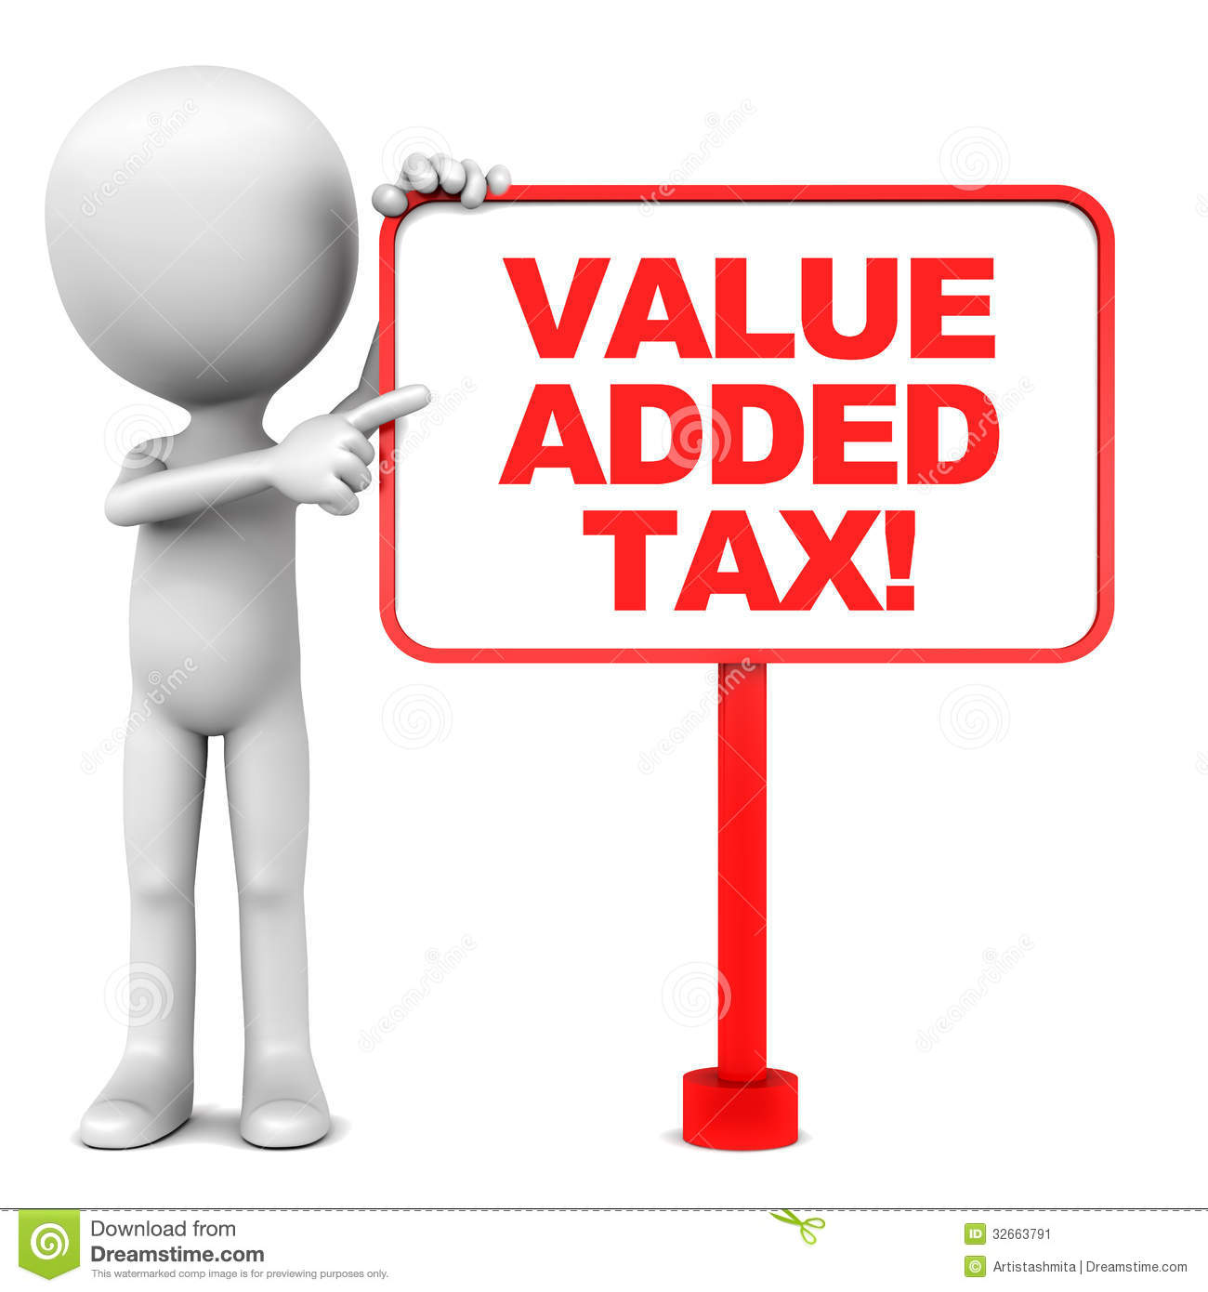

Slide 44
THANK YOU AND HAVE A NICE DAY

