Slide 1
Data base management system dbms
Pooja
Programmer, cse department

Slide 2
Introduction to database
A well organized collection of structured and inter related data is known as database.
It gives a facility to store data at a centralised location and access it logically from all position required.

Slide 3
Components of database
Data
Data item or field
Record
File
Information
Data processing

Slide 4
Data and data item or filed
Data: It is defined as representation of facts in formalized manner suitable for communication, interpretation or processing by human or electronic machine. Data is represented with the help of character like alphabets, digits or special characters.
Data item or Field: A set of characters which are used together to represent a specific data elements called field.

Slide 5
Record, file and information
Fields
File
Student
Roll no. | Name | Marks
1 | a | 10
2 | b | 11
3 | c | 12
Record: record is a collection of related data items
File: file is a collection of related records.
Information: the data that has been converted into a more useful or intelligible form is termed as information.
Record
Data
Information
Raw
information
Data processing

Slide 6
Database and its fundamental concepts
A database is a collection of related objects including tables, forms, reports, queries and scripts created, organised and managed by a database management system.
We can classify them into four kinds as given below:-
Knowledge database
Decision making database
Graphics oriented database
Bibliographic database

Slide 7
Purpose of database
The main purpose of database system is to overcome the problems of conventional file oriented systems, used for data processing, like
Access anomalies
Data redundancy
Data inconsistency
Data dependency
Wastage of resources
Data isolation and integrity problems
Security problems etc.

Slide 8
Database system
As database is a well organised collection of data to be able to carry out operations like insertion, deletion and retrieval, the database needs to be managed by a substantial package of software. This software is usually called a database management system
A database system is like a engine which helps to insert the data and retrieve the data from the database is called database system
E.G.- MySQL server developed by Oracle Corp.

Slide 9
Database language
Each Dbms has a ddl as well as dml. The two languages may be parts of a unified database language . The languages come in at least the following terms
Extended host languages
Query languages

Slide 10
To summarize a database system consists of
The database (data )
A DBMS (Software )
A DDl and a DMl (part of dbms)
application programs
DATABASE
SYSTEM
Application programs/queries
DBMS
SOFTWARE
Software to process
Queries/programs
Software to access stored data
Stored database definition
(meta-data)
Stored database

Slide 11
Characteristics of database
Centralized system
Reduction of redundancy
Data independency
Data consistency
Easy access
Logical relationship

Slide 12
Advantages and disadvantages of database system
Advantages
Redundancy control
Sharing of data
Data consistency
Improved data standards
Protection from unauthorised access
Backup and recovery
Better data accessibility
Disadvantages
High cost of DBMS
High hardware costs
High programming costs
High conversion costs
Slower processing in some applications
Increased vulnerability
Difficult recovery

Slide 13
Conventional file system
Application 1
Application 2
Application 3
In conventional approach, information is stored in flat files where each file is a sequence of records. The files are maintained by the file system under the operating system’s control. Application programs go through the file system in order to access these flat files.
Conventional file system
File 1
File 2
File 3

Slide 14
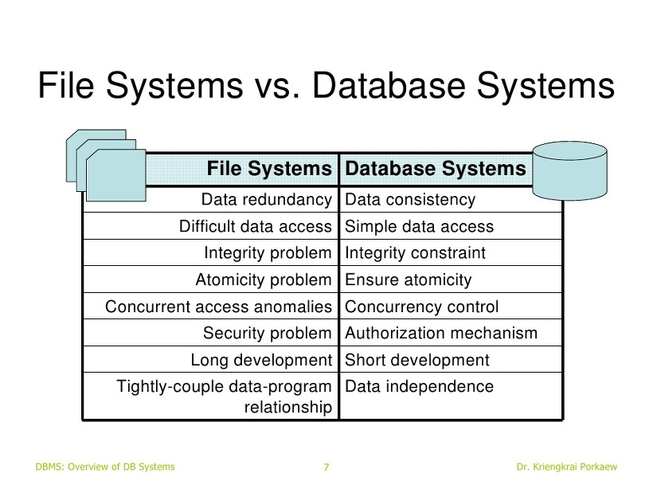

Slide 15
Classification of dbms users
DBMS users
We may classify the DBMS users in three broad categories as follow:
Actors on scene
Controllers
DBMS workers behind the scene
Actors on scene
Workers behind the scene
Controllers
Application
programmer
Sophisticated
user
Specialized
user
Naïve
user
System
analyst
Database designer
Database administrator
System designer
System implementers
Tool developers
Operators
Maintenance personnel

Slide 16
Actors on the scene
The main aim of database is to provide an environment for storing and accessing data in a more secured and efficient way. Once it is created, it can be used by the user in various ways. Depending on its use, the actors on scene or actual users are classified in following four categories:
Application programmers
Sophisticated users
Specialized users
Naïve users

Slide 17
controllers
The second group of people who actually are the DBMS controllers include database administrator, database designers and system analysts. The database designer creates the back bone of the database and then it is created and maintained by the database administrator. But before doing all this the overall ground work for its designing and creation is done by the system analyst. Thus the initial job for a DBMS starts from the system analyst. DBMS controllers that are classified as:
System analyst
Database designer
Database administrator

Slide 18
Workers behind the scene
The third category of people involved with a DBMS are those who are the actual workers behind the scene i.e. those who actually perform the job of implementation of the DBMS. Without their job the DBMS management, creation and even use is not possible. This group people include
DBMS system designers
DBMS system implementers
Tool developers
Operators
Maintenance personnel

Slide 19
thankyou

