Slide 1
CATHODE RAY TUBE

Slide 2
What is cathode ray tube?
The cathode ray tube (CRT) is a vacuum tube containing an electron gun (a source of electrons) and a fluorescent screen, with internal or external means to accelerate and deflect the electron beam, used to create images in the form of light emitted from the fluorescent screen. The image may represent electrical waveforms (oscilloscope), pictures (television, computer monitor), radar targets and others.

Slide 3
Basic Cathode Ray Tube
The CRT uses an evacuated glass envelope which is large, deep, heavy, and relatively fragile.

Slide 4
Overview
A cathode ray tube is a vacuum tube which consists of one or more electron guns, possibly internal electrostatic deflection plates, and a phosphor target. In television sets and computer monitors, the entire front area of the tube is scanned repetitively and systematically in a fixed pattern called a raster. An image is produced by controlling the intensity of each of the three electron beams, one for each additive primary color (red, green, and blue) with a video signal as a reference. In all modern CRT monitors and televisions, the beams are bent by magnetic deflection, a varying magnetic field generated by coils and driven by electronic circuits around the neck of the tube, although electrostatic deflection is commonly used in oscilloscopes, a type of diagnostic instrument.

Slide 5
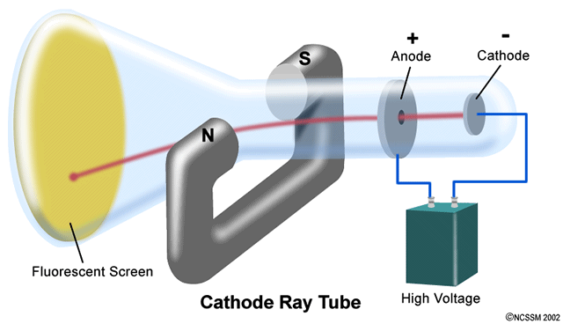
How CRTs work & display?
A CRT monitor contains millions of tiny red, green, and blue phosphor dots that glow when struck by an electron beam that travels across the screen to create a visible image. In a CRT monitor tube, the cathode is a heated filament. The heated filament is in a vacuum created inside a glass tube. The electrons are negative and the screen gives a positive charge so the screen glows.

Slide 6
Phosphor persistence
Various phosphors are available depending upon the needs of the measurement or display application. The brightness, color, and persistence of the illumination depends upon the type of phosphor used on the CRT screen. Phosphors are available with persistence's ranging from less than one microsecond to several seconds. For visual observation of brief transient events, a long persistence phosphor may be desirable. For events which are fast and repetitive, or high frequency, a short-persistence phosphor is generally preferable.

Slide 7
Micro channel plate
When displaying fast one-shot events the electron beam must deflect very quickly, with few electrons impinging on the screen; leading to a faint or invisible display. Oscilloscope CRTs designed for very fast signals can give a brighter display by passing the electron beam through a micro-channel plate just before it reaches the screen. Through the phenomenon of secondary emission this plate multiplies the number of electrons reaching the phosphor screen, giving a significant improvement in writing rate (brightness), and improved sensitivity and spot size as well.

Slide 8
Color CRTs
Color tubes use three different phosphors which emit red, green, and blue light respectively. Color CRTs have three electron guns, one for each primary color, arranged either in a straight line or in a triangular configuration (the guns are usually constructed as a single unit). A grille or mask absorbs the electrons that would otherwise hit the wrong phosphor. A shadow mask tube uses a metal plate with tiny holes, placed so that the electron beam only illuminates the correct phosphors on the face of the tube.
The three beams in color CRTs would not strike the screen at the same point without convergence calibration. Instead, the set would need to be manually adjusted to converge the three color beams together to maintain color accuracy.

Slide 9
Advantages of CRT
The cathode rayed tube can easily increase the monitor’s brightness by reflecting the light.
They produce more colours
The Cathode Ray Tube monitors have lower price rate than the LCD display or Plasma display.
The quality of the image displayed on a Cathode Ray Tube is superior to the LCD and Plasma monitors.
The contrast features of the cathode ray tube monitor are considered highly excellent.

Slide 10
Disadvantages of CRT
They have a big back and take up space on desk.
The electromagnetic fields emitted by CRT monitors constitute a health hazard to the functioning of living cells.
CRTs emit a small amount of X-ray band radiation which can result in a health hazard.
Constant refreshing of CRT monitors can result in headache.
CRTs operate at very high voltage which can overheat system or result in an implosion
Within a CRT a strong vacuum exists in it and can also result in a implosion
They are heavy to pick up and carry around

Slide 11
CONCLUS1ON
CRTs can be useful for displaying photos with high pixels per unit area and correct color balance. LCDs, as currently the most common flat screen technology, have generally inferior color rendition (despite having greater overall brightness) due to the fluorescent lights commonly used as a backlight.
CRTs are still popular in the printing and broadcasting industries as well as in the professional video, photography, and graphics fields due to their greater color fidelity, contrast and better viewing from off-axis (wider viewing angle). CRTs also still find adherents in video gaming because of their higher resolution per initial cost, fast response time, and multiple native resolutions.

